Slide 1
- The Wombat Project -
Recent Developments in Threats Analysis
www.wombat-project.eu
Olivier Thonnard
EURECOM // RMA
olivier.thonnard@rma.ac.be
Andy Moser
Technical University Vienna
andy@seclab.tuwien.ac.at

Slide 2



Who we are
Olivier Thonnard
  Research engineer
  Partnership with Symantec Research Labs (Europe)
  PhD obtained in March 2010 at EURECOM, Sophia Antipolis (France)
  Research on methods for attack attribution in cyberspace
    Data mining, Clustering, Multi-criteria Decision Analysis (MCDA)
Andy Moser
  Postdoc Security researcher @ iSeclab
  iSeclab member since 2005, PhD obtained in 2010
  Research on malware analysis, vulnerability detection, cyber-crime

Slide 3
Overview
The WOMBAT Project
Attack Attribution
  The TRIAGE method
  One example: attribution of Rogue AV Campaigns
FIRE
  Finding Rogue nEtworks
  Maliciousnetworks.org
Conclusions
Notes:
3

Slide 4
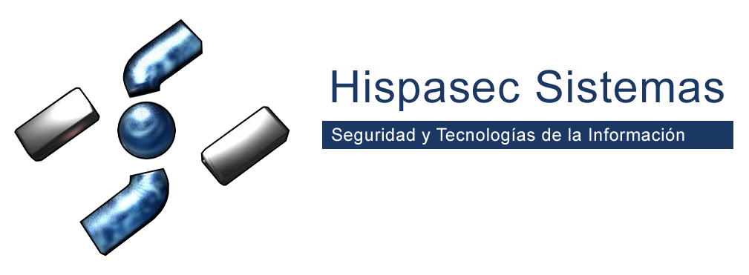










A Worldwide Observatory of Malicious Behaviors and Attack Threats
  Go to www.wombat-project.eu for the list of publications and deliverables
Notes:
Before entering into the topic, we need some context. WOMBAT is a project funded by the European Commission within the 7th Framework Program. It groups together research institutions and industrial partners in a joint effort to generate intelligence on the evolution of malicious activity

Slide 5
The WOMBAT approach

Slide 6
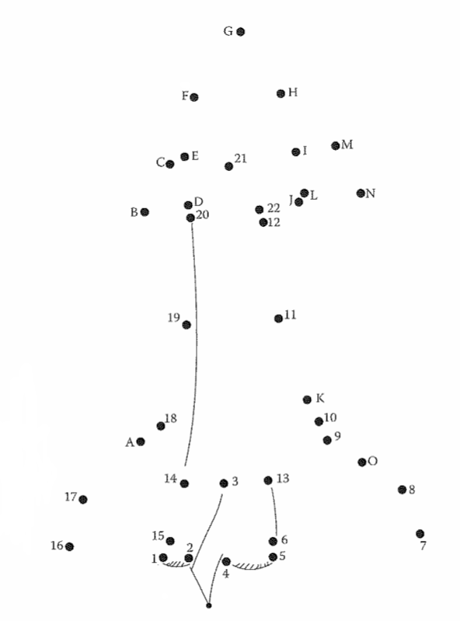
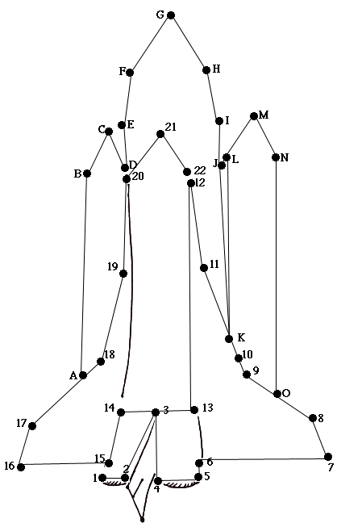
What is WOMBAT about, in practice?
6
Find the dots, and connect them
Notes:
Before going into the details of the WOMBAT attribution method we have used to analyze a data set related to Rogue SS, let’s sketch the general idea behind our method.
Everybody in his/her childhood has probably played to this kind of game, which consists in “connecting the dots” in order to (hopefully) expose the “big picture”.
What we try to do with our attribution method is no different: the dots can be seen here as the observable characteristics (=evidences) that we collect about threats or attacks in the Internet, and consequently, by connecting those dots in a meaningful way, we hope to obtain a better idea of the underlying phenomena that has caused the things we have observed.
However, in the real-world, it is obviously a bit more difficult since, most of the time, how to connect the dots does not appear so clearly… (i.e., you don’t a priori have the numbering information that appear on the picture on the left).
So, similarly to experts in criminal investigations (eg, CSI), our attribution method aims at revealing these unobvious relationships, so that the root cause of the phenomena (or the author responsible for it) can be identified more easily.
6

Slide 7
Generating the dots: need of data
Development / integration of new sensors
  SGNET (distributed honeypot deployment)
  HARMUR (dynamics of client-side threats)
  Anubis (malware sandbox)
  HoneySpider (hybrid high/low client honeypot)
  Wepawet (analysis of web-borne threats)
  …
Generation and sharing of metadata: the WAPI
  SOAP-based API to explore security datasets
  Common language to interact with a variety of security datasets
  Currently deployed on all WOMBAT datasets:
    VirusTotal, Anubis, Wepawet, SGNET, HARMUR, Shelia, …
Notes:
If we go back to our initial “WOMBAT circle”, generating the dots ultimately is associated to the collection of data, through the development of new sensors (SGNET and HARMUR are the twos maintained/developed by Symantec in the context of WOMBAT) and the generation of metadata, and the sharing of metadata through the research community. For the latter purpose, the WOMBAT project has developed a “WOMBAT API” or WAPI.
WAPI provides a set of SOAP primitives that allow clients to make “questions” to different security datasets using a uniform language. It is currently implemented in all the WAPI datasets and allows a security analyst to easily aggregate information from the different datasets in a scriptable way (we offer a python interface)

Slide 8





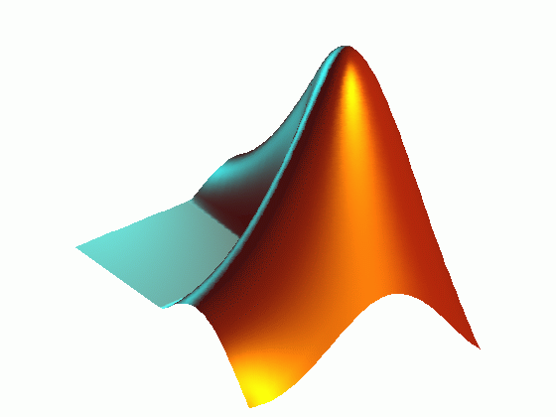

Example of a WOMBAT sensor: the SGNET data enrichment framework
Code Injection information
Malware
AV identification
statistics
Internet
Symantec ++
SGNET
dataset
Generated
alerts
Clustering
techniques
Behavioral Information
Models
Anubis
8
Notes:
Our framework is composed of three main blocks.
8

Slide 9
Overview
The WOMBAT Project
Attack Attribution
  The TRIAGE method
  One real-world example: attribution of Rogue AV Campaigns
FIRE
  Finding Rogue nEtworks
  Maliciousnetworks.org
Conclusions
Notes:
9

Slide 10
Attack Attribution
“Chance is a word void of sense;
nothing can exist without a cause.”
- Voltaire

Slide 11

Attack Attribution ….
… is not about IP traceback
… is about identifying the root causes of observed attacks by linking them together thanks to common, external, contextual “fingerprints”
… is about “connecting the dots”

Slide 12
Analogy
Serial killers accomplish a ritual that leaves traces
Cybercriminals for efficiency reasons automate the various steps of their attack workflow and this leaves traces
  Typical “patterns” reflecting their modus operandi
  We want a tool that can uncover those patterns
    ... by mining large security data sets in a consistent manner

Slide 13
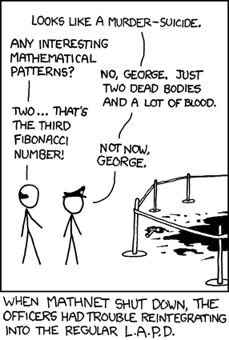
Danger…
“When all you have is a hammer, everything looks like a nail”
  Maslow's hammer law,
  The Psychology of Science,
  1966
http://xkcd.com/587/

Slide 14
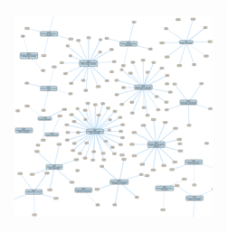
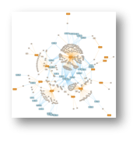

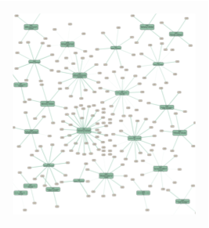

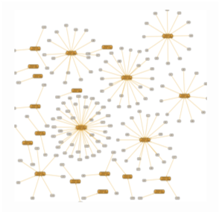



The TRIAGE approach
TRIAGE⁽¹⁾
  = atTRIbution of Attack using Graph-based Event clustering
  Multicriteria clustering method
Features
Selection
Σ
Per feature
Graph-based clustering
Multi-criteria
Aggregation
Multi-dimensional
Visualization
Events
Create “viewpoints”
Data fusion
1) Triage (med.): process of prioritizing patients based on the severity of their condition

Slide 15
Multi-criteria fusion
In many cases, a simple mean does not work! [O.Thonnard, 2010]
  Appropriate combination of attack features is not constant
Ordered Weighted Average [R. Yager, 1988]
  Weights associated with the score ranks (not particular features)
  More flexible way to model expert knowledge
    Can express things like “most of” or “at least 3” criteria
Choquet integral [G. Choquet. Theory of capacities. 1953]
  Most flexible aggregation function
  Can model interactions among coalitions of attack features

Slide 16
Towards automated attack attribution
Within WOMBAT, we have developed an automated framework that includes the expert knowledge in order to extract meaningful sets to reason about the modus operandi of the malicious actors: the TRIAGE framework
First application of that approach led to significant contributions in the latest Symantec ISTR Rogue AV report
Public deliverable D12 is available on line and contains 6 published peer reviewed papers on the topic as well as the rogue AV analysis technical report.
  http://wombat-project.eu/WP5/FP7-ICT-216026-Wombat_WP5_D12_V01_RCA-Technical-survey.pdf

Slide 17
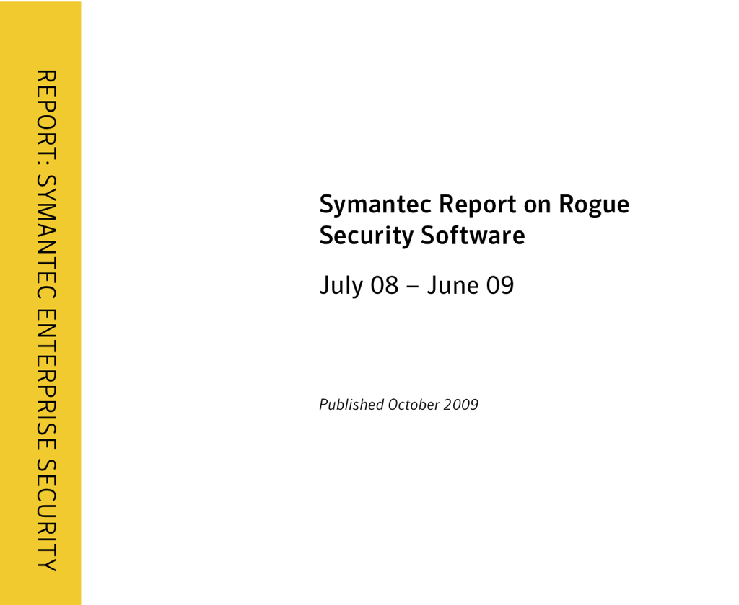

An example of real-world application

Slide 18
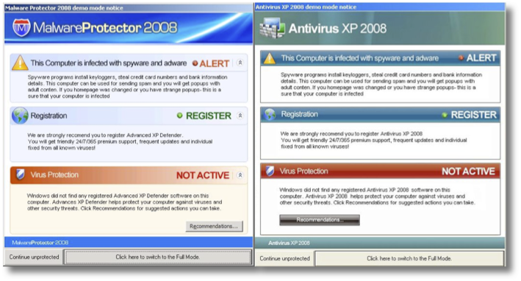
Rogue AV
Type of misleading application (“scareware”)
Propagates via malicious / infected websites

Slide 19
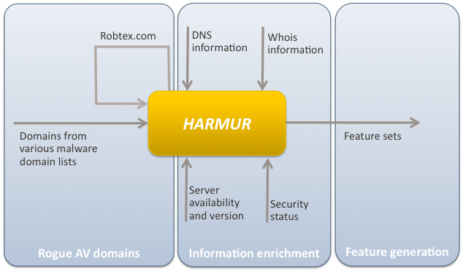
Rogue dataset generation
Notes:
The generation of the dataset thus consists in three main phases, that address the previously mentioned challenges.
Notice: robtex.com is a public service offering passive DNS listing, basically traccking IP-name associations and allowing to retrieve all the domains associated to an IP (much more than simple reverse resolution). This has allowed us to enrich the dataset with all the domains hosted on the same servers (being them malicious or not)

Slide 20
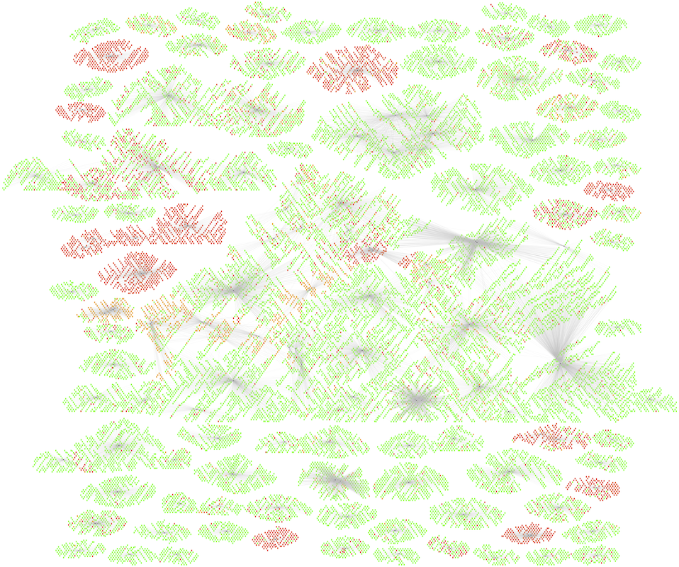
The big picture:
Domains and webservers
Only servers associated to 100+ domains are represented
Notes:
Red dots: rogue AV domains
Orange dots: domains containing other threats
Green dots: no threat known
The gray edges associate the domain to any IP address ever linked to the domain through a DNS “A” record.

Slide 21
Rogue AV campaigns
21
Multi-criteria analysis of > 6,500 rogue domains
  Whois information (registrant, registrar)
  DNS mappings (domains → IP addr. / IP subnets)
  Domain naming schemes
    Eg, home-antivirus2010.com & homeav2010.com
  Threat information [Safeweb, MDL]
Application of the TRIAGE method
  Analysis of the campaigns used to distribute rogue AV software
  Interconnections between web servers, domains, registrants, dates, etc.

Slide 22
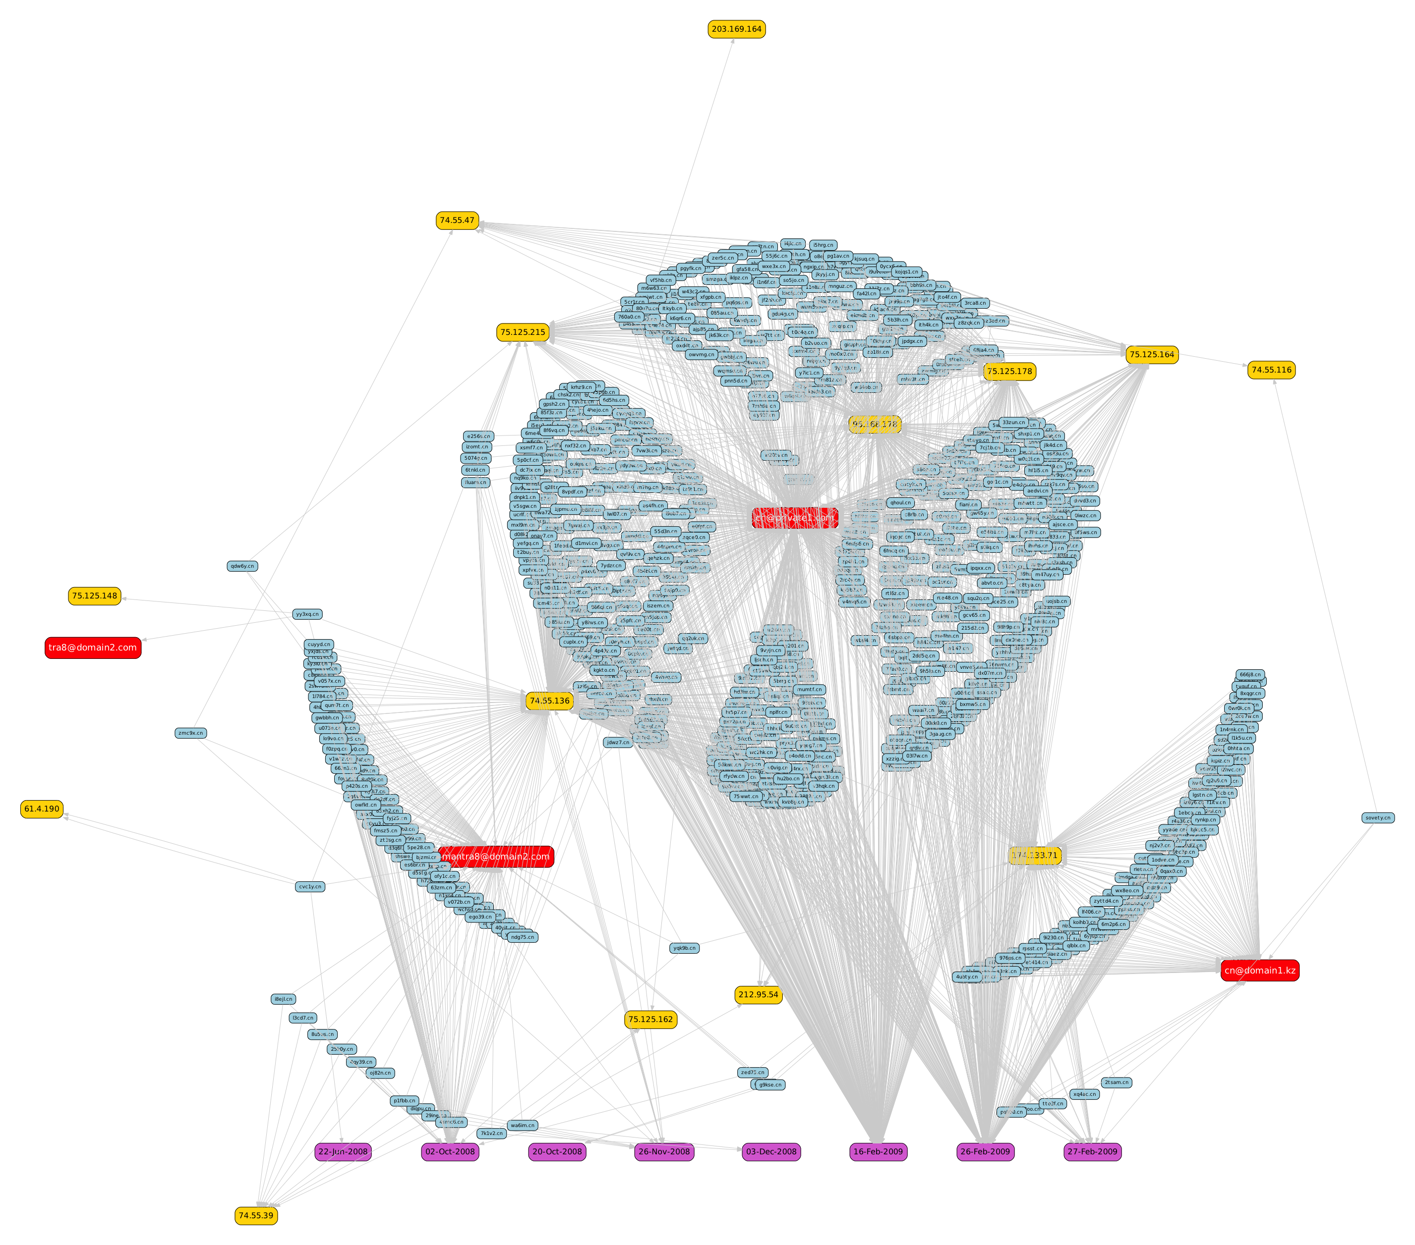
Registration dynamics
750 domains registered
over a span of 8 months
Registration date
Notes:
network where 750 domains were registered on 8 days over a span of 8 months
Only 3 or 4 (anonymized) email addresses were used this case (bc you have to pay to use whois privacy protection services…)
There were mainly 3 days of campaign on which those domains were registered in a bulk fashion
Different ISP’s seem to be used (because there are several subnets on which we found the hosting web servers – see yellow boxes)

Slide 23
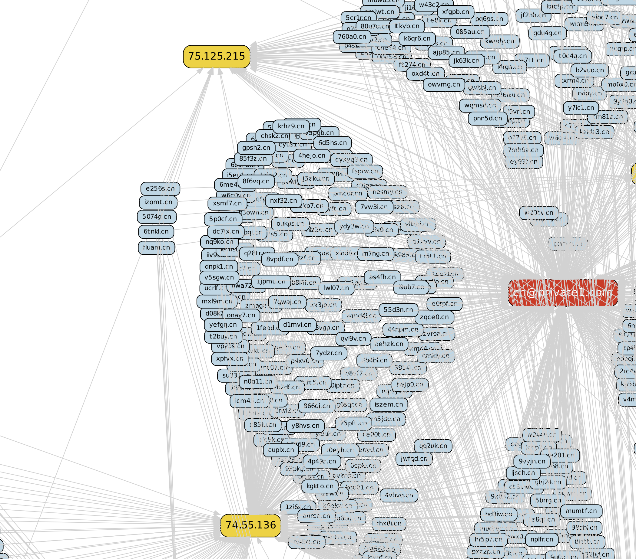
Registration dynamics
- domain name patterns
use of whois privacy protection services
Notes:
A zoom on previous figure
Note the similar pattern used for the creation of all those domain names (5 randomly chosen characters, apparently)

Slide 24
Rogue AV: lessons learned
24
User as primary target
  Rather few campaigns rely on drive-by downloads
Threat ecosystem very ≠ from exploit websites
Blacklisting is strained
  IP-based blacklisting
  Domain-based blacklisting
Take-down of Rogue AV campaigns?
  Payment processing sites
  DNS-based threat detection

Slide 25
So… why is it useful?
25
Cyber criminality is a new business model
  Financial profits can be huge (large scale)
  Better organized - more systematic, automated procedures are used
TRIAGE can help to:
  Get better insights into how cyber criminals operate, or how / when they change their tactics
    Consequently, help improving detection or end-user protection systems
  Automate the identification of “networks” of attackers
    Unless they completely change their modus operandi for each campaign…
  Go toward an early warning system
  Ultimately, support law-enforcement for stopping emerging / ongoing attack phenomena
Notes:
What are the implications of developing and using such a method:
if we can better understand how cybercriminal operate, then obviously we can improve our counter-measures, which also improves the protection of the end-user
cyber criminals play a “cat and mouse” game, which means they will try to adapt their tactics, or change certain things in their behavior in order to stay under the radar level. To a certain extent, TRIAGE can cope with this dynamicity related to the way they operate. Moreover, by design, the method will highlight those changes (unless their behavior changes completely…).
However, there is also a significant cost for them if they must modify 100% of their modus operandi for each campaign (eg, development of new automated tools, purchase of new kind of domains, new registrant addresses, new kind of hosting, etc).
we are also confident in the fact that this attribution method could be used to develop a sort of early warning system
ultimately, law enforcement could also take advantage of those results to help stopping emerging attacks or ongoing rogue campaigns
25

Slide 26
Overview
The WOMBAT Project
Attack Attribution
  The TRIAGE method
  One example: attribution of Rogue AV Campaigns
FIRE
  Finding Rogue nEtworks
  Maliciousnetworks.org
Conclusions
Notes:
26

Slide 27
FIRE: FInding Rogue nEtworks
What infrastructure is used by criminal organizations?
Rogue networks
  a.k.a. bullet-proof hosting
  Guarantee the availability of hosted resources regardless of content
    Botnet command-and-control servers
    Spam, scams, and phishing
    Child pornography
    Malware

Slide 28
Rogue Networks
Networks persistently hosting malicious content for an extended period of time
Legitimate networks will respond to abuse complaints and remove offending content
Examples
  Russian Business Network (RBN)
  Atrivo/Intercage
  McColo
  Triple Fiber Network (3FN)

Slide 29
Motivation
Taking down rogue networks has a significant (albeit temporary) effect on some malicious activities
  Worldwide drop in spam
    Atrivo: 10-20% reduction
    McColo: 60-75% reduction
    3FN: 30% reduction
Blacklisting rogue networks hinders distribution of malware

Slide 30
Objectives
Systematically identify networks that are acting maliciously
Notify legitimate networks to remediate malicious activity
Assist legitimate ISPs de-peer (disconnect) from rogue networks
Make it difficult for cybercriminals to find safe havens for their illicit activities

Slide 31
Challenges
Identifying malicious networks
  How to identify malicious content?
  When to consider a host malicious?
    Compromised server vs. malicious server
      Longevity
  How to account for size?
    Larger ISPs and hosting providers will naturally have more malicious content
Notes:
What data sources

Slide 32
System Overview
Monitor malicious activities
  Botnet Command-and-Control (C&C) servers
  Phishing servers
  Drive-by-download servers
  Spam servers
Replay network traffic to mimic a victim
  Determine uptime of malicious servers
Aggregate malicious IP addresses at an autonomous system level

Slide 33
System Overview
Autonomous system: a connected group of one or more IP prefixes run by one or more network operators which has a single and clearly defined routing policy
  RFC 1771 and RFC 1930
Resolve IP addresses to autonomous system numbers (ASN)
Compute malicious score for the ASN
Monitoring since August 2008

Slide 34
Data Collection
Botnet C&C Servers
  Anubis
    anubis.iseclab.org
Drive-by-Download Hosting Providers
  Spamtraps
    URL Analysis with Capture HPC
  Wepawet
    wepawet.iseclab.org
Phish Hosting Providers
  PhishTank.com
Notes:
Flag download servers only, not hacked machines for drive by
Phishtank: Filter out Compromised servers, Fast-flux hosts
Spam – not related and, thus, not listed

Slide 35
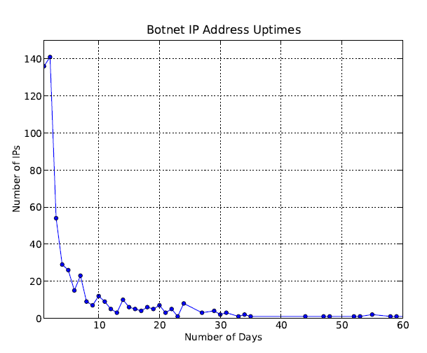
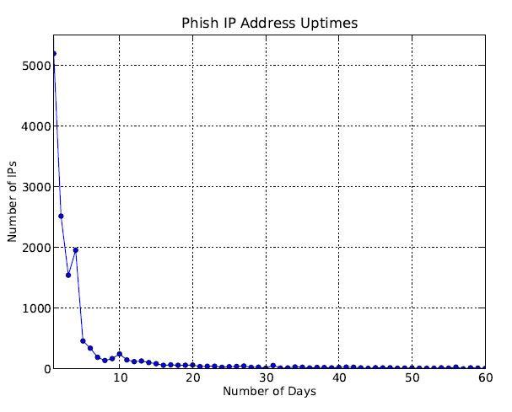
Data Analysis
Longevity of Malicious IP addresses
  A vast majority of malicious content is taken down within a few days
  Some malicious content online for more than a year!
  Exponential drop-off for botnet C&C and phishing servers
  Drive-by-download servers have a longer average lifespan
Notes:
Talk about thresholds!!

Slide 36
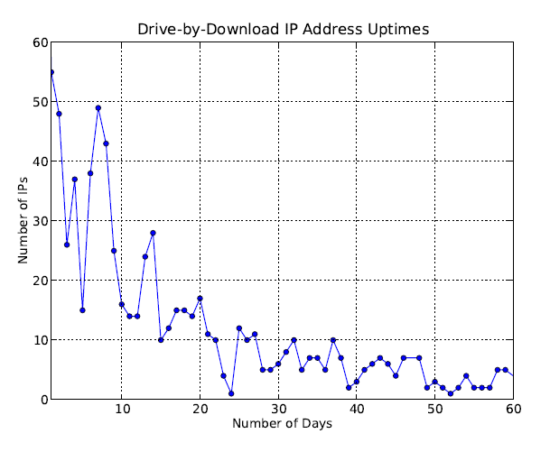
Data Analysis
Longevity of Malicious IP addresses
  A vast majority of malicious content is taken down within a few days
  Some malicious content online for more than a year!
  Exponential drop-off for botnet C&C and phishing servers
  Drive-by-download servers have a longer average lifespan
Notes:
Talk about thresholds!!

Slide 37
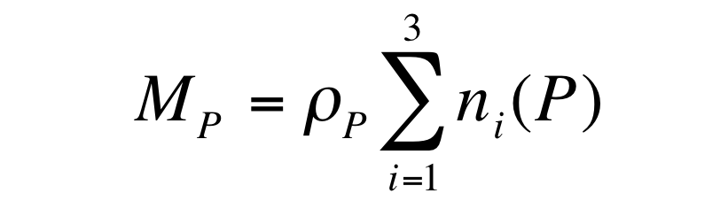
Data Analysis
Computing a malscore for an autonomous system P
ρ_{P} : scaling factor for network size
n_{i} : number of IP addresses from List ℓ_{i}

Slide 38
Evaluation
FIRE Rank | ASN | Name | Country | Score | Shadow Server | Google SB | Zeus Tracker | Blogs
1 | 23522 | IPNAP-ES - GigeNET | US | 42.4 | 1 | - | - | -
2 | 44050 | Petersburg Internet Network | UK | 28.0 | - | - | 6
3 | 3595 | Global Net Access | US | 18.2 | - | 23 | - | -
4 | 41665 | National Hosting Provider | ES | 16.5 | - | 104 | 5 | -
5 | 8206 | JUNIKNET | LV | 14.1 | - | 30 | - | -
6 | 48031 | Novikov Aleksandr Leonidovich | UA | 14.0 | - | - | -
7 | 16265 | LEASEWEB | NL | 13.0 | 24 | 14 | - | -
8 | 27715 | LocaWeb Ltda | BR | 11.6 | - | 130 | - | -
9 | 22576 | Layered Technologies | US | 11.5 | - | 64 | -
10 | 16276 | OVH OVH | FR | 10.6 | 25 | 18 | - | -
Notes:
Top 10 Rogue Networks (July 2009)
IPNAP-ES - GigeNET – leader in IRC-based botnets
Novikov Aleksandr Leonidovich – Beladen drive-by-download campaign
Petersburg Internet Network – Zeus botnet hosting
Global Net Access – leader in hosting phishing pages

Slide 39
Evaluation
Top 10 Rogue Networks (July 2009)
  IPNAP-ES - GigeNET – leader in IRC-based botnets
  Novikov Aleksandr Leonidovich – Beladen drive-by-download campaign
  Petersburg Internet Network – Zeus botnet hosting
  Global Net Access – leader in hosting phishing pages

Slide 40
Evaluation
ShadowServer Botnet C&Cs
ShadowServer Rank | FIRE Rank | ASN | Name | Large Network
1 | 1 | 23522 | GigeNET
2 | 118 | 3265 | XS4ALL
3 | - | 25761 | Staminus Comm
4 | - | 30058 | FDCservers
5 | 148 | 174 | Cogent
6 | - | 2108 | Croatian Research
7 | - | 31800 | DALnet
8 | 86 | 13301 | Unitedcolo.de
9 | - | 790 | EUnet Finland
10 | 68 | 35908 | SWIFT Ventures

Slide 41
Evaluation
Google Safe Browsing
Google Rank | FIRE Rank | ASN | Name | Large Network
1 | 17 | 4134 | Chinanet Backbone No.31
2 | 13 | 21844 | ThePlanet
3 | 90 | 4837 | China169 Backbone
4 | 30 | 36351 | SoftLayer Technologies
5 | 15 | 26496 | GoDaddy
6 | 23 | 41075 | ATW Internet Kft.
7 | 89 | 4812 | Chinanet-SH-AP Telecom
8 | 12 | 10929 | Netelligent Hosting
9 | 11 | 28753 | Netdirect
10 | - | 8560 | 1&1 Internet AG

Slide 42
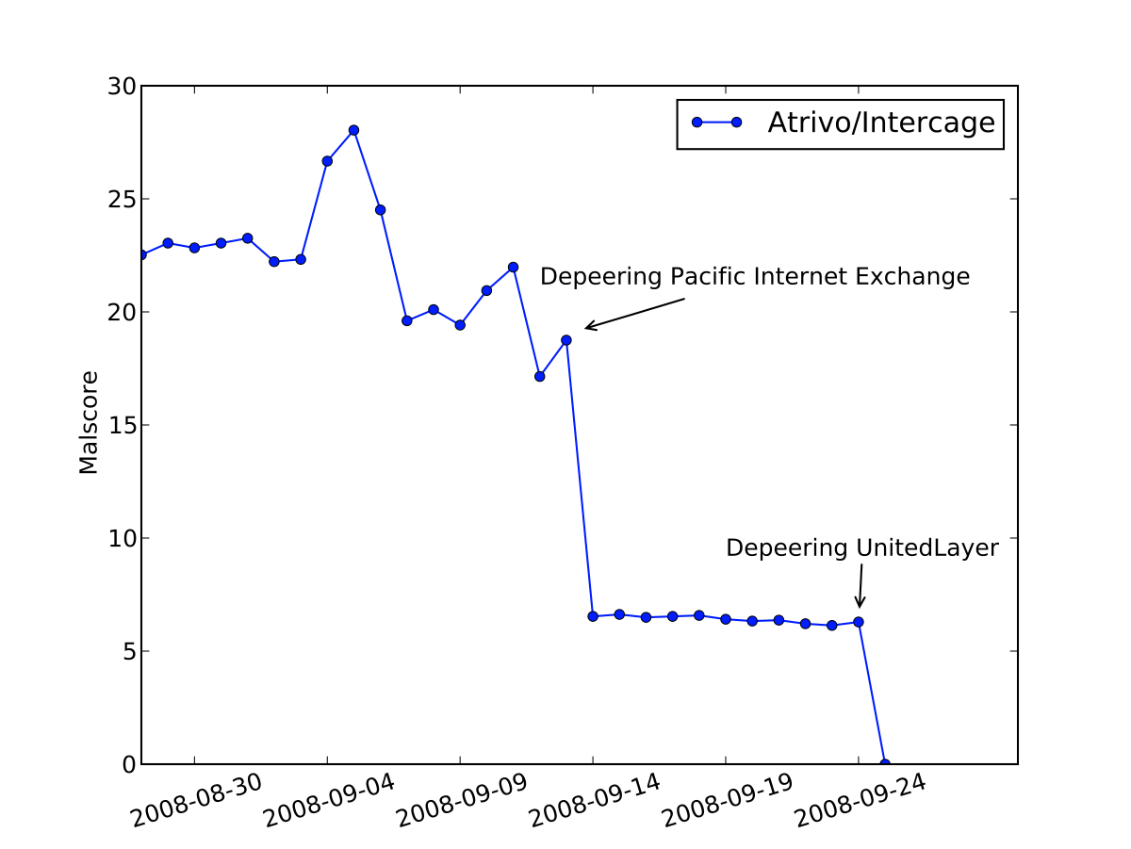
Case Study – Atrivo

Slide 43
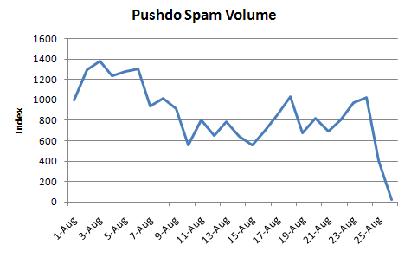
Case Study – Pushdo

Slide 44
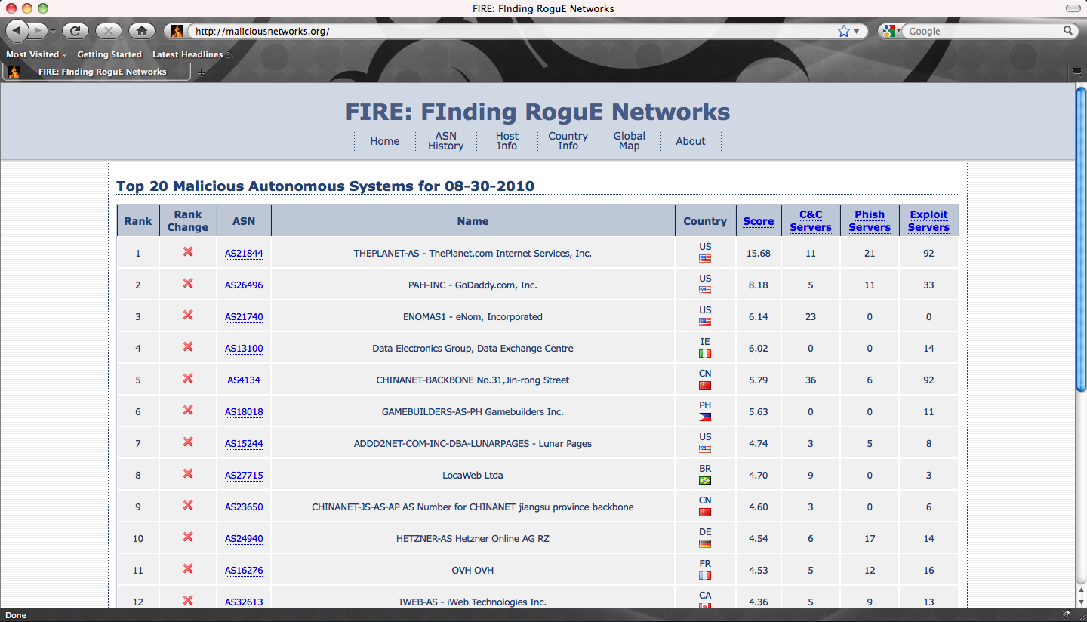
Maliciousnetworks.org
Notes:
Blocklist!!

Slide 45
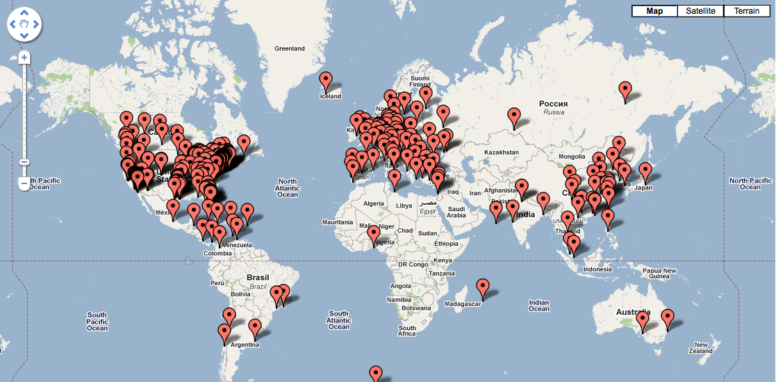
Maliciousnetworks.org

Slide 46
Overview
The WOMBAT Project
Attack Attribution
  The TRIAGE method
  One example: attribution of Rogue AV Campaigns
FIRE
  Finding Rogue nEtworks
  Maliciousnetworks.org
Conclusions
Notes:
46

Slide 47
The need for data
Attack attribution is an emerging field
It requires a multi-disciplinary approach and international collaboration
It requires access to stable, representative and diversified sets of data.
Everyone is welcome to host an SGNET sensor and benefit from the dataset and tools generated by the project.
The more sensors we can get, the more we will learn about the attacks.

Slide 48
Joining WOMBAT with an SGNET sensor: a WIN-WIN partnership
What is needed
  4 routable IP addresses
  An old computer
    At least Pentium II, 256 MB RAM, 1GB Hard Disk
  Non-Disclosure Agreement
    Protects identity of the participants to the project
What you get
  Access to the whole dataset
  Wiki for sharing interesting results
  Data mining tools
  Web interface (demo available at http://www.leurrecom.org/event2/index.html)

Slide 49
Thank you!
“The cause is hidden; the effect is visible to all.”
- Ovid

Slide 50
Some references
A Multicriteria Clustering Approach to Support Attack Attribution in Cyberspace, O.Thonnard, PhD thesis, ENST, March 2010.
FIRE: Finding Rogue nEtworks. Brett Stone-gross, Chris Kruegel, Kevin Almeroth, Andreas Moser and Engin Kirda, ACSAC 2009, 25th Annual Computer Security Applications Conference, December 7-11, 2009, Honolulu, Hawaii, USA.
An Analysis of Rogue AV Campaigns. Marco Cova, Corrado Leita, Olivier Thonnard, Angelos D. Keromytis and Marc Dacier. 13th International Symposium on Recent Advances in Intrusion Detection (RAID 2010), Sep 2010, Ottawa, Ontario, Canada.
Behavioral Analysis of Zombie Armies, O. Thonnard, W. Mees (Royal Military Academy of Belgium) and M. Dacier (Symantec), Proc. of Cyber Warfare Conference (CWCon), Cooperative Cyber Defense Center Of Excellence (CCD-COE), June 17-19, Tallinn, Estonia.
Addressing the Attack Attribution Problem using Knowledge Discovery and Multi-criteria Fuzzy Decision-making, O. Thonnard, W. Mees (Royal Military Academy of Belgium) and M. Dacier (Symantec), Proc. of KDD’09, 15th ACM SIGKDD Conference on Knowledge Discovery and Data Mining, Workshop on CyberSecurity and Intelligence Informatics, June 28, 2009, Paris, France.

