Slide 1
CobraDroid
Hooking Android Applications
Jake Valletta
BruCON 2013

Slide 2
About Me
Consultant at Mandiant
Pen-testing, IR, forensics, application security
Strong interests in mobile security
Mobile security blog and research: “The Cobra Den”
http://blog.thecobraden.com/
http://www.thecobraden.com/
@jake_valletta

Slide 3
Agenda
Background & Overview
CobraDroid Features
Demo
Future Plans
Questions & Answers

Slide 4
Background & Overview

Slide 5
Current Situation – Background
People want/need to analyze Android applications
Companies pay to be told they are “safe”
Analyzing malware
General curiosity (why is Angry Birds asking to use my camera?)

Slide 6
Current Situation – Static Analysis?
Lots of tools!
Smali/Baksmali
Dex2jar
Apktool
Dexter by BlueBox
IDA Pro
Lots of information on how to tear applications apart…
…And modify and repackage!

Slide 7
Current Situation – Dynamic Analysis?
Less common
“AppUse” by AppSecLabs (closed-source)
There are plenty of services that will analyze your application
Upload to website, get results
NOT ideal for client related work
“Blackbox”

Slide 8
Goals of CobraDroid
Create a free and open dynamic analysis platform
Needs to be easy to install, setup, and use
Give the tester as much control and visibility as possible
Make their job easier and successful
Learn about Android internals ☺

Slide 9
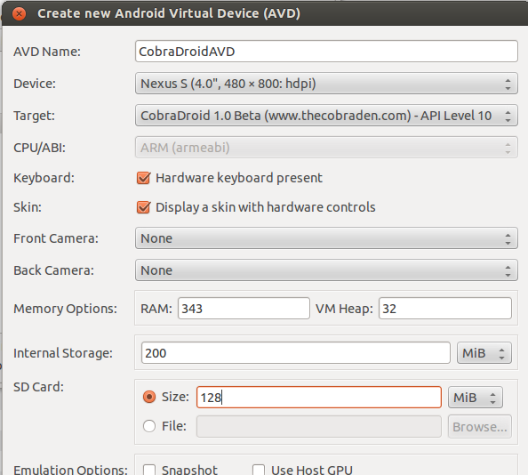
Using CobraDroid
Setup Android SDK
Download archive from my website
Unzip to “add-ons” directory (SDK)
Create new AVD

Slide 10
CobraDroid Features

Slide 11
What is CobraDroid?
Modified Android build for the emulator
QEMU emulating ARM code
Android 2.3.7 (“GingerBread”)
Modified from the lowest point up
Kernel
User-space libraries + tools
Dalvik VM
Android applications

Slide 12
Updated Kernel (CobraKernel)
At the time of development, latest “Goldfish” kernel was 2.6.29
“kernel.org” publish date of April 13, 2008
Default kernel with Android 1.5 “Donut” (released Sept 19, 2009)
Updated to 2.6.36
Default kernel with Android 3.0 “HoneyComb” (released Feb 22, 2011)
More powerful configuration
Full netfilters
Loadable kernel modules

Slide 13
Bash & BusyBox
Android 2.3 shell is terrible. Terrible.
No autocomplete
No coloring
No pipes
Lack of tools/utilities
No editors
No [insert your favorite Unix tool]

Slide 14
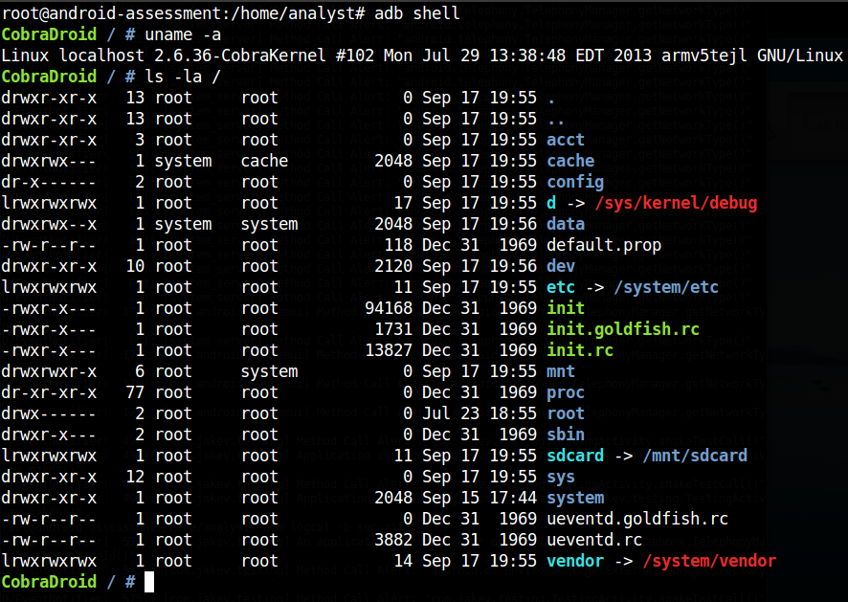
Bash & BusyBox

Slide 15
LiME Forensics
Linux Memory Extractor by Joe Sylve (504ensics)
http://code.google.com/p/lime-forensics/
Allows for live memory acquisition via Loadable Kernel Module
Open saved files with Volatility or Dalvik Inspector
Modified to fit CobraDroid as device driver + user-space API
https://github.com/jakev/lime-forensics-jakev

Slide 16
LiME Forensics
“lime” command line utility
Links against “liblime.so”
“android.jakev.Lime” class for Android applications
NOT SAFE - Currently implementing safer solution
Gives Android application access to kernel driver

Slide 17
Editable Radio & Device Identifiers
Lets you make the phone look like anything you want!
Helps with application whitelisting/blacklisting
Is this a Vodafone? Telefónica? Is it a Nokia? Motorola?
Previously very tedious to change on emulator
Radio properties: Modify “emulator-arm” binary
Device properties: Modify :“/etc/build.prop” and reconstruct the “system.img”

Slide 18
Editable Radio & Device Identifiers
Re-written “TelephonyManager” class
Queries a custom file instead
Removed “android.os.Build” class initialization in Zygote
Hooked “SystemProperties” class
Queries a custom file instead

Slide 19
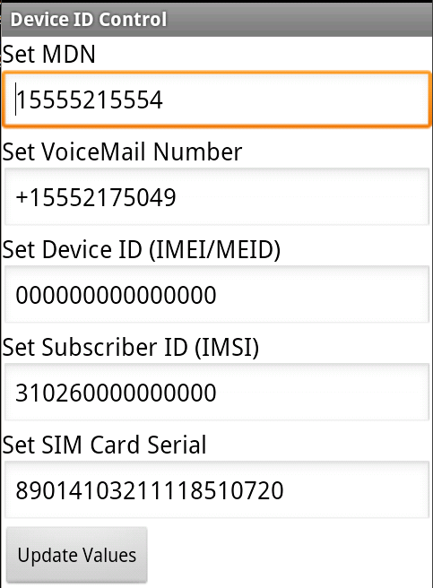
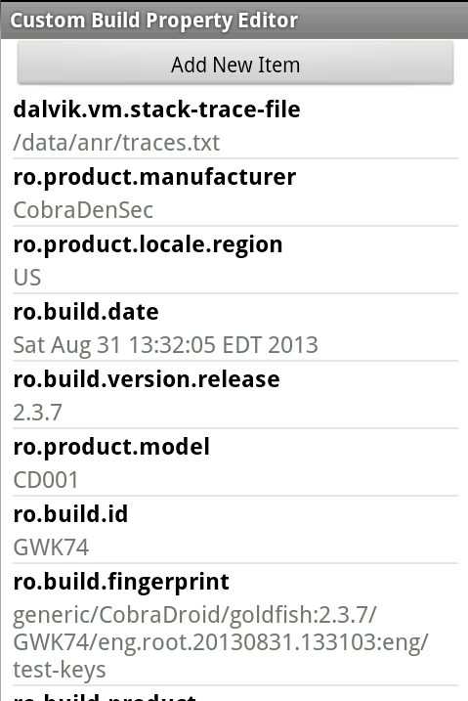
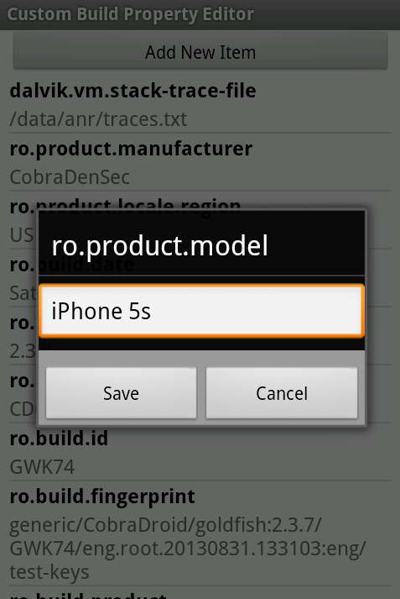
Editable Radio & Device Identifiers

Slide 20
SSL Validation Bypass
Allows you to man-in-the-middle any SSL connection
Disables certificate pinning and CA validation silently
Re-written constructors and getter/setters
Works for all default SSL libraries on Android 2.3
HttpsURLConnection (core.jar)
DefaultHttpClient (ext.jar)
SSLSocketFactory (ext.jar)

Slide 21
Application Specific Packet Capture
Show me only traffic for application X (and application Y)
Focus on only the traffic you actually care about
Uses Custom “iptables” rules to redirect traffic
View in Wireshark afterwards
Tested on 1.8.5 Stable, 1.11.0 Dev. (incompatible with older versions)

Slide 22
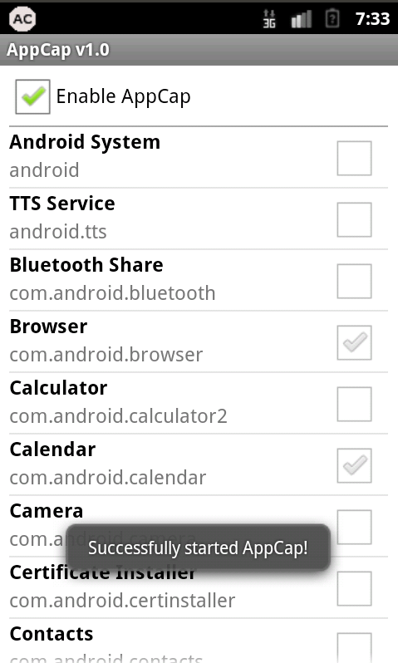
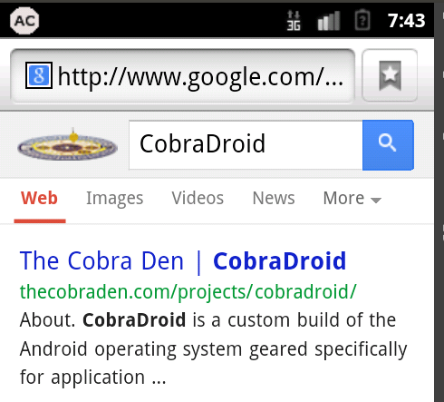
Application Specific Packet Capture

Slide 23
Method Hooking
CobraDroid uses it to alert on method calls
Much more to come
Could have an entire 45 minute talk on hooking the DVM
I’m going to try and do it in about 7 ☺
TL;DR – Instrumenting method byte-code during Class loading

Slide 24
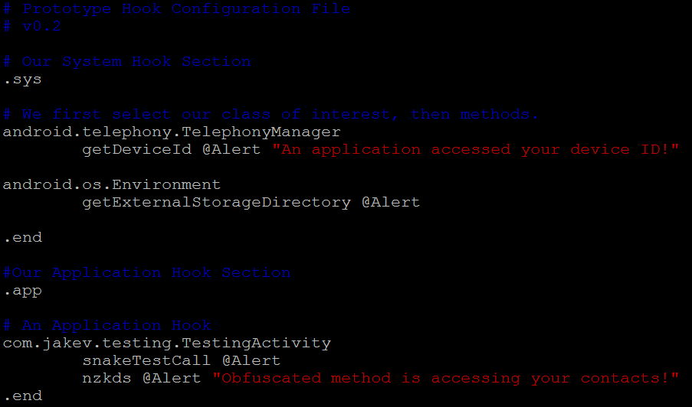
Method Hooking
Configuration file: “/etc/hooks.conf”

Slide 25
Method Hooking
Configuration file: “/etc/hooks.conf”
System JARs
Application APKs

Slide 26
Method Hooking
Configuration file: “/etc/hooks.conf”
System JARs
Class
Message
Action
Method
Application APKs

Slide 27
Method Hooking
It’s magic! (Right?)

Slide 28
Hook Step #1 – DVM Startup
Read configuration file and parse hooks into global DVM memory
Utilize the “gDvm” variable (DvmGlobals struct)
For each JAR/DEX file, over-allocate strings, methods, etc. based on configuration
Modify calloc() calls when initializing “pDvmDex” (DvmDex struct)
Structure used to hold resolved classes, methods, etc.

Slide 29
Hook Step #2 – Class/Method Loading
Read global memory to determine if loaded class and method should be hooked
For the given method, allocate n bytes for new DexCode struct
The original DexCode struct is read-only mapped directly from the DEX file

Slide 30
“DexCode” Structure
Name | Format
registers_size | u2
ins_size | u2
outs_size | u2
tries_size | u2
debug_info_off | u4
insns_size | u4
insns | u2[insns_size]
padding | u2
tries | try_item[tries_size]
handlers | encoded_catch_handler_list
Contains all declaration details for a method

Slide 31
“DexCode” Structure
Name | Format
registers_size | u2
ins_size | u2
outs_size | u2
tries_size | u2
debug_info_off | u4
insns_size | u4
insns | u2[insns_size]
padding | u2
tries | try_item[tries_size]
handlers | encoded_catch_handler_list
Contains all declaration details for a method
“insns” is what we actually want to modify!
Add new instructions to do X
Need to repair structure after

Slide 32
Hook Step #2 – Class/Method Loading
Add new instructions to “insns”
In this case, we call: Landroid/jakev/EventNotifier;.notifyEvent();
Responsible for printing to logs
Optionally add our payload message
Re-align the remaining DexCode structure
Repair “tries”
Repair “handlers”

Slide 33
Hook Step #3 – Resolving
Resolving occurs at runtime, when the DVM must determine what code to run and where it is located
Log.d(“here”, “i am a snake”);
In our app’s DEX file
In another DEX file!

Slide 34
Hook Step #3 – Resolving
Question: How do we call a method or use a string that a DexFile struct does not know about?
Answer: Instrument the code with an index beyond the max, then add checks to dvm.*Resolver() function calls!
i.e. attempting to resolve string 33 out 32
Usually this indicates an error condition

Slide 35
Additional Packages
ProxyDroid
Makes it painless to proxy traffic on the emulator
Superuser/“su”
Provides root level access to the device
Drozer
Allows you to assume the role of an Android application at a command line
EmuCoreTools
Front-end interface to CobraDroid features

Slide 36
Demo!

Slide 37
Future Research & Plans
Move to Ice Cream Sandwich (4.0.0+)
Expand hooking capabilities
Add “payload” action handler
More “man in the middle” capabilities
SQL database queries
Intents (broadcast & directed)

Slide 38
Getting More Information
Check my website & blog for updates, technical material, etc.
http://www.thecobraden.com
http://blog.thecobraden.com
Getting CobraDroid (beta)
http://www.thecobraden.com/projects/cobradroid
https://github.com/jakev/CobraDroidBeta (source)

Slide 39
Questions & Answers

