Slide 1
Dissecting Non-malicious Artifacts:
One IP At A Time
Ido Naor (@idonaor1) & Dani Goland (@danigoland)

Slide 2
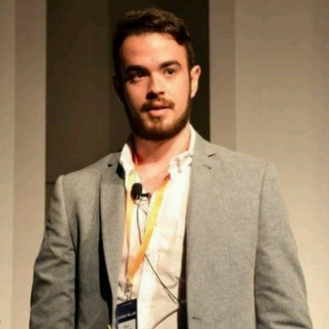
About us
Founders
Kaspersky
Undot Ltd.
Alumni & Lecturer
Student
Father
Active
Origin
“for research purposes”

Slide 3
Disclaimer
A few people from companies X,Y & Z
gave us a “friendly” call to not expose information linking back to them. Hence, we had to redact the juicy content of our presentation

Slide 4
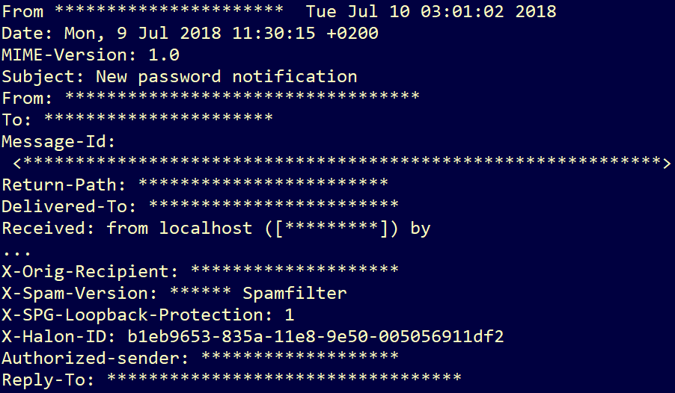
Research Motive

Slide 5
Research concept
RESEARCH
FOCUS
Employees use
online services
to educate themselves
Security products
ARE NOT SUPPOSED TO use online services
to enhance detection
vendors use
data of their clients and later have zero responsibility for it
Hackers steal data and later publish it to online platforms

Slide 6
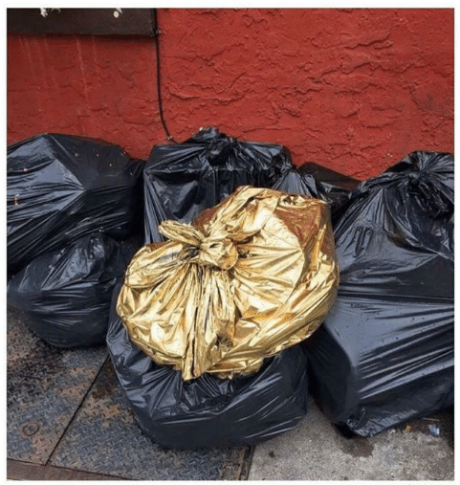
Research Scope

Slide 7
Research Goal
Starting points
Paid/non-paid services
Repositories
Other
Building Blocks
Malware Research
Yara
Data Science
Goal
Prove that data is being unwillingly exfiltrated from organizations, and that with simple tools – it can be exposed.

Slide 8
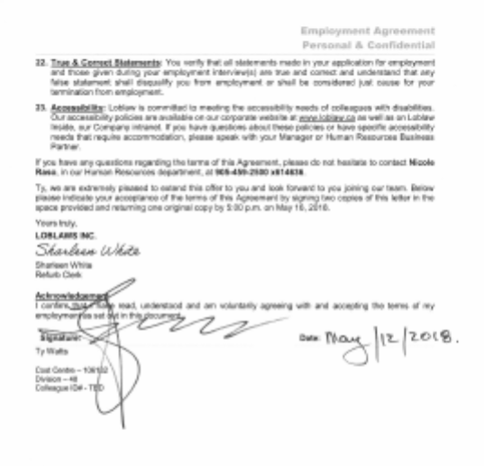
Proof of Concept
One simple search: “message”
Mail containing non-malicious artifacts
Options:
Mail uploaded by employee
Mail suspected by security product
Mail uploaded by 3rd party
Triple by the thousands
Personal & Confidential
May 12, 2018

Slide 9
Linking The Subjects
</>
Emails
Code
Dumps
Archives
Documents
Certificates
Keys
Secrets
Graphs

Slide 10
Step 1: Possible Feeds
Code repositories / Open source
Script/Paste repositories
Malware repositories
Multi-scanners
Online sandboxes
Forums / Social platforms

Slide 11
Step 2: Yara rules
rule filter_interesting_eml {
strings:
$eml_01 = "From:”
$eml_02 = "To:"
$eml_03 = "Subject:"
$attachment_id = "X-Attachment-Id"
$mime_type = "Content-Type: multipart/mixed"
condition:
all of ($eml_*) and $attachment_id and $mime_type and filesize > 300KB
}
rule filter_interesting_outlook {
strings:
$a1 = {D0 CF 11 E0 A1 B1 1A E1}
$a2 = "FROM:" nocase $a3 = "TO:" nocase
condition:
all of them and filesize > 300KB
}

Slide 12
Step 3: Collection
var https = require('https');
var AWS = require('aws-sdk');
AWS.config.region = 'us-west-2';
var s3 = new AWS.S3();
let url = "https://<datasource>/...";
exports.handler = function (event, context,callback) {
https.get(url, res => {
res.setEncoding("utf8");
let body = "";
res.on("data", data => {
body += data;
});
let ids = []
res.on("end", () => {
body = JSON.parse(body);
let notifs = body[‘notifs’];
let filtered = {alerts:[]};
for(let i = 0; i<notifs.length;i++)
{
…
}
}
Searched feeds for undetected samples
List hashes from results
Downloaded undetected samples
Filtered emails using Yara
Sent matches to pipeline

Slide 13
General Architecture
SNS
RSS feeds
Pull Hashes
Send SNS
AWS Lambda
Download Samples
Push
Get Tasks
ec2 instances
Samples & Attach.
Headers + Parsed Body + Metadata
Queue
Bucket (S3)
Postgres DB
EMR
Elastic Search & Kibana

Slide 14
Analysis Pipeline
NLP Pipeline
Spam Or Ham
TF-IDF → Naïve Bayes
Open Source Dataset
Preprocessing
Stemming
Stop word Removal
Tokenization
POS Tagging
#1 Feature
Custom Parser
Subject & Body
Language Detection
Domain Names
Geo lookup on domains
Extract Attachments
Named Entity Recognition
Names Of Persons
Organizations
Roles(CXO,VP)
Locations
Monetary Values
Topic Modeling
10 Topics
Top 10 words/topic
Postgres
Email Queue
*NMF
*LDA
Attachment Queue
1(Casual Email) - 4(Critical/Highly Confidential)
Content & Metadata Extraction
NMF = Non-Negative Matrix Factorization
LDA = Latent Dirichlet Allocation

Slide 15
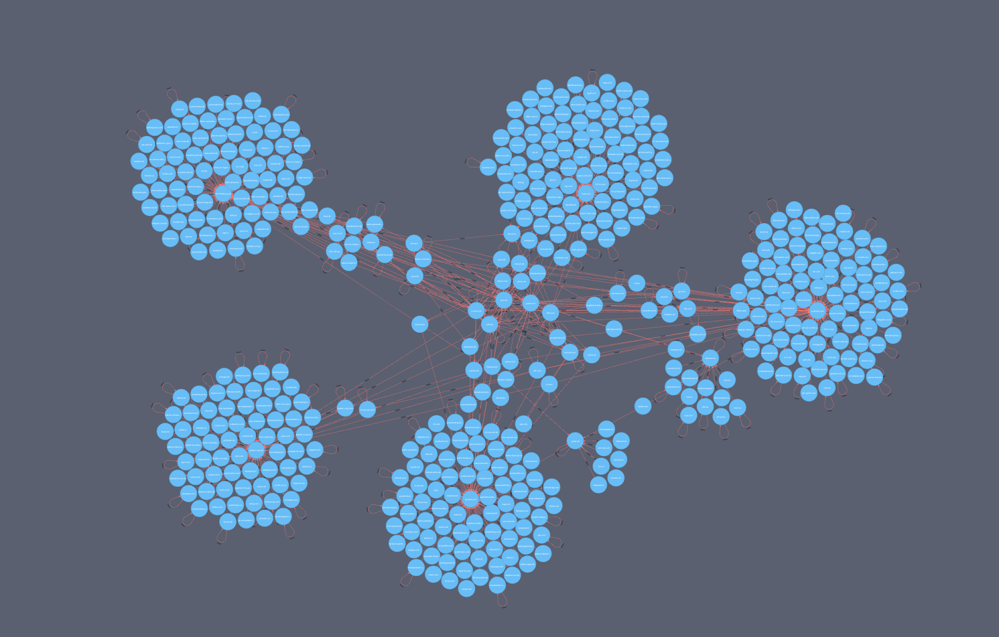
Graph-based

Slide 16
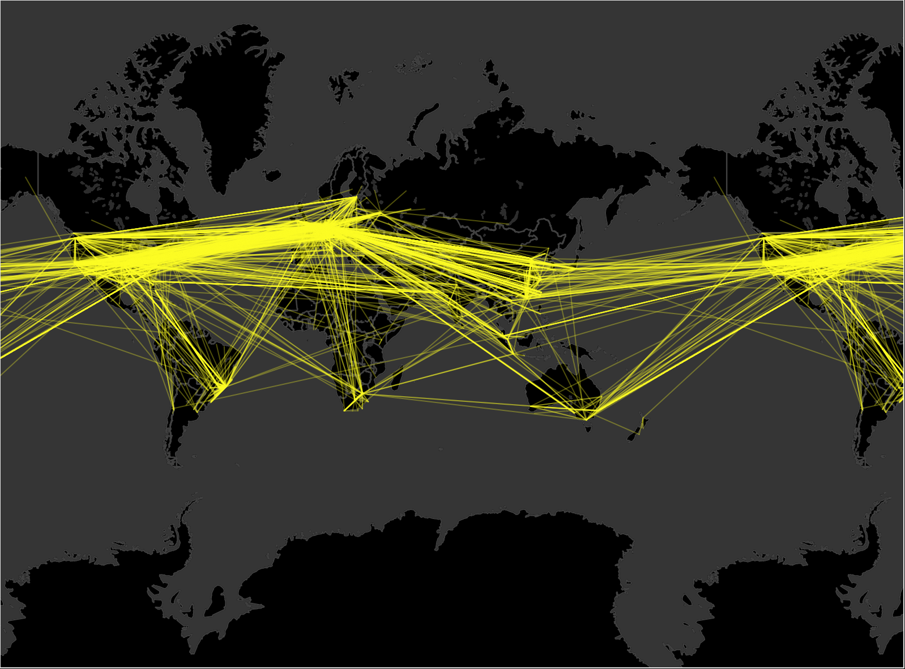
Global Problem

Slide 17
DEMO TIME

Slide 19
THANK YOU BRUCON!
Ido Naor (@idonaor1) & Dani Goland (@danigoland)

