Slide 1
Notes:
talking about vulnerabilities me and my teammate Patrick DeSantis discovered in the MicroLogix 1400 Programmable Logic Controller and how they can be chained together to gain full control over the firmware on the device
font: https://www.google.com/fonts#UsePlace:use/Collection:Exo+2

Slide 2
INTRODUCTION
Notes:
Jared
Talos
Focus Primarily Embedded systems research and detection
Search for vulnerabilities in devices
Work to create coverage based on those vulns as well as others from intel sources for Snort to detect and alert

Slide 3
PROJECT ORIGIN
Notes:
!!!!! USE NOTES HERE
Advanced Persistent Thirst
Remote controlled kegerator
Uses ICS equipment that could be found in the field
MicroLogix 1400 selection rationale
Compact
All in one device
Commonly known PLC
From Box to Backdoor
First talk on the results of research into the devices used in APT
Including the MicroLogix 1400
Discussed vulns discovered during the process
Namely a major SNMP issue

Slide 4
PRIOR WORK
Thiago Alves
University of Alabama
Mark Gondree, Francisco Tacliad, and Thuy Nguyen
Sonoma State University & Naval Postgraduate School
Patrick DeSantis
Cisco Talos
Matthew Luallen
Cybati
Eyal Udassin
C4 Security
Ruben Santamarta and K. Reid Wightman
Digitalbond
Notes:
Time: 30 Seconds
Notes:
Numerous other people have worked on related equipment
Interesting work that helped while working on the project

Slide 5
PROJECT GOALS
Remotely Control the Device
Modify Configuration to Gain Additional Access
Flash the Device with Modified Firmware
Notes:
Time: 1minute
Notes:
Determine a way to interact with the device without being physically connected
Change the settings applied by engineers to get the device into a desired state
Reflash the PLC with our own firmware to achieve the desired end goal

Slide 6
PROGRAMMABLE LOGIC CONTROLLER (PLC)
Notes:
Est Time Marker: 4 Minutes
!!!!!!!!! Use notes
Computer
Fancy casing
Designed to operate in sub-optimal conditions
Out in the weather
In a factory
Etc
Used to automate the control of a device or system according to a defined program
Could be as simple as turning on a light at night
Could be as complex as controlling the precise amounts of different elements being combined together
Uses a special operating system designed to keep the device’s input and output controls as close to real time as possible

Slide 7
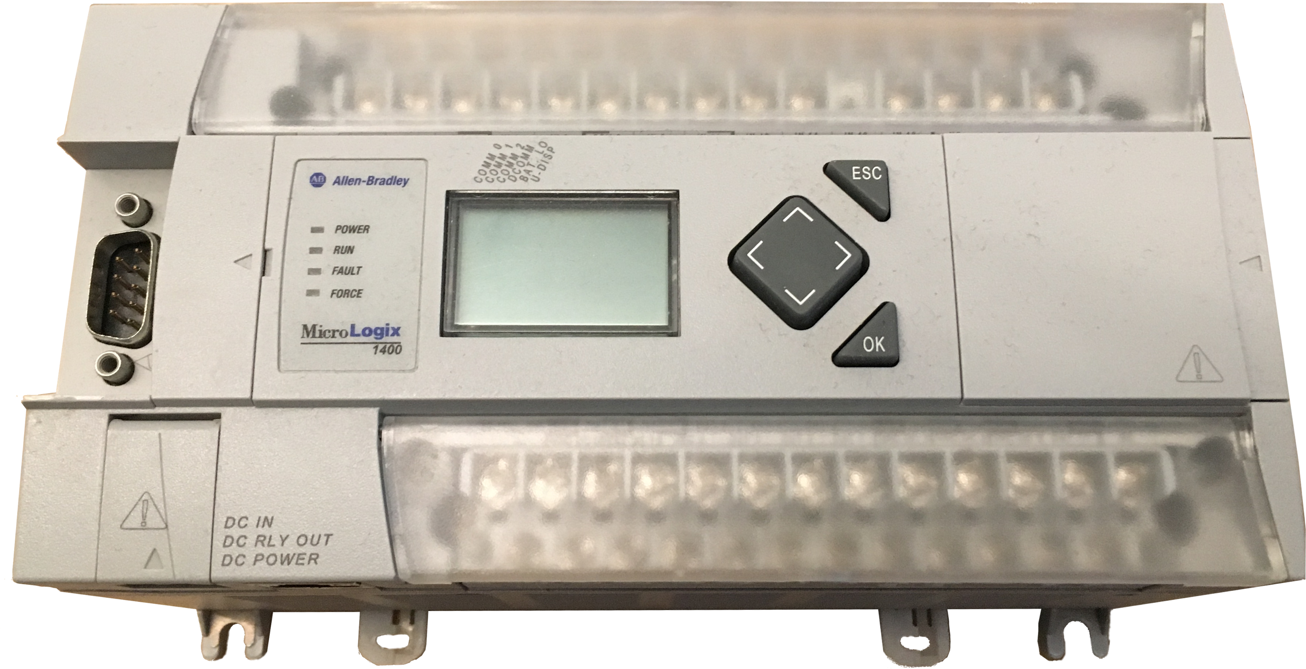
PLC - MICROLOGIX 1400
Typical applications for our MicroLogix™ programmable controllers include:
  Material Handling
  Packaging Applications
  General Industrial Machinery
  Printing
  Food and Beverage
  Pharmaceutical
  Water Wastewater / SCADA
  Clutch/Brake control
  Position Control - Pick-and-place / Conveyo
- Allen Bradley
Notes:
Time: 2 minutes
Notes:
Micrologix Line
Location
Reference on screen
Uses
Smaller environments
Hence ‘micro’
Notable elements in the 1400
Included I/O
On-device LCD screen
Applications Reference:
https://ab.rockwellautomation.com/Programmable-Controllers/MicroLogix-1400#applications

Slide 8
PLC – KEYSWITCH STATES
RUN
REMOTE
PROG
Notes:
Time: 2minutes
Notes:
Keyswitch
Changes the operating mode of the CPU
PROG
Programming mode
Non-executing mode
Allows for reprogramming of the device
RUN
Execution Mode
Non-Programming mode
Program is running in this mode
REMOTE
A melding of PROG and RUN
Contains a programming mode
Contains a run mode
Contains others as well
Sub Modes
REMOTE RUN
REMOTE PROG
Others not relevant to this talk

Slide 9
PLC - COMMUNICATION PROTOCOLS
Ethernet
IP
TCP
EtherNet/IP
PCCC
Programmable Controller Communication Commands
(PCCC)
Notes:
Time: 30s
Notes:
Discuss PCCC and where it fits into the encapsulation structure
Emphasize that it EtherNet/IP is its own protocol, not just referencing L2&3

Slide 10
PLC - PCCC STRUCTURE
PCCC
CMD
Data
FNC
TNS
Notes:
Time: 30s
Notes:
Basic format of a PCCC message
This would be encapsulated within the ENIP data
Data field
Not always used
Sometimes only contains a few bytes
Sometimes contains a large amount of information

Slide 11
PLC – PROTOCOL RESOURCES
DF1 Protocol and Command Set
Communicating with RA Products using EtherNet/IP Explicit Messaging
EtherNet/IP Adaptation of CIP Specification
Notes:
Time: 30sec
Notes:
Names of three documents that are helpful in understanding the protocol

Slide 12
PLC – DEVICE CONFIGURATION
Device Model
MicroLogix 1400
Series B
CPU State
REMOTE RUN
SNMP State
DISABLED
Memory Module
Installed
w/o
Write-Protect
Firmware Version
21.003 or below
Notes:
Time: 1 minutes
Notes:
Device Model
May work on Series A controllers. Did not have one to test on
Series C may give issues due to the firmware signing
CPU state
Most of the attack can be performed in RUN mode
One part requires REMOTE, forcing this attack to require REMOTE
SNMP state
Default state of Disabled
Memory Module
Installed (non-default)
Write-Protect not enforced
Firmware Version
21.003 or lower
Newest before our disclosure

Slide 13
ENABLING SNMP
Notes:
EST Time Marker: 8:45 minutes
Time: 30s
Notes:
Transition
Discuss how this is the start of the attack path

Slide 14
ENABLING SNMP – REASONS & REQUIREMENTS
Reasons
Requirements
Flash New firmware
No Keyswitch Requirement
Firmware Version 21.003 or Below
SNMP Disabled By Default
ENIP Enabled
Notes:
Time: 1 minute
Notes:
Reason
SNMP is a required element of the firmware flashing process
SNMP is disabled by default since firmware version 21.0
Before we can upload our custom firmware we have to find a way to enable the service
Requirements
No keyswitch requirement
This means it can be conducted in any mode including RUN
This cannot be done in this method through RSLogix
Emphasize that this is only a queued for enablation
Firmware version 21.003 or below
Version 21.004 fixed this when in RUN mode

Slide 15
ENABLING SNMP - RSLOGIX
Enable SNMP
Reboot Device
Notes:
Time: 3 minute
Notes:
Initial Approach
RSLogix
Programming and control software for the MicroLogix line (among others)
Enable SNMP via the device’s programming software – RSLogix
Watch the traffic in Wireshark and pick out the related traffic
Switch the CPU to PROG for a start marker
Enable the service
Switch the CPU to RUN for an end marker
Investigate errors
TNS issue
CRC issue when modifications are made
Mention Dissector

Slide 16
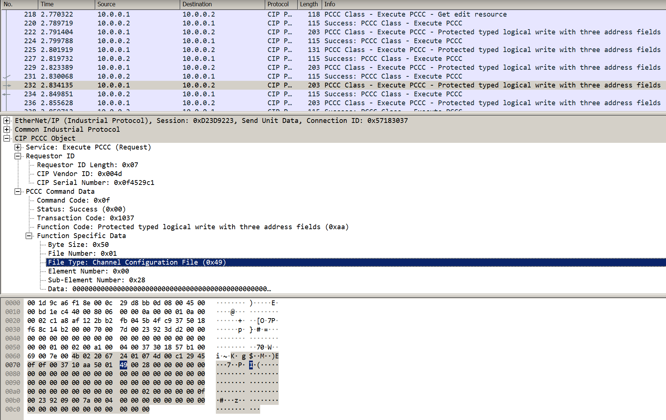
ENABLING SNMP - RSLOGIX
Notes:
Time: 1 minute
- discuss dissector

Slide 17
ENABLING SNMP – GET CURRENT CONFIG
PCCC Protected Typed Logical Read with Three Address Fields
CMD
Byte Size
FNC
TNS
File Number
File Type
Element Number
Sub-Element Number
PCCC Read # 1
File Type: 0x49
Element Number: 0x00
Byte Size: 0x50
File Number: 0x01
Sub-Element Number: 0x00
PCCC Read # 2
Byte Size: 0x50
File Number: 0x01
File Type: 0x49
Element Number: 0x00
Sub-Element Number: 0x28
Notes:
Time: 3minute
Notes:
To make any changes we need to first know what the existing data is
Can obtain this via two PCCC Protected Typed Logical Read with Three Address Fields commands
File Number 0x01
File Type 0x49
Structure is a normal PCCC command with the following elements in the data field
Byte Size
Number of bytes to read
File Number
Specific file to read
File Type
Type of that file
Seems to be more defining than the File Number
Element Number
Offset within the file
Sub-Element Number
Offset within the file
Reads are limited to 0x50 bytes, but we need more than 0x50 bytes for the full configuration

Slide 18
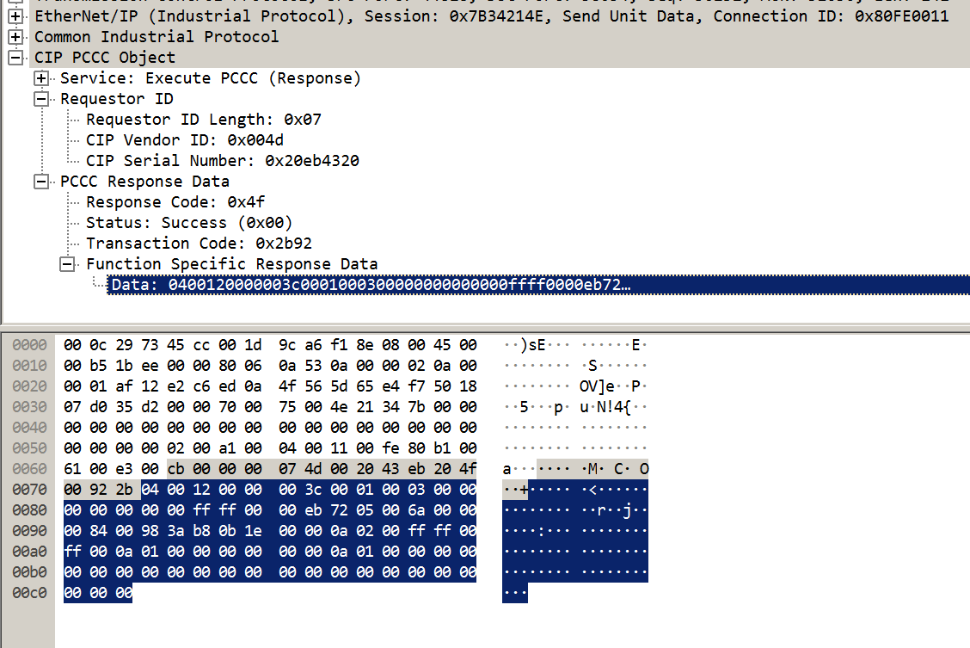
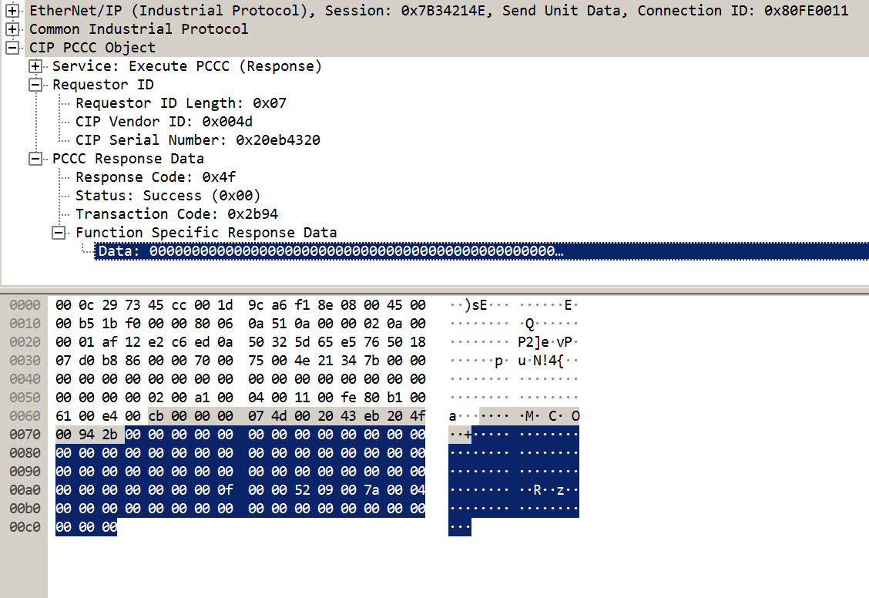
ENABLING SNMP – GET CURRENT CONFIG
Notes:
Time: 1minute
Notes:
Response data of the requested size when the request is successful
Response 1
Contains, among other things, the network configuration data
Ex: four first highlighted bytes indicate the device’s IP address
Response 2:
First highlighted byte
Protocol control byte
Contains a bitfield of the service states
Second highlighted bytes:
CRC for the channel configuration file

Slide 19
ENABLING SNMP – PROTOCOL BITFIELD
PCCC Read # 2 Response - Original
00 | 00 | 00 | 00 | 00 | 00 | 00 | 00 | 00 | 00 | 00 | 00 | 00 | 00 | 00 | 00
00 | 00 | 00 | 00 | 00 | 00 | 00 | 00 | 00 | 00 | 00 | 00 | 00 | 00 | 00 | 00
00 | 00 | 00 | 00 | 00 | 00 | 00 | 00 | 00 | 00 | 00 | 00 | 00 | 00 | 00 | 00
00 | 00 | 00 | 00 | 0F | 00 | 00 | 52 | 09 | 00 | 7A | 00 | 04 | 00 | 00 | 00
00 | 00 | 00 | 00 | 00 | 00 | 00 | 00 | 00 | 00 | 00 | 00 | 00 | 00 | 00 | 00
PCCC Read # 2 Response - Modified
00 | 00 | 00 | 00 | 00 | 00 | 00 | 00 | 00 | 00 | 00 | 00 | 00 | 00 | 00 | 00
00 | 00 | 00 | 00 | 00 | 00 | 00 | 00 | 00 | 00 | 00 | 00 | 00 | 00 | 00 | 00
00 | 00 | 00 | 00 | 00 | 00 | 00 | 00 | 00 | 00 | 00 | 00 | 00 | 00 | 00 | 02
00 | 00 | 00 | 00 | 0F | 00 | 00 | 52 | 09 | 00 | 7A | 00 | 04 | 00 | 00 | 00
00 | 00 | 00 | 00 | 00 | 00 | 00 | 00 | 00 | 00 | 00 | 00 | 00 | 00 | 00 | 00
Bit 7 | Bit 6 | Bit 5 | Bit 4 | Bit 3 | Bit 2 | Bit 1 | Bit 0
ENIP | ? | ModbusTCP | DNP3 | ? | SMTP | SNMP | HTTP
Notes:
Time: 1minute
Notes:
Protocol Bitfield breaks out as shown above
Field we’re interested in is SNMP
Requires that bit 1 is set, giving us the value 0x02 when all other services are toggled off

Slide 20
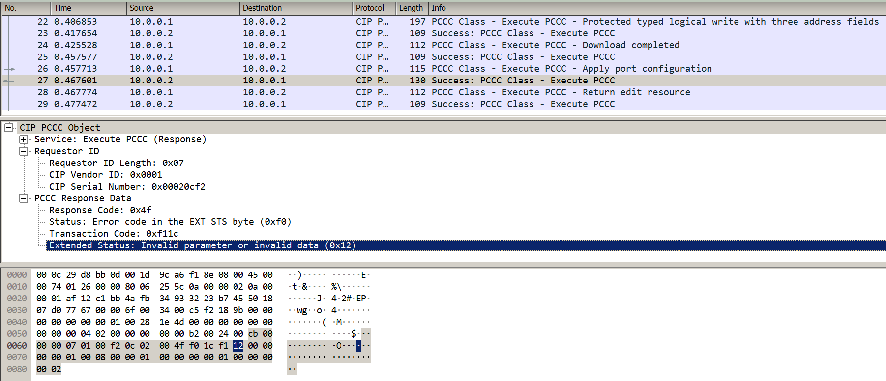
ENABLING SNMP – CRC ERRORS

Slide 21
ENABLING SNMP – REBUILD CONFIG
PCCC Read # 1 Response
04 | 00 | 12 | 00 | 00 | 00 | 3C | 00 | 01 | 00 | 03 | 00 | 00 | 00 | 00 | 00
00 | 00 | FF | FF | 00 | 00 | EB | 72 | 05 | 00 | 6A | 00 | 00 | 00 | 84 | 00
98 | 3A | B8 | 0B | 1E | 00 | 00 | 0A | 02 | 00 | FF | FF | 00 | FF | 00 | 0A
01 | 00 | 00 | 00 | 00 | 00 | 00 | 0A | 01 | 00 | 00 | 00 | 00 | 00 | 00 | 00
00 | 00 | 00 | 00 | 00 | 00 | 00 | 00 | 00 | 00 | 00 | 00 | 00 | 00 | 00 | 00
PCCC Read # 2 Response - Modified
00 | 00 | 00 | 00 | 00 | 00 | 00 | 00 | 00 | 00 | 00 | 00 | 00 | 00 | 00 | 00
00 | 00 | 00 | 00 | 00 | 00 | 00 | 00 | 00 | 00 | 00 | 00 | 00 | 00 | 00 | 00
00 | 00 | 00 | 00 | 00 | 00 | 00 | 00 | 00 | 00 | 00 | 00 | 00 | 00 | 00 | 02
00 | 00 | 00 | 00 | 0F | 00 | 23 | 92 | 09 | 00 | 7A | 00 | 04 | 00 | 00 | 00
00 | 00 | 00 | 00 | 00 | 00 | 00 | 00 | 00 | 00 | 00 | 00 | 00 | 00 | 00 | 00
Notes:
Time: 1minute
Notes:
With the protocol control byte changed, the CRC needs to be updated
CRC details
CRC-16
Calculated across bytes 0x00-0x85
Placed into bytes 0x86-0x87
Gotchas with the CRC
If the byte 0x10 is encountered in the response it will always be repeated
This is due to compatibility restraints with the serial DF1 protocol where 0x10 is used as an escape
The repeated 0x10 is necessary when sending data, but it is NOT included when calculating the CRC

Slide 22
ENABLING SNMP – REBUILD CONFIG
PCCC Protected Typed Logical Write with Three Address Fields
CMD
Byte Size
FNC
TNS
File Number
File Type
Element Number
Config Data
Sub-Element Number
PCCC Write # 1
File Type: 0x49
Element Number: 0x00
Byte Size: 0x50
File Number: 0x01
Sub-Element Number: 0x00
PCCC Write # 2
Byte Size: 0x50
File Number: 0x01
File Type: 0x49
Element Number: 0x00
Sub-Element Number: 0x28
Config Data
Config Data
Notes:
Time: 1minute
Notes:
With the new data we can overwrite the existing configuration
Can send this via two PCCC Protected Typed Logical Write with Three Address Fields commands
File Number 0x01
File Type 0x49
Structure is almost the same as the Read used earlier, with an added Data field
Byte Size
Number of bytes to read
File Number
Specific file to read
File Type
Type of that file
Seems to be more defining than the File Number
Element Number
Offset within the file
Sub-Element Number
Offset within the file
Data
The modified data split into two messages
Writes are limited to 0x50 bytes, but we need more than 0x50 bytes for the full configuration

Slide 23
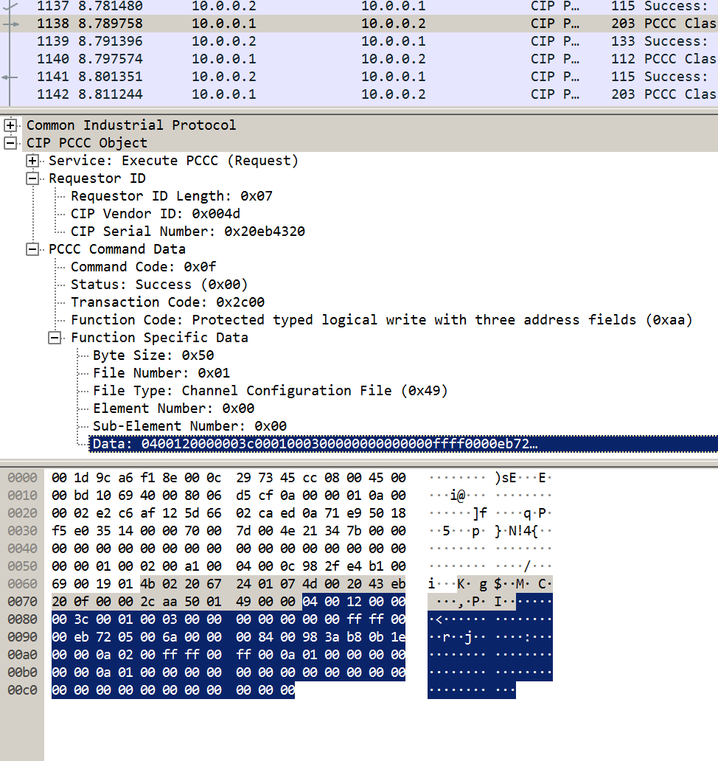
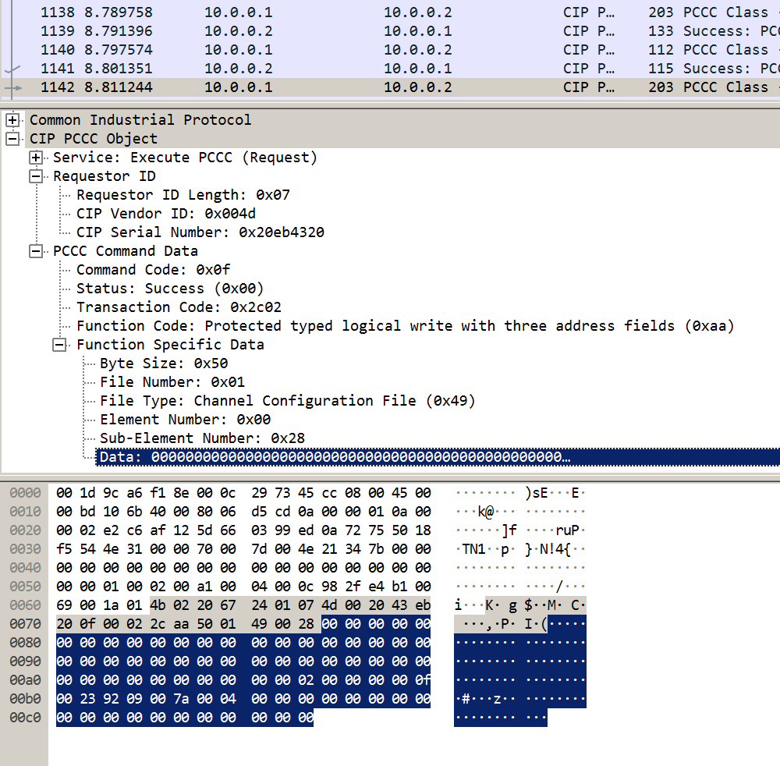
ENABLING SNMP – WRITE CONFIG

Slide 24
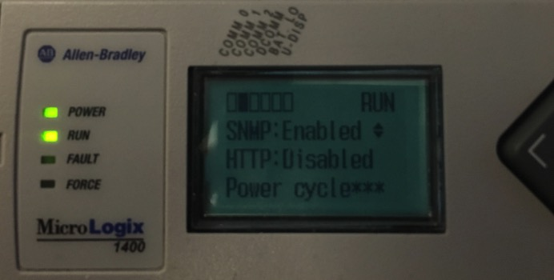
ENABLING SNMP – SUCCESS INDICATOR
Advanced Settings
ENET Config
Protocol Setup
ESC
Notes:
Time: 1minute
Notes:
Verification
Can check on the PLC screen itself
Navigate using the keypad throught the following menus
Physical ESC key
‘Advanced Set’ menu
‘ENET config’ menu
‘Protocol Setup’ menu
Notice that ‘SNMP’ now has the ‘Enabled’ message flashing
Also will contain the ‘Power Cycle***’ message at the bottom
This indicates that the change was made to the channel configuration file
But a reboot is necessary before the service actually gets enabled

Slide 25
REBOOTING THE PLC
Notes:
Est Time Marker: 16 minutes
Time: 10s
Notes:
Quickly transition

Slide 26
REBOOTING THE PLC - REASONS & REQUIREMENTS
Reasons
Requirements
Required to Fully
Enable SNMP
No Keyswitch Requirement
Firmware Version 21.003 or below
No User Accessible Reboot Functionality
ENIP Enabled
Notes:
Time: 1 minutes
Notes:
Reasons
As shown earlier
Need to reboot to make the device fully enable the service
No documented reboot functionality to leverage
Requirements
Using the method we found
No requirement on keyswitch mode
This means the device can be in RUN mode
Requires firmware version 21.003 or below
The newest during our research
EtherNet/IP enabled
Default configuration

Slide 27

REBOOTING THE PLC – BASIC FUZZING
Notes:
******* need a segway slide
Time: 3 minutes
Notes:
Attempt some Basic fuzzing
Piping /dev/urandom directly to the device on port 44818
Surprisingly works after a while
Couldn’t consistently reproduce
Crash still occurred
Sometimes it took a couple seconds
Sometimes it took over an hour
Got lucky and had wireshark running one of the times it crashed in a couple seconds
Replayed the capture and was able to reproduce every time
after discovery, cropped the packet to find the affecting bytes
replaced all irrelevant bytes with nulls for easier reading

Slide 28
REBOOTING THE PLC – E8FF CRASH
TCP Data
00 | 00 | E8 | FF | 00 | 00 | 00 | 00 | 00 | 00 | 00 | 00 | 00 | 00 | 00 | 00
00 | 00 | 00 | 00 | 00 | 00 | 00 | 00
Notes:
Time: 2 minutes
Notes:
Simple case shown above
Any two bytes to start the packet
The bytes ‘0xE8 0xFF’
Any 20 bytes to finish the packet
Emphasis on the third and fourth byte – highlighted in orange
I’ll refer to this crash as the E8FF crash throughout the rest of the talk as its is the most consistent part of the crash

Slide 29
REBOOTING THE PLC – E8FF CRASH
TCP Data
00 | 00 | 00 | 00 | 00 | 00 | 00 | 00 | 00 | 00 | 00 | 00 | 00 | 00 | 00 | 00
00 | 00 | 00 | 00 | 00 | 00 | 00 | 00 | 00 | 00 | 00 | 00 | 00 | 00 | 00 | 00
00 | 00 | 00 | 00 | 00 | 00 | 00 | 00 | 00 | 00 | 00 | 00 | 00 | 00 | 00 | 00
00 | 00 | E8 | FF | 00 | 00 | 00 | 00 | 00 | 00 | 00 | 00 | 00 | 00 | 00 | 00
00 | 00 | 00 | 00 | 00 | 00 | 00 | 00
Notes:
Time: 1 minutes
Notes:
Complex case shown above
Any amount of 24-byte blocks of null characters
Followed by
The simple case
During testing we discovered additional cases that also cause the crash
Any amount of 24 null byte character groups before the crash block will also cause the crash
When doing this the preceding bytes MUST be null

Slide 30
REBOOTING THE PLC – E8FF CRASH
SNMP Change Queued
E8FF Crash
SNMP Back To Default
Notes:
Time: 1 minute
Notes:
Crash successfully triggers a reboot
Crash also takes away the changes we made to the Channel Configuration File
Unsure why

Slide 31
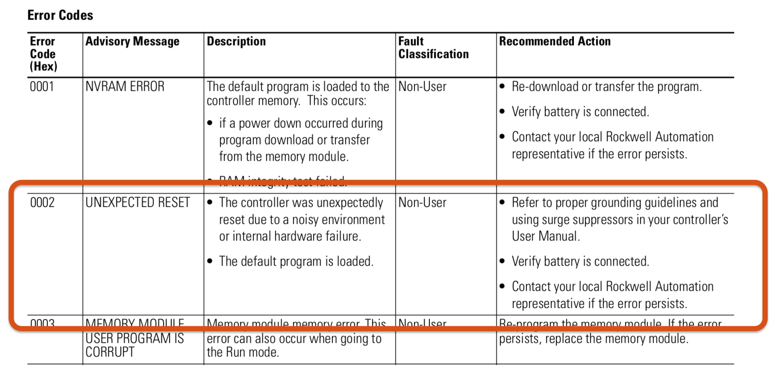
REBOOTING THE PLC – E8FF CRASH
MicroLogix 1400 Programmable Controllers Instruction Set Reference Manual - Appendix C
Notes:
Time: 1 minute
Notes:
Did some looking into the type of fault that is caused when this crash is triggered
Causes a fault with Error Code 0x02 – Unexpected Reset
This loads the default program
Default program
Not something that we have access to change during any normal operation
May be able to change it with malicious firmware, but not tested
Contains a blank project file with default configuration

Slide 32
REBOOTING THE PLC – E8FF CRASH
MicroLogix 1400 Programmable Controllers Instruction Set Reference Manual - Appendix C
Notes:
Time: 1 minute
Notes:
Did some looking into the type of fault that is caused when this crash is triggered
Causes a fault with Error Code 0x02 – Unexpected Reset
This loads the default program
Default program
Not something that we have access to change during any normal operation
May be able to change it with malicious firmware, but not tested
Contains a blank project file with default configuration

Slide 33
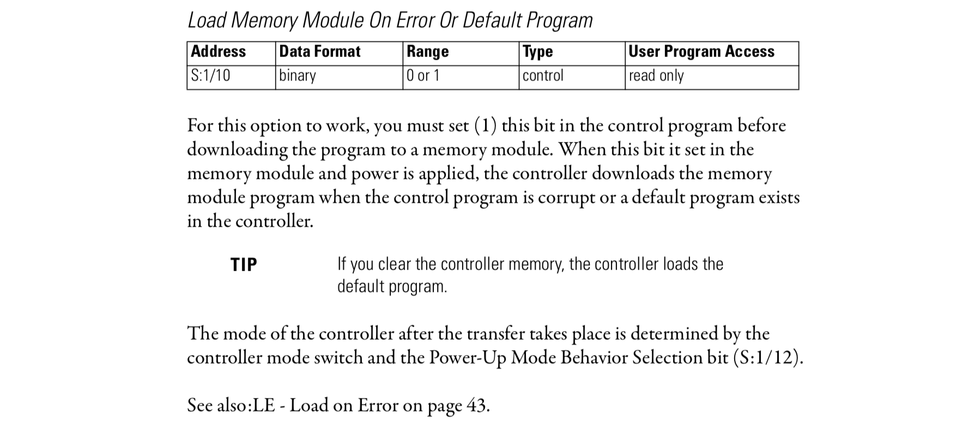
REBOOTING THE PLC – CRASH RECOVERY
MicroLogix 1400 Programmable Controllers Instruction Set Reference Manual - Appendix B
Notes:
Time: 1 minute
Notes:
Did some looking into ways to modify the default program
Found a way to load a stored program instead
By setting the bit S:1/10, the PLC is instructed to load its program from a memory module instead of from the default program
This allows us to control the post-crash program as long as we can control the memory module program

Slide 34
MEMORY MODULE
Notes:
Est Time Marker: 23:30 minutes
10s
Briefly introduce the section

Slide 35
MEMORY MODULE - REASONS & REQUIREMENTS
Reasons
Requirements
Storage Persistent
Through Crash
Keyswitch in REMOTE mode
Memory Module w/o Write-Protect
Location That Can
Restore Program
ENIP Enabled
Programming Routine
Notes:
Time: 1 minutes
Notes:
Reasons
Need to store our changes in a way that will persist across a device crash
Need that location to be somewhere that can restore after the crash
Requirements
This command requires that the PLC be in the REMOTE keyswitch mode
Programming mode
Talked about shortly
A memory module must be installed in the PLC
It must not be in Write-Protect mode
EtherNet/IP enabled
Default configuration

Slide 36
MEMORY MODULE – LOAD ON ERROR
PCCC Protected Typed Logical Write with Three Address Fields
CMD
Byte Size
FNC
TNS
File Number
File Type
Element Number
Config Data
Sub-Element Number
Load from Memory Module on Error
Byte Size: 0x02
File Number: 0x02
File Type: 0x84
Element Number: 0x00
Sub-Element Number: 0x01
Config Data: 0x0004
Function Code: 0xAA
Notes:
Time: 1 minute
Notes:
Triggered by a write to the Status file
File Number 0x02
File Type 0x84
forces the PLC to use the memory module program instead of the default
Requires the programming routine
By proxy requires REMOTE

Slide 37
MEMORY MODULE – WRITE NEW CONFIG
Programming Routine
Get Edit Resource
Custom Configuration
Set CPU – REMOTE PROG
Execute Command List
Download Completed
Apply Port Configuration
Return Edit Resource
Notes:
Time: 1 minute
Notes:
Some commands require elevated privileges to execute
This includes most commands that write configuration information
Enabling SNMP in the Channel Configuration interestingly does not fall into this category
To go through this routine, the PLC must be in a programming mode
PROG would work, but the chances of that are minimal
Using REMOTE in this example
Setup Commands
Change the CPU into a programming state like REMOTE PROG
Run the ‘Execute Command List’ command
Run the ‘Get Edit Resource Command’
Custom Commands
If the three commands above were successful
Can send as many commands as necessary
Any commands can be sent here – not only ones that require escalated privleges
Confirm Commands
Run the ‘Download Completed’ command
Run the ‘Apply Port Configuration’ command
Run the ‘Return Edit Resource’ command

Slide 38
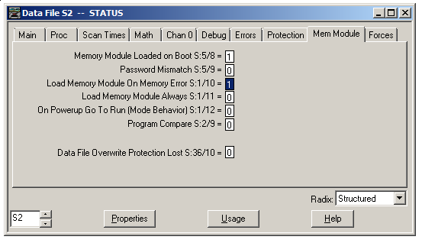
MEMORY MODULE – CONFIG VERIFICATION
Notes:
Time: 1 minute
Notes:
If everything was successful
Can check the PLC’s Status file via RSLogix
Verify that the ‘Load Memory Module on Memory Error’ bit is set to 1

Slide 39
MEMORY MODULE – STORE PROGRAM
PCCC
CMD
Data
FNC
TNS
Store to Memory Module
Data: 0x01000000
Function Code: 0x58
Notes:
Time: 1 minute
Notes:
Once the program has been successfully updated
Issue the command to store the existing program to the PLC’s memory module

Slide 40
ATTACK SO FAR
Notes:
EST Time: 27 min
Briefly introduce the section

Slide 41
ATTACK SO FAR
Patched Device
Modify Channel Configuration File
Enable Load from Memory Module on Error
Store to Memory Module
Crash the device
Patched Device with SNMP Fully Enabled
Notes:
Time: 1 minute
Notes:
Recap
Started with a patched device
Modified the channel configuration file to partially enable SNMP
Set the program to allow loading from a memory module when an error is encountered
Stored the new program to a memory module
Crashed the device with a bad packet
Waited for the device to reboot
Ended with a device that has SNMP fully enabled

Slide 42
MODIFIED FIRMWARE
Notes:
EST Time: 28
10s
Briefly introduce the section

Slide 43
MODIFIED FIRMWARE - CREATION
Notes:
******** ADDRESS THE TECHNICAL STEP BACK
Time: 4 minutes
Notes:
With SNMP fully enabled, we now have full ability to upload new firmware
Need to build custom firmware
Using Patrick DeSantis’ method for firmware creation from his DEFCON25 talk
series B only implements a checksum for error checking
can make any changes as long as the net change is zero
display images of the result when REMOTE is changed to HACKED

Slide 44
FLASHING FIRMWARE
Notes:
EST Time: 29
Briefly introduce the section

Slide 45
FLASHING FIRMWARE - SNMP BACKDOOR
root@kali:~# snmpwalk -c private -v 1 <ip_addr> .1.3.6.1.4.1.95
iso.3.6.1.4.1.95.2.2.1.1.1.0 = IpAddress: 0.0.0.0
iso.3.6.1.4.1.95.2.2.1.1.2.0 = ""
iso.3.6.1.4.1.95.2.2.1.1.3.0 = Hex-STRING: 00 00 00 00 00 00 00 00 00 00 00 00 00 00
iso.3.6.1.4.1.95.2.2.1.1.4.0 = Hex-STRING: 00 00 00 00 00 00 00 00
iso.3.6.1.4.1.95.2.2.1.1.5.0 = Hex-STRING: 00 00 00 00 00 00
iso.3.6.1.4.1.95.2.2.1.1.6.0 = INTEGER: 0
iso.3.6.1.4.1.95.2.2.1.1.7.0 = INTEGER: 0
iso.3.6.1.4.1.95.2.2.2.3.0 = INTEGER: 4
iso.3.6.1.4.1.95.2.3.1.1.1.1.0 = INTEGER: 1
iso.3.6.1.4.1.95.2.3.1.1.1.2.0 = INTEGER: 1
iso.3.6.1.4.1.95.2.3.1.1.1.3.0 = STRING: "public"
iso.3.6.1.4.1.95.2.3.1.1.1.4.0 = IpAddress: 0.0.0.0
iso.3.6.1.4.1.95.2.4.1.0 = STRING: "wheel"
iso.3.6.1.4.1.95.2.4.2.0 = STRING: "public"
iso.3.6.1.4.1.95.2.4.3.0 = STRING: "private"
End of MIB
root@kali:~#
Notes:
Time: 1 minutes
Notes:
Flashing firmware is conducted in three phases
Setup
Transfer
Flashing
The setup phase requires sending three SNMP write commands
1) Set the IP Address of the TFTP server
2) Set the name of the firmware file on the TFTP server
3) Reboot the device
NOTE: this is the same reboot we talked about earlier
All of these commands require use of a privileged SNMP Community string
Here we can leverage a backdoor string discovered by Patrick DeSantis in 2016
Still not patched

Slide 46
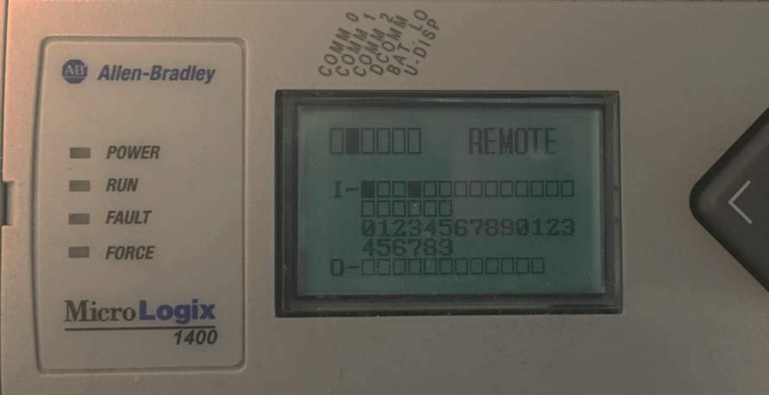
FLASHING FIRMWARE – SNMP REBOOT
root@kali:~# snmpset -c wheel -v 1 <ip_addr> .1.3.6.1.4.1.95.2.3.1.1.1.1.0 i 2
Notes:
Time: 2 minutes
Notes:
First method for a reboot that we discovered
When a device is going through a firmware update we noticed that the device reboots
Investigated what traffic is sent when a firmware update is requested
Will discuss the entire process later
One message was of particular interest
A write to the OID shown above
Value integer 2
Causes the device to reboot
If none of the other information for a firmware update is sent the device will reboot without entering the firmware update cycle
Command above leverages an undocumented privileged community string disclosed by Patrick DeSantis in TALOS-2016-0184

Slide 47
FLASHING FIRMWARE – SNMP REBOOT
Reboot required to enable SNMP
SNMP required to reboot device
Notes:
Time: 1 minute
Notes:
Did not end up working for our purposes as it created a catch 22
Still useful if SNMP is already enabled and we want to enable a different service
Requires the device be in PROG or REMOTE mode
Comment on the contradiction from the slides before
Required us to keep looking

Slide 48
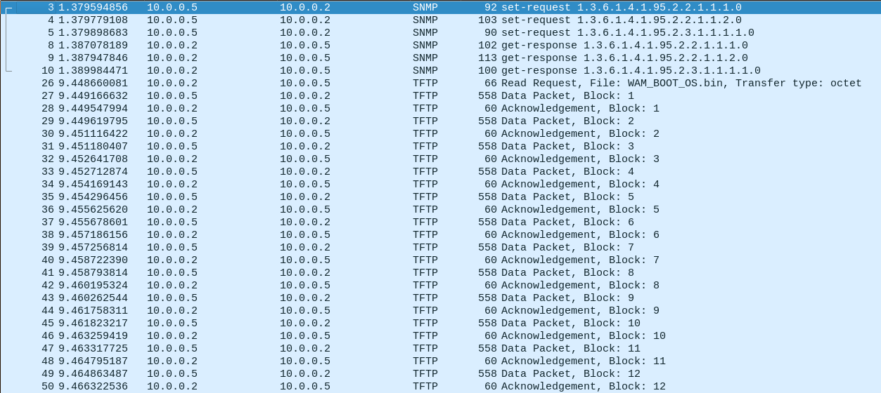
FLASHING FIRMWARE - TFTP
Notes:
Time: 1 minutes
Notes:
Once a reboot is triggered, the PLC reaches out to the defined TFTP server requesting the desired file
TFTP server must be accessible
File must exist and be readable
If all conditions are met, the PLC starts downloading the new firmware file
Once the transfer has completed, integrity checks are calculated

Slide 49
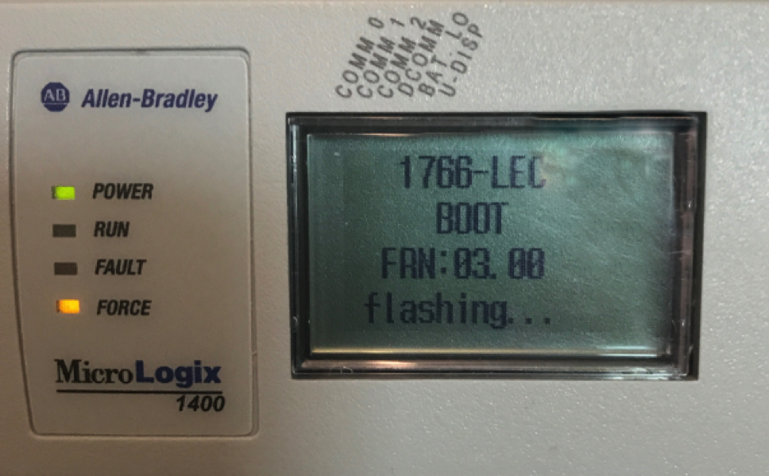
FLASHING FIRMWARE – UPDATE PROCESS
Notes:
Time: 1 minutes
Notes:
If the integrity checking passes, the device will move on to the flashing stage
This can be verified by the screen shown here displaying on the PLC
If the operation succeeds, the PLC will reboot once more

Slide 50
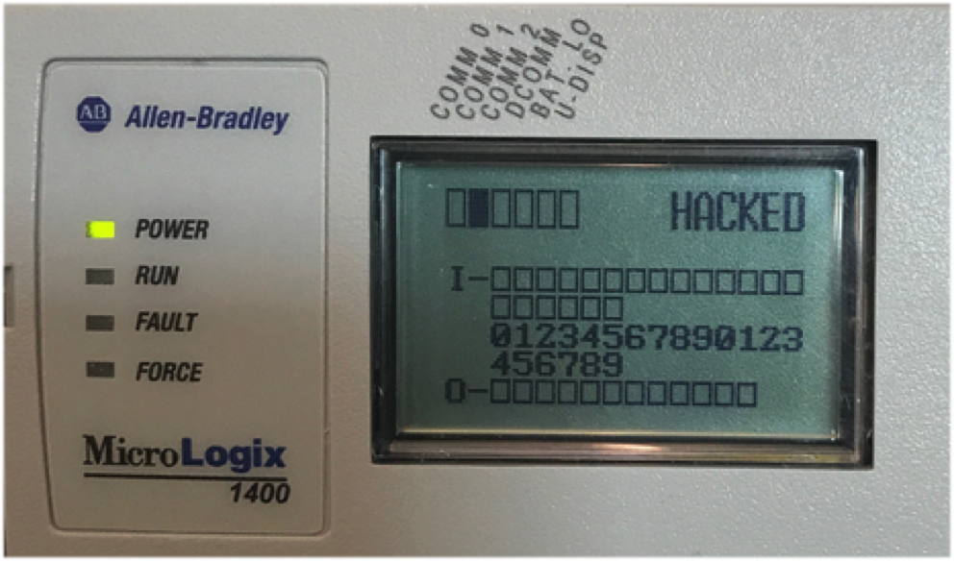
FLASHING FIRMWARE – SUCCESS
Notes:
Time: 1 minutes
Notes:
When the PLC comes back up, the new firmware will be running
Shown in the example above with the label ‘HACKED’ in place of the previous ‘REMOTE’

Slide 51
DEMO
Notes:
EST Time: 31

Slide 52
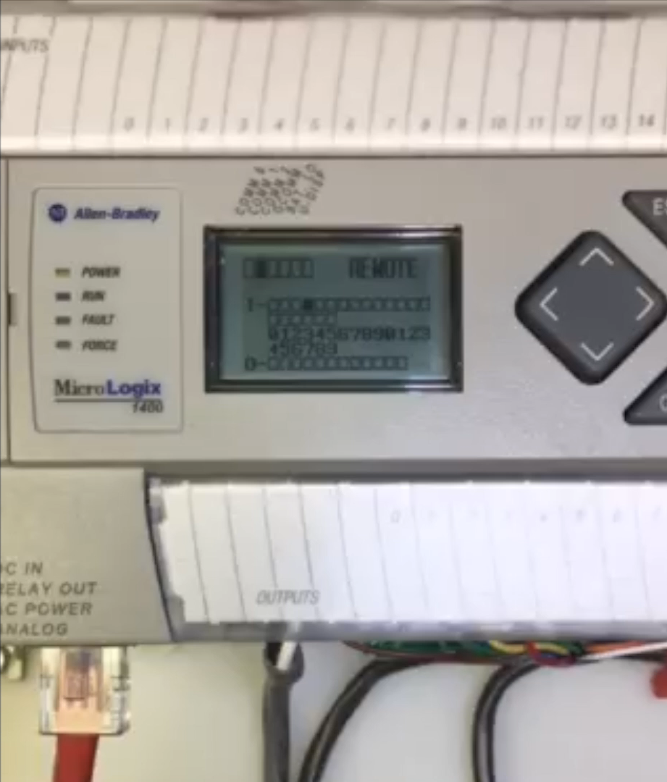

Slide 53
IMPACT
Notes:
EST Time: 33 minutes
10s
Briefly introduce the section

Slide 54
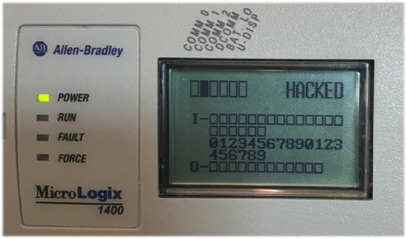
IMPACT
Important to remember the modification was made at the firmware level
Consequential changes are possible via this strategy with enough time/money
“… you can’t really tell if the logic running on the controller is what you uploaded …” – R. Wightman about TRISIS @ S4x18
Notes:
Time: 8 minutes
Notes:
No secret that just changing the text for a state doesn’t affect the operation of the device
We need to understand the broader implications of how that change was made
Any piece of the firmware could have been changed
Ranging from
other minor display changes
Modified code executed before runtime
with enough time and money this strategy could be used for consequential changes
Taking it a step further
if the checksum is determined our strategy wouldn't be necessary anymore
Reid Wightman made a comment at S4x18
… you can’t really tell if the logic running on the controller is what you uploaded …”
He was talking about the TRISIS situation, but the comment stuck with me
Since we control the firmware completely we are capable of making it do whatever we want
Including lie to its operators
After all it’s a computer at the end of the day

Slide 55
MITIGATION
Notes:
EST Time: 34:30
10s
So, how do we fix it

Slide 56
MITIGATION – RECOMMENDATIONS
Keyswitch RUN mode
Firmware Version >= 21.004
Follow proper network segmentation practices
Monitor your network for suspicious activity
Notes:
Time: 1 minute
Notes:
Standard recommendations
Make sure your device is left in the RUN keyswitch mode at all times when not being programmed
Follow proper network segmentation practices
Monitor network for suspicious activity
Apply firmware version 21.004 or newer to your MicroLogix 1400

Slide 57
MITIGATION – SPECIAL RECOMMENDATIONS
Successful in Keyswitch RUN
Enable SNMP Setting (CVE-2017-14462)
E8FF Crash (CVE-2017-12088)
Device Fault (CVE-2017-14470)
Read Ladder Logic (CVE-2017-14472)
Read Master Password (CVE-2017-14473)
Enable Write-Protect on memory modules
Enable Snort Rules 44419 through 44429
Notes:
Time: 2 minutes
Notes:
Special Recommendations
Enable Write-Protect on any memory module in use
This will prevent any future writes
Make sure the program is correct, however, as only 1 write is possible
Enable SNORT sids above
These will detect and alert on additional vulnerabilities discovered that do not require the keyswitch to be in REMOTE

Slide 58
RESOURCES
Notes:
EST Time: 36

Slide 59
ADDITIONAL RESOURCES
Talos IDs
TALOS-2017-0440
- through -
TALOS-2017-0445
Contact
jared.rittle@cisco.com
@talossecurity
blog.talosintelligence.com
Snort Coverage
SID 44419
- through -
SID 44429
Wireshark Dissector
github.com/wireshark/wireshark/blob/master/epan/dissectors/packet-cip.h
White Paper
talosintelligence.com/resources/62
Relevant Blog Posts
blog.talosintelligence.com/2018/03/ab-micrologix-1400-multiple-vulns.html
blog.talosintelligence.com/2016/08/rockwell-snmp-vuln.html
Notes:
End time : 37

