Slide 1

Adversarial Modeling Exercises Simulation
aka: Some new term to use because we keep screwing up terminology and treating people like children
with a crayon box

Slide 2


Slide 3


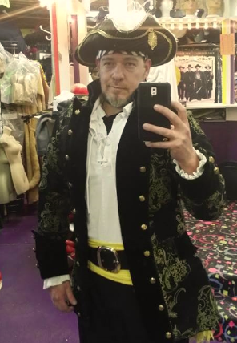
HI…I’m Chris

Slide 4
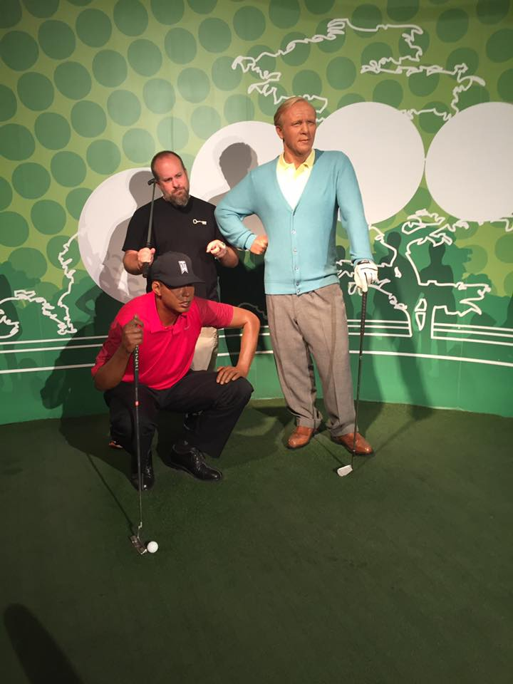
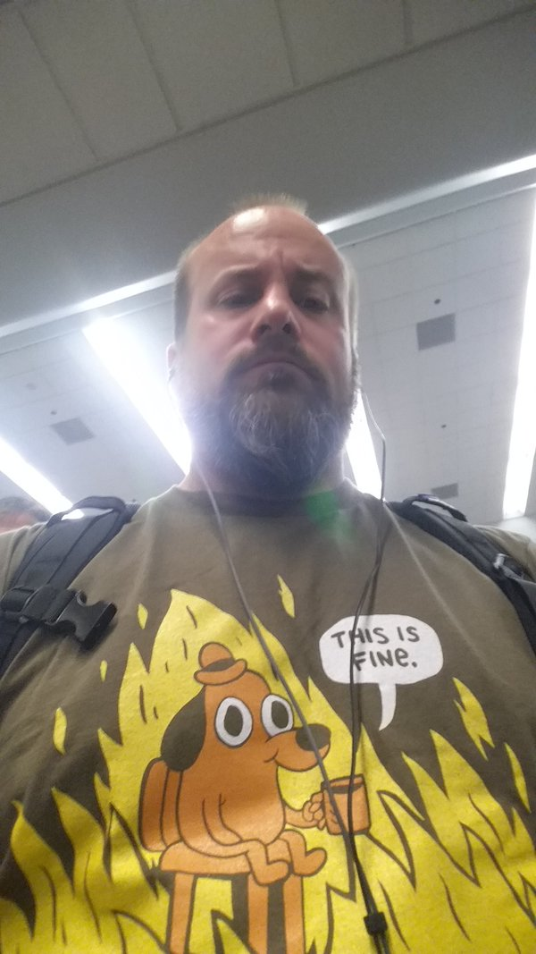
and…I’m Chris

Slide 5


Slide 6
Trigger Warnings
Cursing
Racism
Religious Prejudice
Sex
Drugs
Daddy / Abandonment issues
Socio Economic Hate crimes
Thin Skin
Lack of sense of humor
Sexual orientation
Sexism
Violence
Vomiting
Abuse
Truth
Fear
Honesty
Facts
Emotions
Opinions

Slide 7
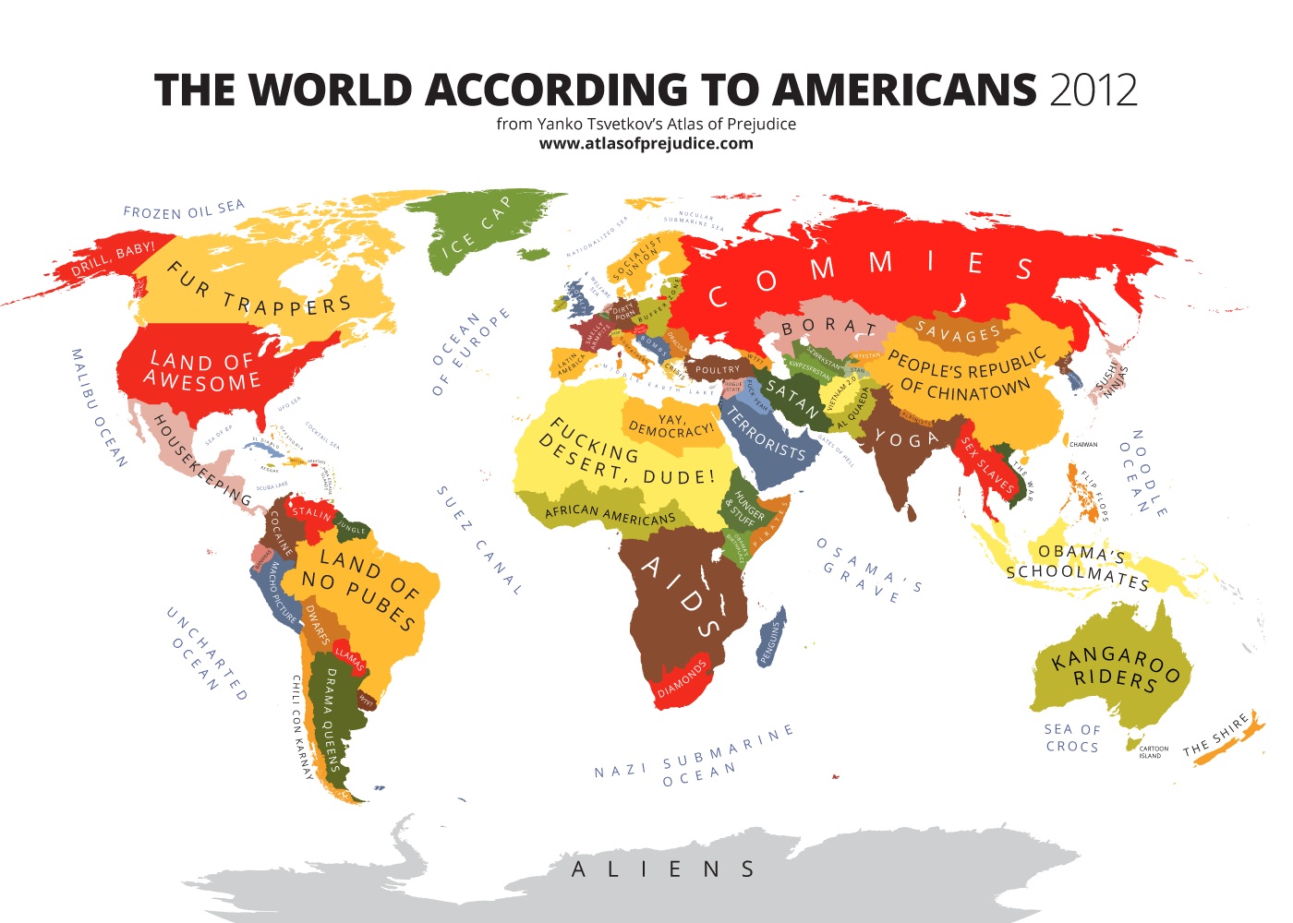

Slide 8











Slide 9





Chris Gates - Sr. Incident Response Engineer - Uber
Twitter: @carnal0wnage
Blog: carnal0wnage.attackresearch.com
Talks: slideshare.net/chrisgates

Slide 10


Slide 11
http://www.pentest-standard.org/

Slide 12

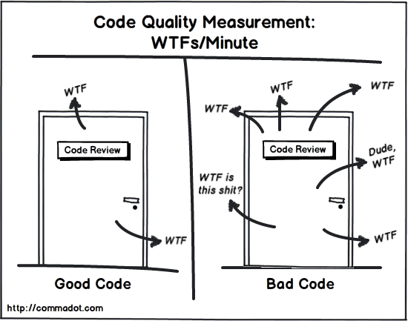
Notes:
Code review

Slide 13
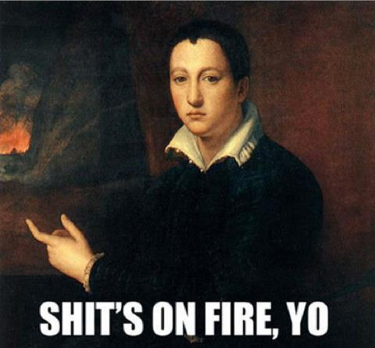
Notes:
Incident response

Slide 14

Notes:
Incident response

Slide 15

Notes:
Risk Assessment

Slide 16
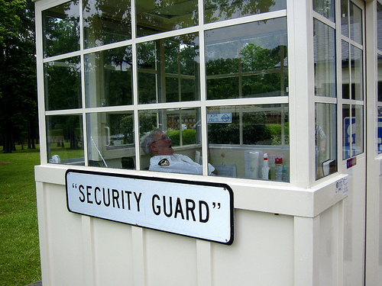
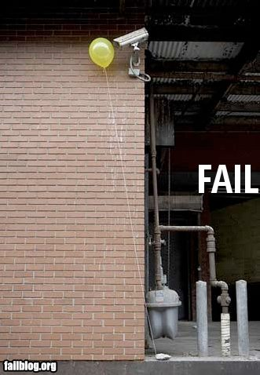
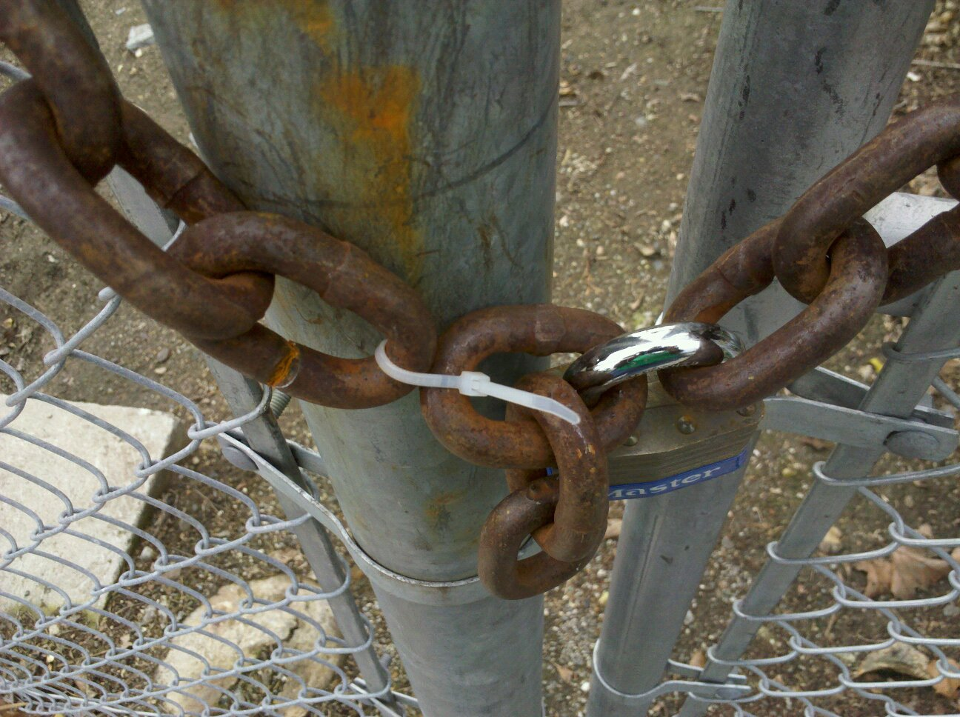
Notes:
Physical security

Slide 17
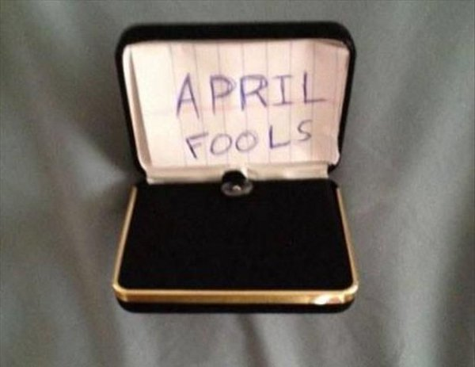

Slide 18
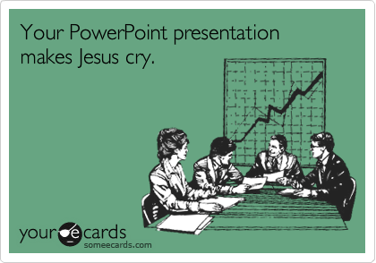
Notes:
To my stupid ppt

Slide 19
A story
Got Red Teamed at work
It was not fun
I’m usually the person bringing the pain, not receiving it
Tons of thoughts and emotions

Slide 20

A story
Initially

Slide 21
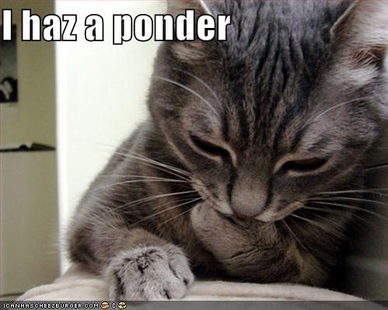
A story
Then… reflection

Slide 22
A story
Then… realization
I was probably that a$$hole on the phone
  Actually, I’m sure of it
Super difficult to give valid recommendations in a generic way
  I’m blind to internal processes, roadmaps, politics

Slide 23
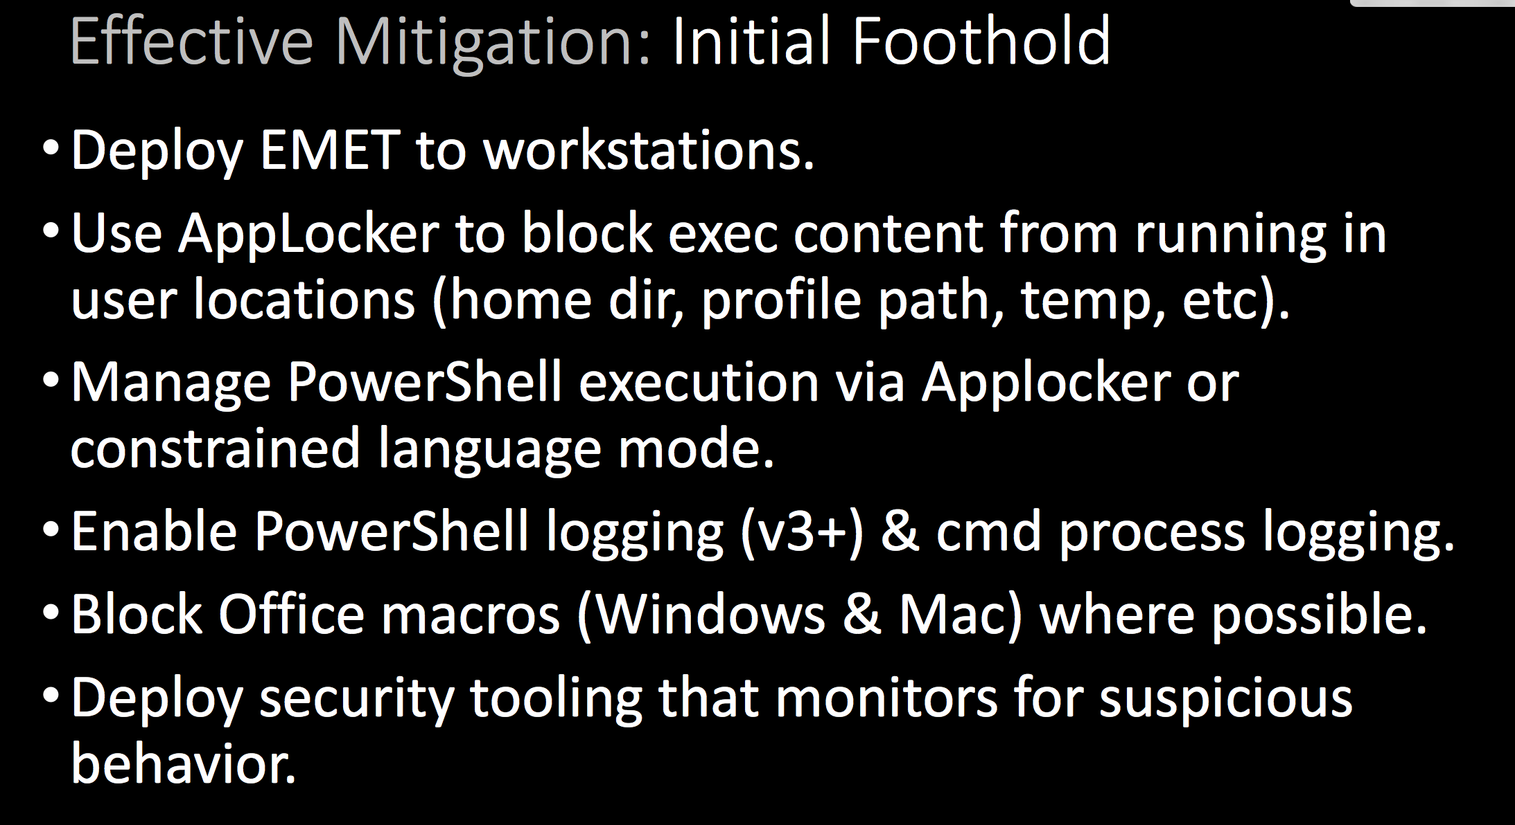
A story
We give recommendations like these:

Slide 24
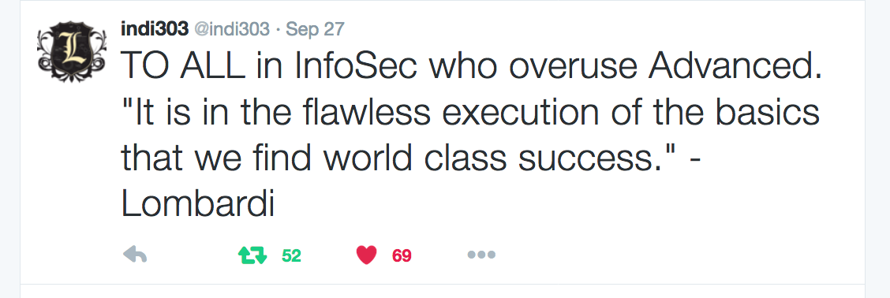
A story
Do a bunch of complex recommendations, then you’ll be “secure”
Most org fail at the basics, but basics aren’t sexy
  In fact tell an org they need to do a bunch of basic hardening and see if you get follow-on work

Slide 25


Slide 26
Problems With Testing Today
Limited metrics
Increased Tech debt
Fracturing of TEAM mentality
Looks NOTHING like an attack
Gives limited experience
Is a step above Vuln Assessment
Is NOT essential to the success of the organization
Is REALLY just a glorified internal pentest team

Slide 27
Building a successful internal Adversarial Simulation Team

Slide 28
Easy!
Standard players: (limited scope, limited flexibility)
Step #1: Get people who can do the hack
Step #1.5: Complain about the scope
Step #2: Hack all the things!
Step #3: Write up stuff to tell people why the hax iz bad.
Advanced players: ( increased scope and flexibility)
Step #4: Tell Defense Team how u did hax
Step #5: Defense team does defensive’y stuff or blames team that refuses to patch the thing
Step #6: repeat
Notes:
Dat roadmap yo
#value

Slide 29


Slide 30
Terminology:
Gotta get a few things straight first
We keep screwing up terms
  Vulnerability Assessment person ( U ran a Vuln scanner?)
  Penetration Tester ( U hit autopwn)
  Red Teamer ( U hit autopwn and moved laterally? Maybe even found “sensitive stuff”)
  Purple Teamer (U did all of the above but charged more to talk with the defense teams during the test)
  ADVERSARIAL ENGINEER (U exist to simulate real world TTP’s, generate experience, and provide metric scoring of corporate readiness/resistance to attack)

Slide 31
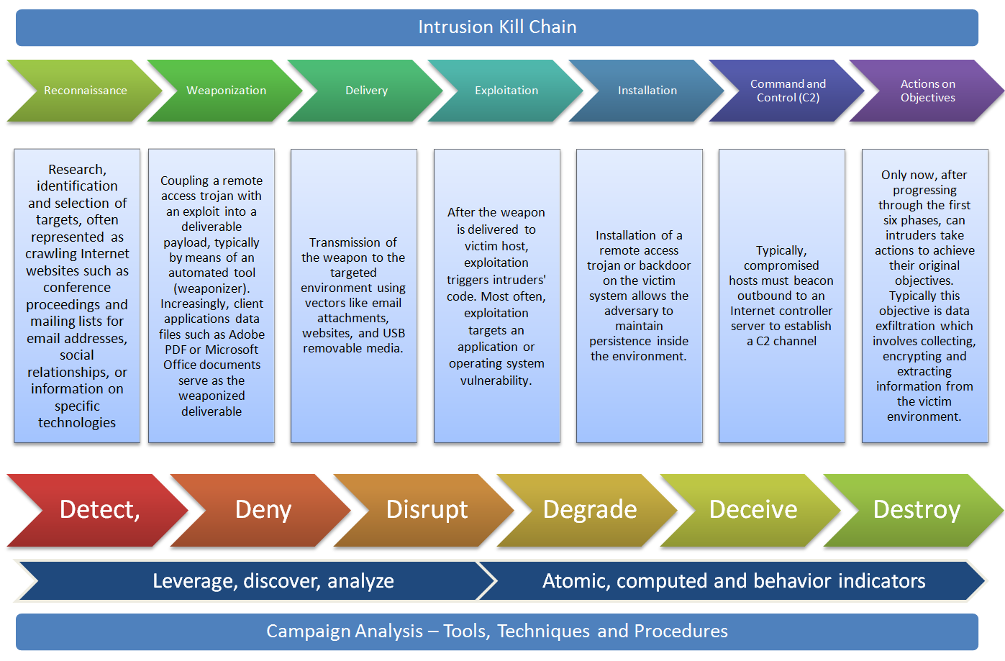

Slide 32
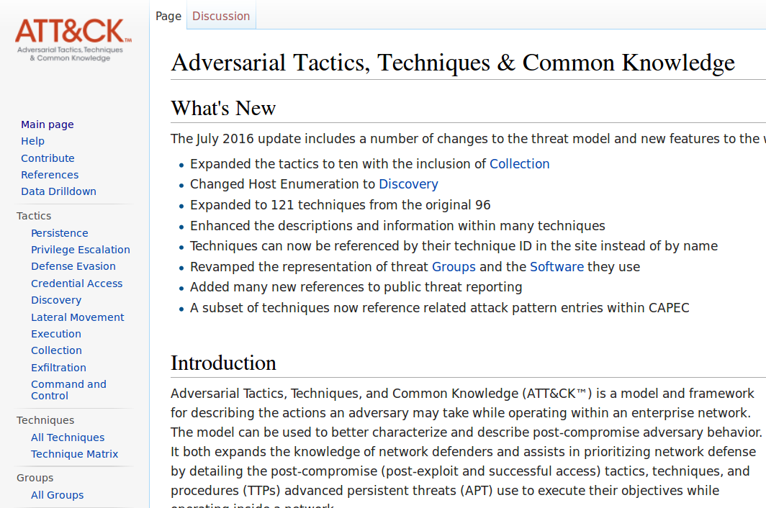
https://attack.mitre.org/wiki/Main_Page
Notes:
HAYDN
ATT&CK focuses on the latter half of the CKC, so it is a deep dive into post exploitation it also almost exclusively windows focused. So if we need OS X/linux you are gonna have to fill in the blanks yourself.. The other stuff is still important though. Again we want to stop this or at a minimum detect this as early in the chain as we can.
It is very recent, with an update as soon as July 2016.
Added more techniques, a few name changes
ATT&CK incorporates information on cyber adversaries gathered through MITRE research,as well as things like pentesting, red teaming etc. This keeps the post compromise information up to date.

Slide 33
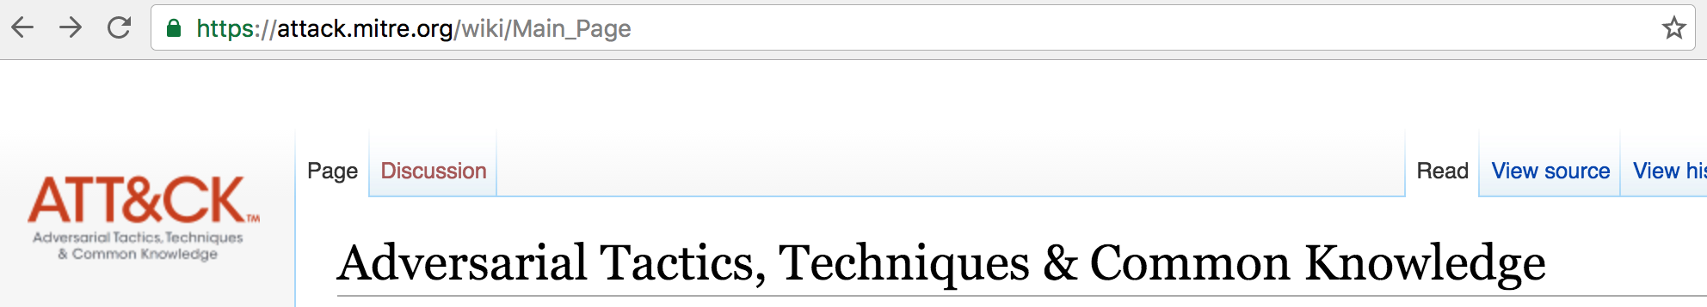
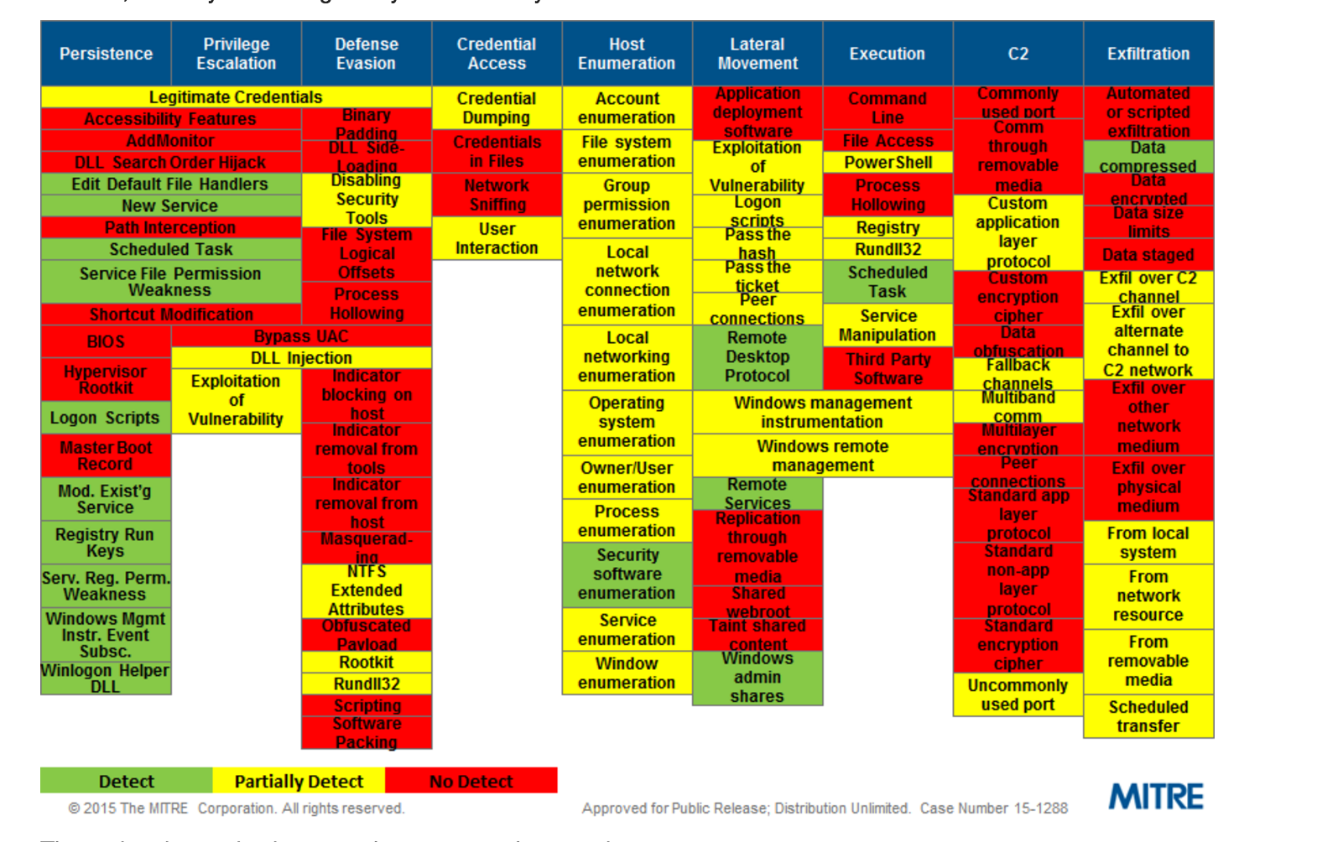
Notes:
Haydn
We want to get to where we are documenting our protection/detection assumptions. Then we can purple team then to validate.
You get a much better picture of all the different attack stages once inside your firewall. A great benefit is understanding the coverage of your defenses, the blind spots.
You have your persistence steps, these include things like accessibility features in windows, sticky keys. Clicking help and receiving a command prompt.
Having legitimate credentials. So with legitimate credentials, these help with persistence and also privilege escalation. So if you can protect credentials better you are limiting the attackers ability on 2-3 fronts, persistence, privilege escalation and evading tools.

Slide 34


Slide 35

#1 You need a charter and a Problem statement

Slide 36
Charter
Analyze real world threats against $Company.
Develop attack models which validate our detection capabilities.
Validate our detection, prevention, and response against real world threats.
Provide metrics around $Company’s corporate readiness/resistance to various attacks across a broad set of threat tactics, techniques, and procedures (TTPs) via table top exercises, automated, and manual testing.
GOAL: Predict likelihood of successful attacks before they happen

Slide 37
#2 Define how you will accomplish solving the problem and how the team will get/consume projects

Slide 38
Notes:
Blue team should feel that engaging the red team is enabling hem, not causing more work for blue. Use the red team to validate the blink box works
Blue team gets RT to check how their own shit is working

Slide 39
#3 Create a repeatable strategy for execution of simulations

Slide 40
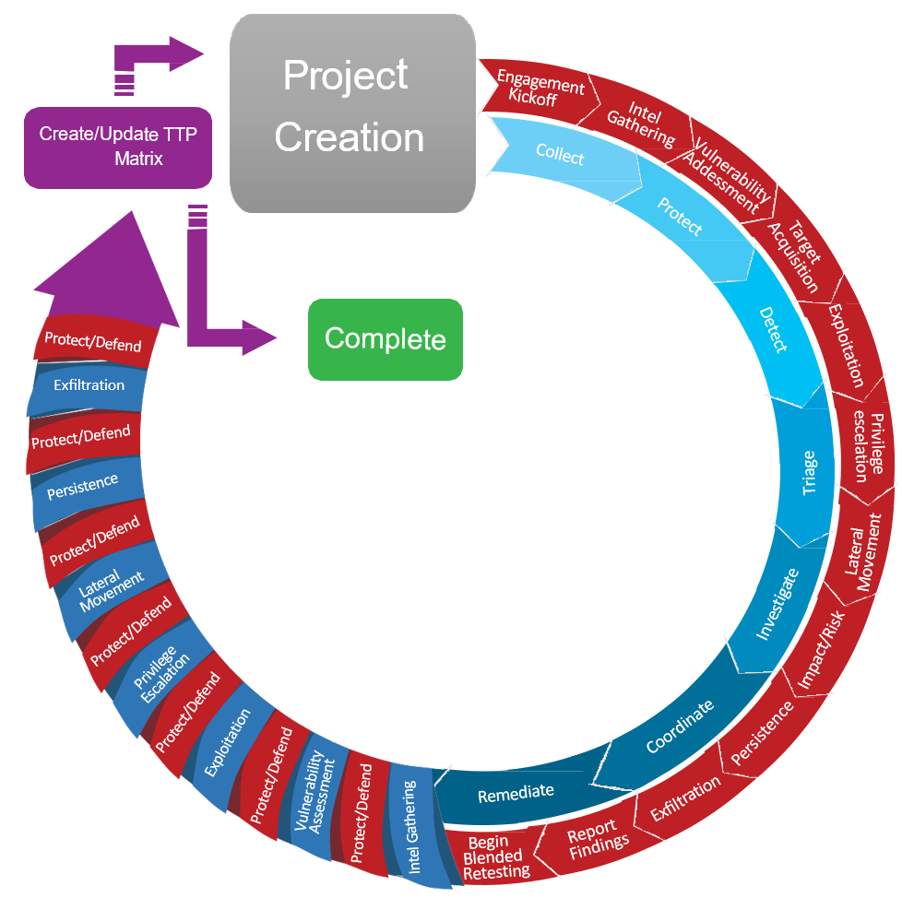

Slide 41
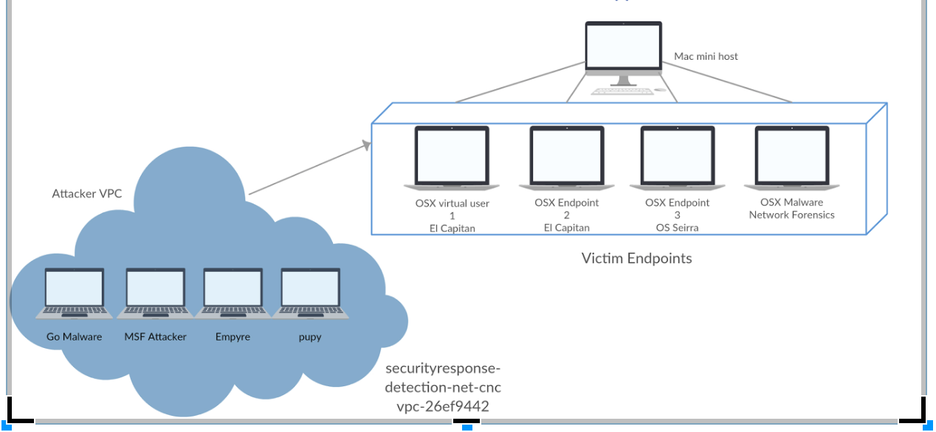
Notes:
You could build a detection network to test instrumentation then do **something** with those rules

Slide 42
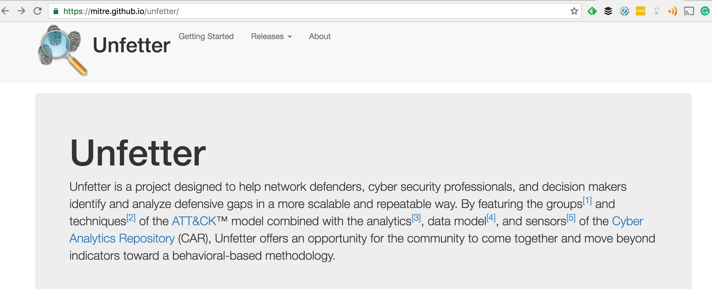
Unit testing for you detection rules
  You don’t deploy untested code to prod do you?
Automate attacks and verify responses

Slide 43
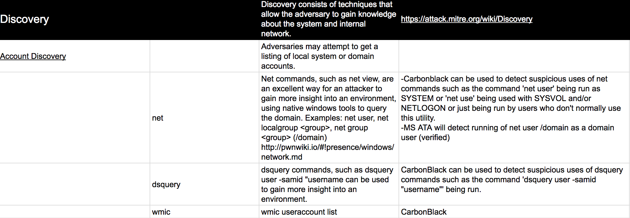
  Example

Slide 44
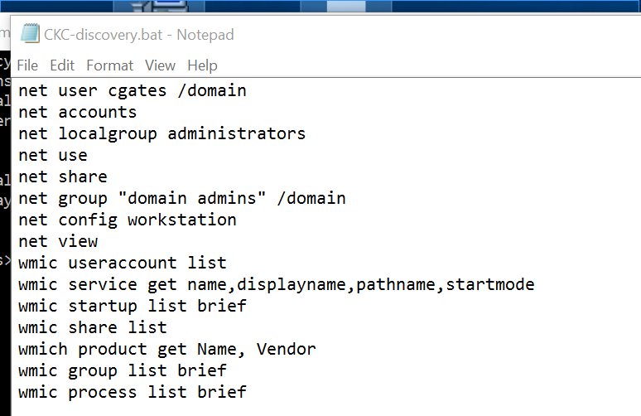
  Example

Slide 45
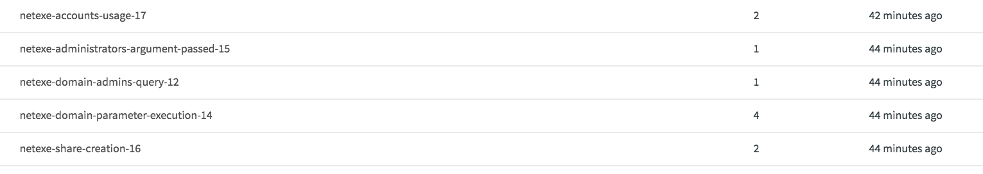
  Example

Slide 46

#4 Creation of an information sharing platform and knowledgebase

Slide 47
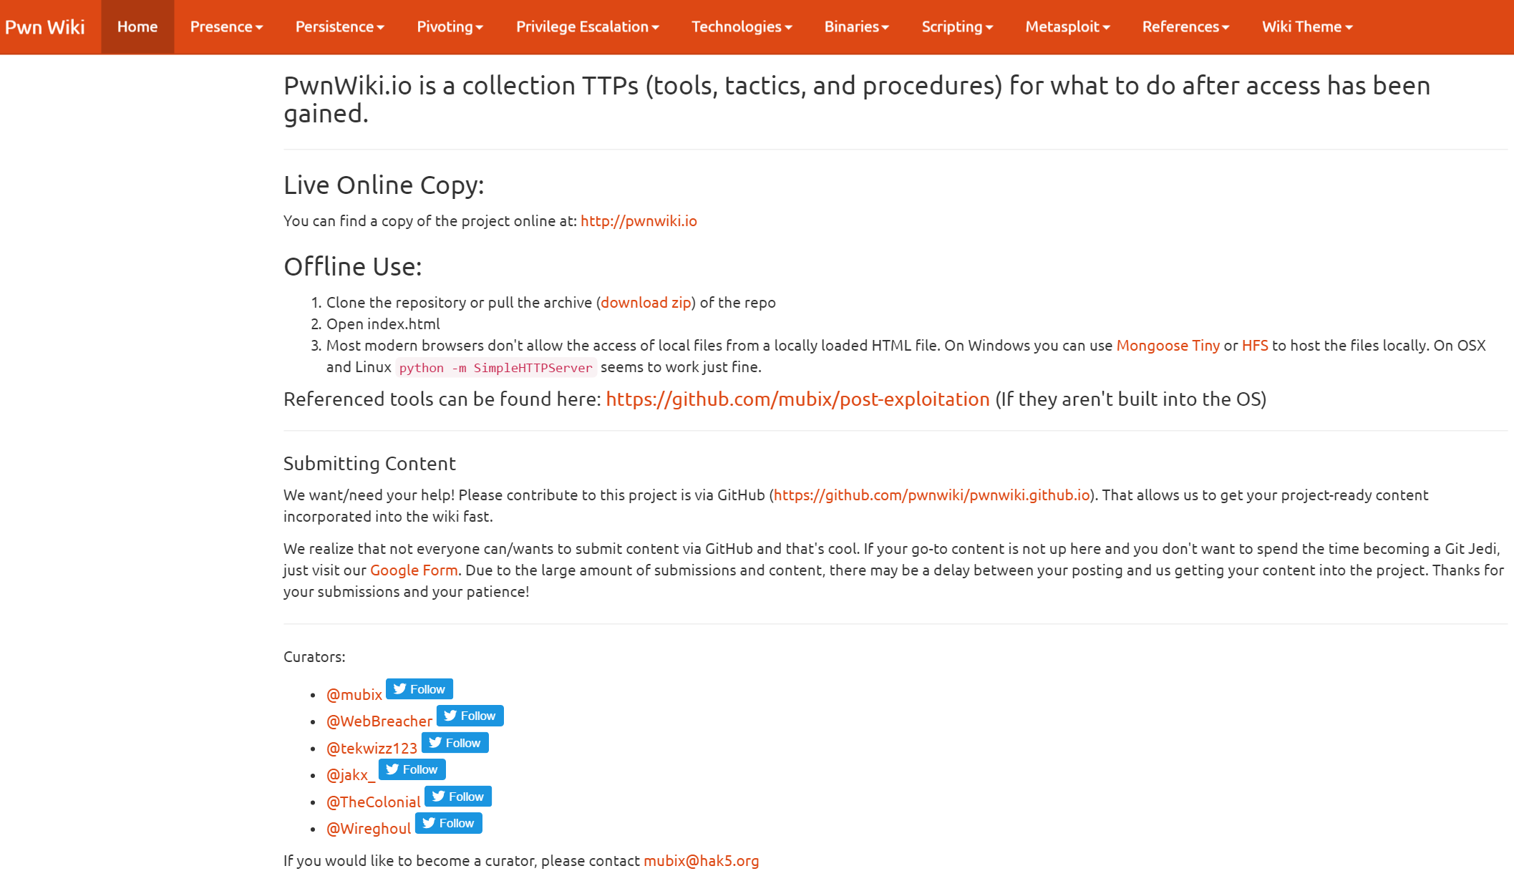
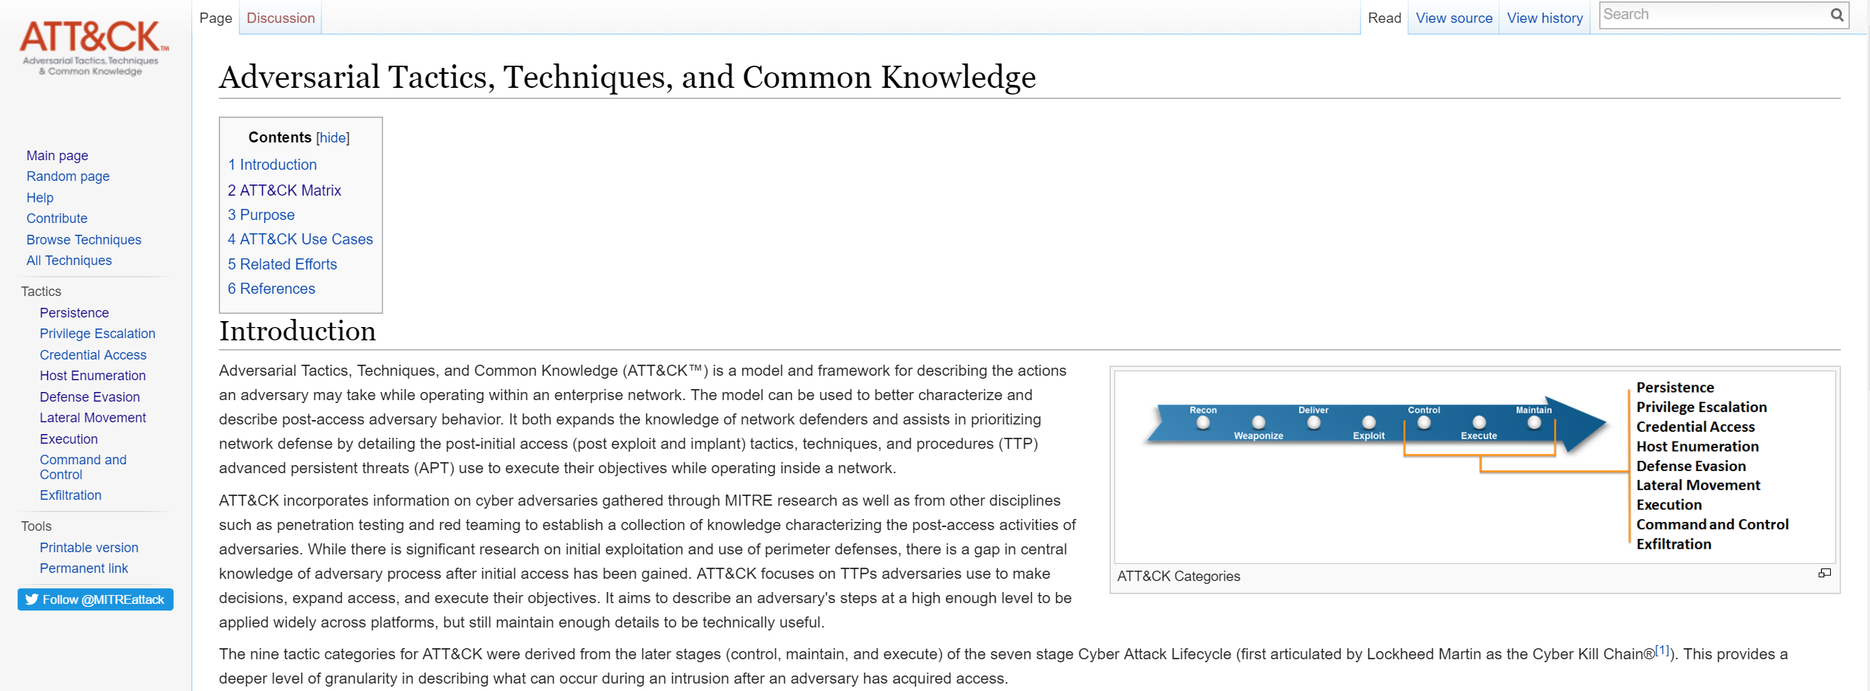

Slide 48
#5 Assemble your team and tools
Think ahead, This is not your normal pentest team!
Servers
Storage
Hardware
Tools
Implants
Customizations
Virtualization infrastructure
Access to all defensive tools
Built out lab environments to recreate / replicate
Cracking Rigs and more…

Slide 49
#6 Create formal collateral
Introduction of the team and it’s capabilities
Services Line Card
Engineering bios and availability
Scoping documentation/questionnaires
Rules of engagement
Internal information handling policy, procedure, process
Engagement request process
Defensive Team Collaboration Workflow
Threat Intel Team Collaboration Workflow
Approval notification Protocols
Templated / Automated reporting output
Team Member Skill matrix

Slide 50
#7 Defensive Coverage Assessment

Slide 51
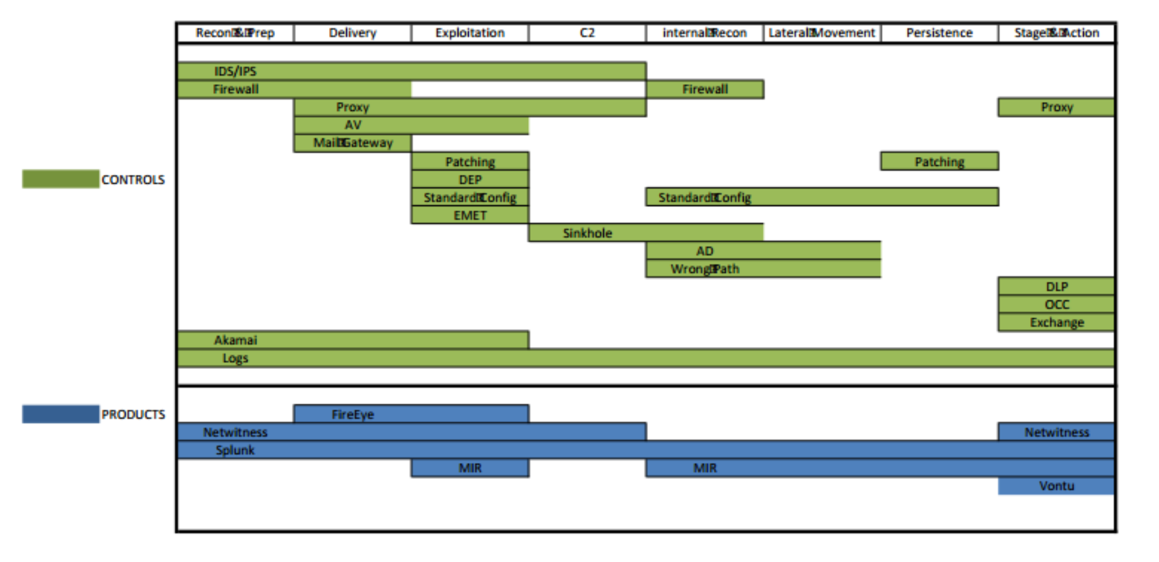

Slide 52
#8 Provide Metrics that evaluate each TTP from a protective, detective and response perspective

Slide 53
Color Key: | Detection Maturity | Protection Maturity
0 | No Detection Controls | No Protection Controls
1 | Non-Centralized Logging | Partially Deployed
2 | Centralized Logging, but no Alerts | Fully Deployed but Defeatable
3 | Centralized Logs, Reactive, Insufficient Alerts, false negatives or positives (Functional) | Fully Deployed, Non-Defeatable
4 | Centralized, Automated Alerts, Proactive, Requires response, no false positives (Stable) | Fully Deployed, Non-Defeatable, and Alerting in place

Slide 54
Technique | Function | Methods for detection | Methods for protection | Detection | Maturity | Protection | Maturity | Last Test Date
LSASS password/hash recovery | Local Security Authority Subsystem Service (LSASS) is a process in Microsoft Windows operating systems that is responsible for enforcing the security policy on the system. It verifies users logging on to a Windows computer or server, handles password changes, and creates access tokens. (from Wikipedia) For the purposes of Single Sign On (SSO) in Windows environments, lsass also stores the NT hash and sometimes, in the case of wdigest, the cleartext credentials of users who have logged into the system. These can be recovered by dumping the contents of the process in memory through use tools such as procdump and mimikatz. | The most optimal way to detect this is to identify processes that are crossproc'd into lsass. The signal to noise ratio here is high, due to the nature of lsass' function. Typically meterpreter uses rundll32 to run, so identifying rundll32 into lsass along with processes injected into winlogon that cross process into lsass will reliably identify malicious activity | An automated password management tool such as CyberArk can be used to randomize passwords and change them after every use, thus decreasing the efficacy of mimikatz as any recovered credential will likely be expired. Further, on all windows 8/2012+ desktops and servers, wdigest should be disabled in accordance with the following KB article from Microsoft: https://support.microsoft.com/en-us/kb/2871997 Enforcing the principle of Least User Access will also help mitigate the effectiveness of mimikatz as it will limit the access provided by the compromised credentials. Lastly, adding some form of Two Factor Authentication, such as smart cards, can further limit the usefulness of the recovered credentials. | Rules written in carbon black to detect cross process activity from rundll32 into lsass Rule written to identify PowerShell crossproc into lsass. Additional rule written to detect an injected process into winlogon with cross process activity into lsass . | 3 | 2FA (user-land only), some CyberArk usage, some credentials flushed every 24 hours | 1 | 4/7/2016

Slide 55
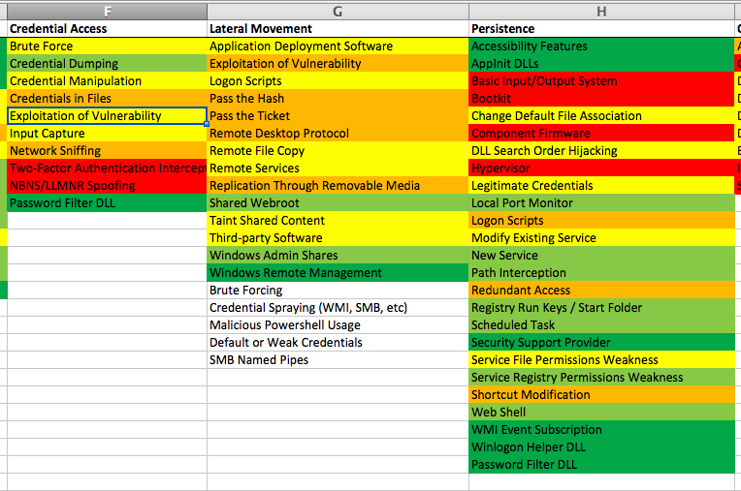

Slide 57
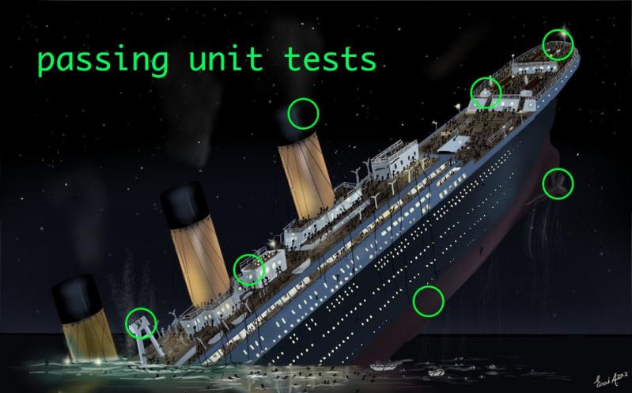

Slide 58
#9 Evaluate adversarial skill to determine urgency of simulation

Slide 59
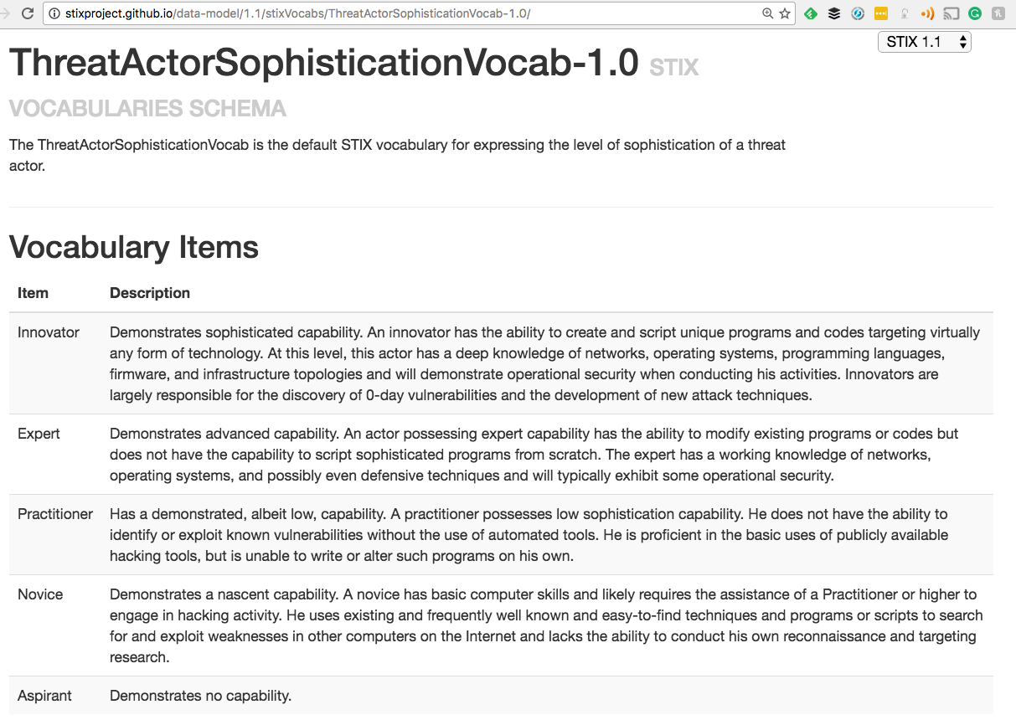
Notes:
Start A Fight

Slide 60

Notes:
Start A Fight

Slide 61
#10 Re-prioritize workload of Adversarial team based on TTP last test date (decay) or based on other external drivers (ex. TTP is used in a current attack campaign)

Slide 62
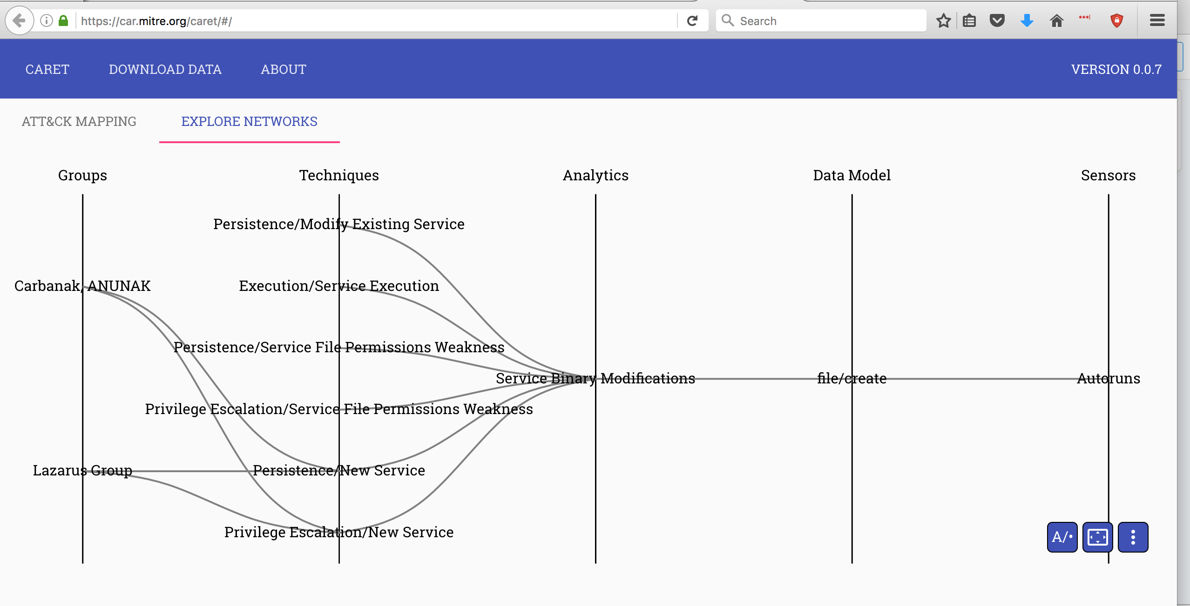

Slide 63
#11 Defensive Measurement
Now that we have measured RT ability to conduct attacks
Now we need to gather defensive metrics
Total Coverage
Mean Time to Detection
Mean Time to Remediation
  % Successful Eradication
Protection Metrics
Automated vs Manual Detection
Automated vs Manual Response
Notes:
Is the event logged at all?
Logged event != alert
Does alert == action taken?

Slide 64
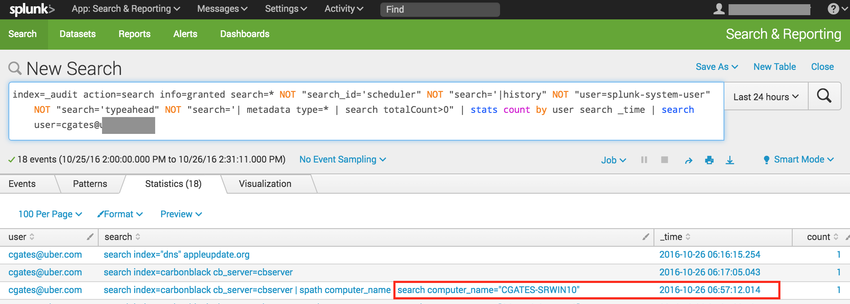

Slide 65
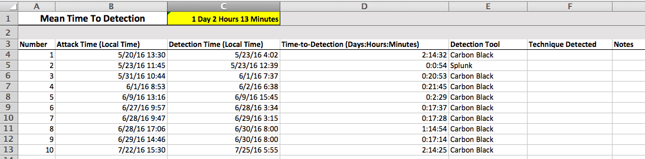

Slide 66
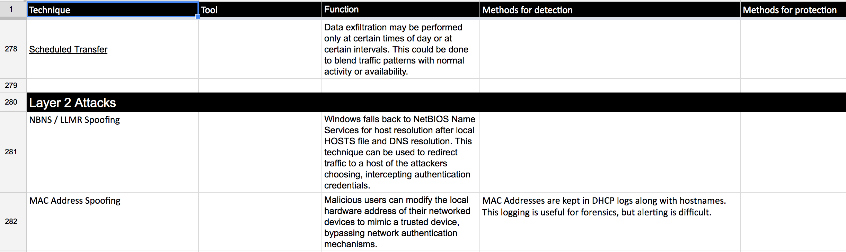

Slide 67
Adversarial Simulation Dashboard

Slide 68
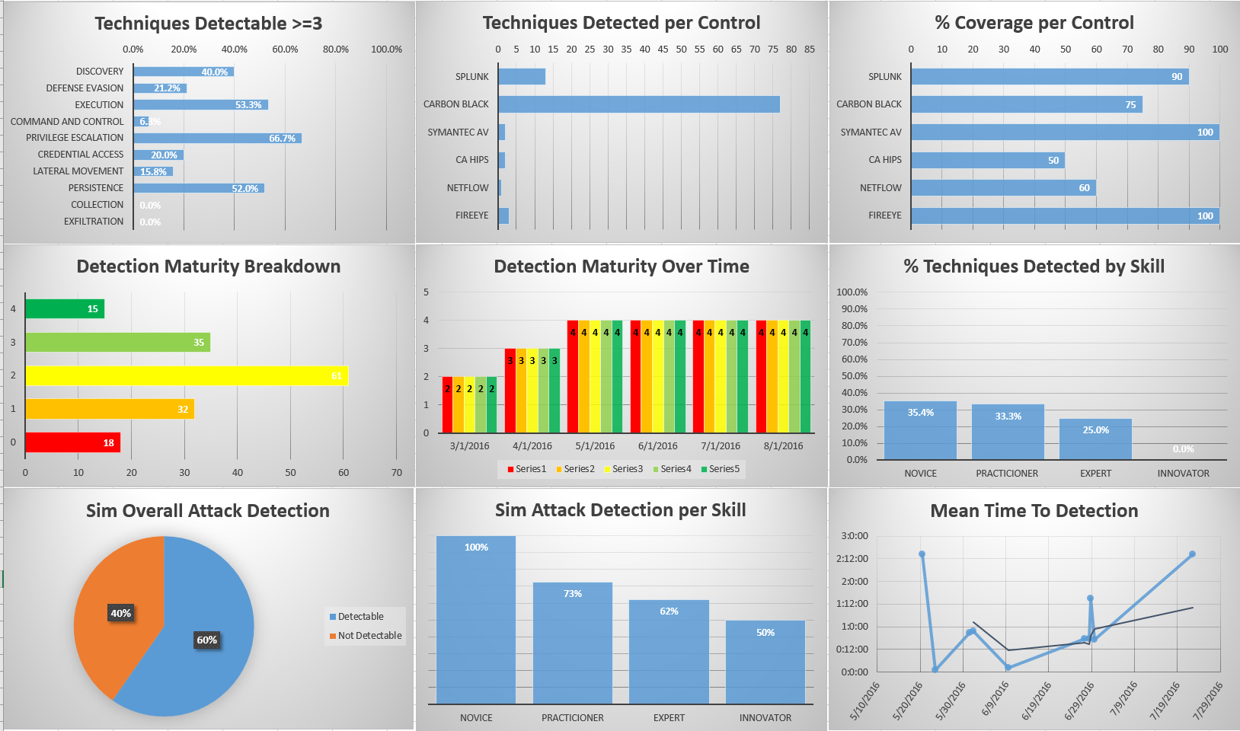

Slide 69
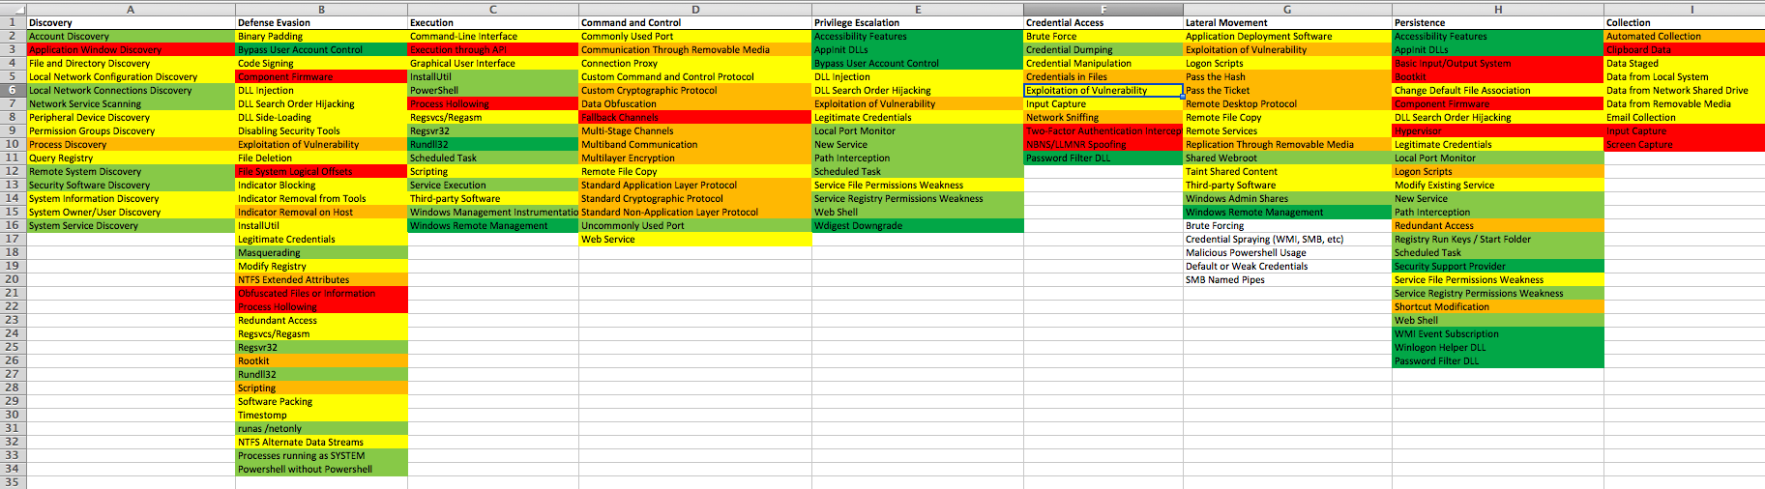
Notes:
Simulate the future montecarlo… blah

Slide 70

$Company asks “What do we do next, buy more stuff?”
Total Protection/Detection/Response
Actual P/D/R
Execution Gap
Coverage
Gap
Potential P/D/R

Slide 71
Future Work

Slide 72
The Future
Automate Red Team / Blue Team correlation
Automate Attack Path simulation
Predict impact of new attacks without running them
Predicting probability of attack chains
Reduced risk testing model
Zero testing debt
Response metrics via API queries of security tooling
Tracking defensive TTPs
Understand how all security tooling come together

Slide 73


