Slide 5
What about? US?

Slide 7
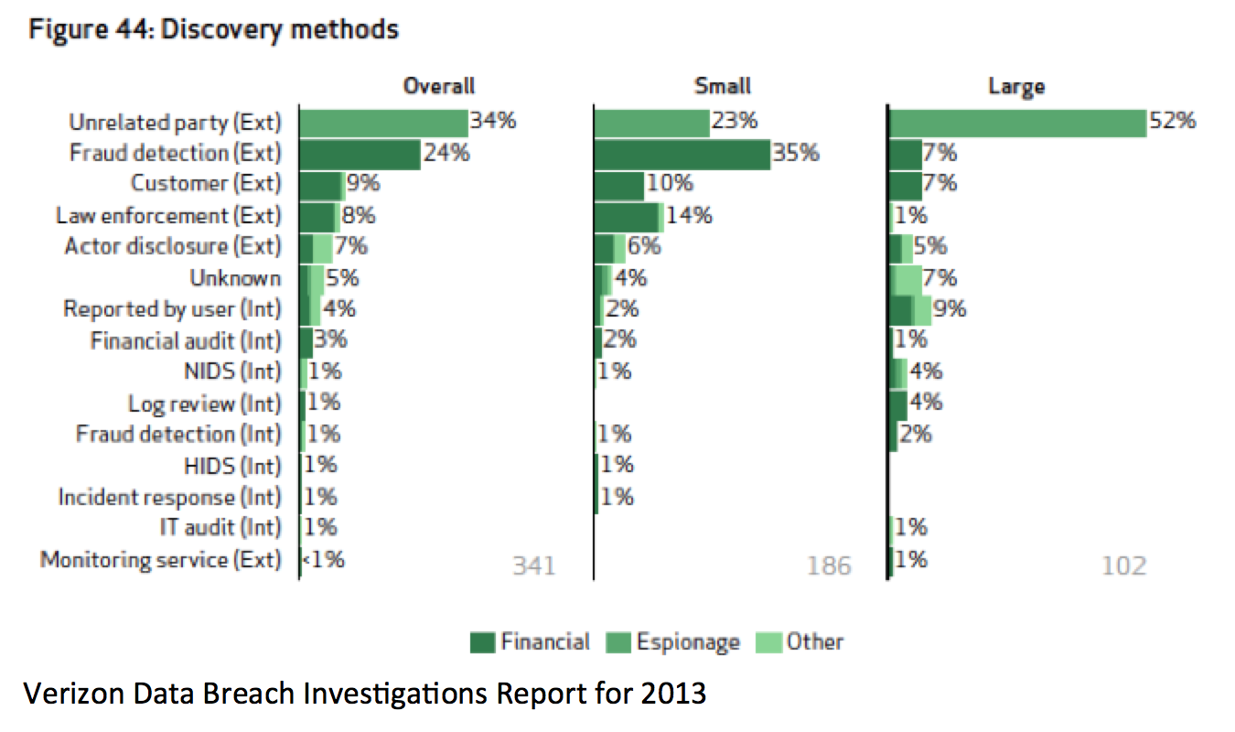

Slide 8
Some things to think about
“All warfare is based on deception”
Overused Sun Tzu quote…
D_{t} + R_{t} < A_{t}
The Three A’s
Annoyance
Attribution
Attack
A range of options is a very good thing

Slide 9
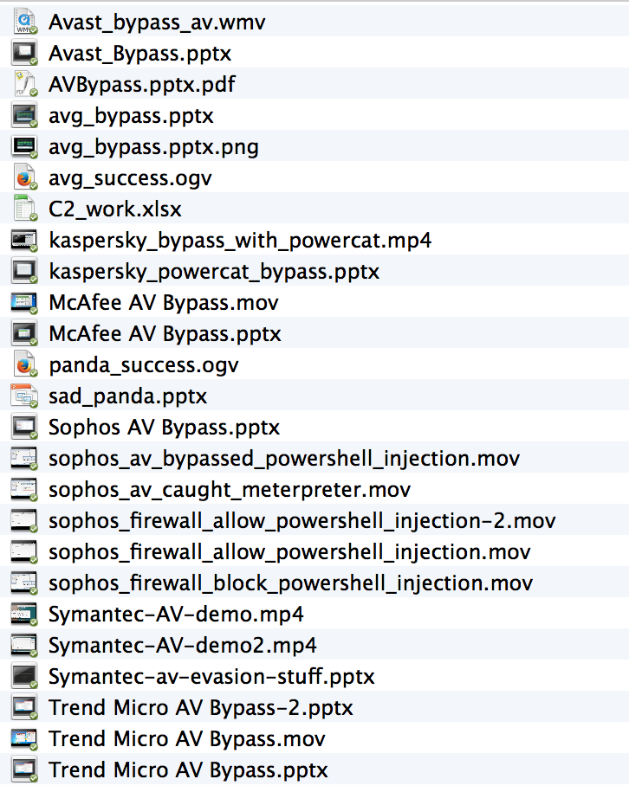

Slide 10
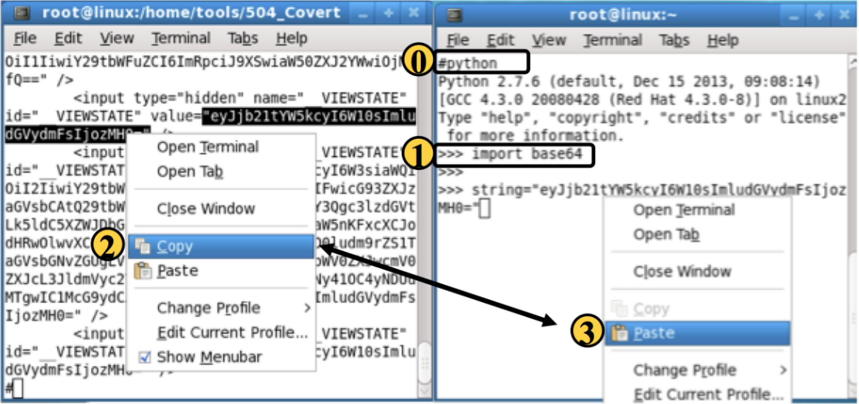

Slide 15
Another Way To Put It
D_{t} + R_{t} < A_{t}
Or…
All Warfare is Based On Deception

Slide 25
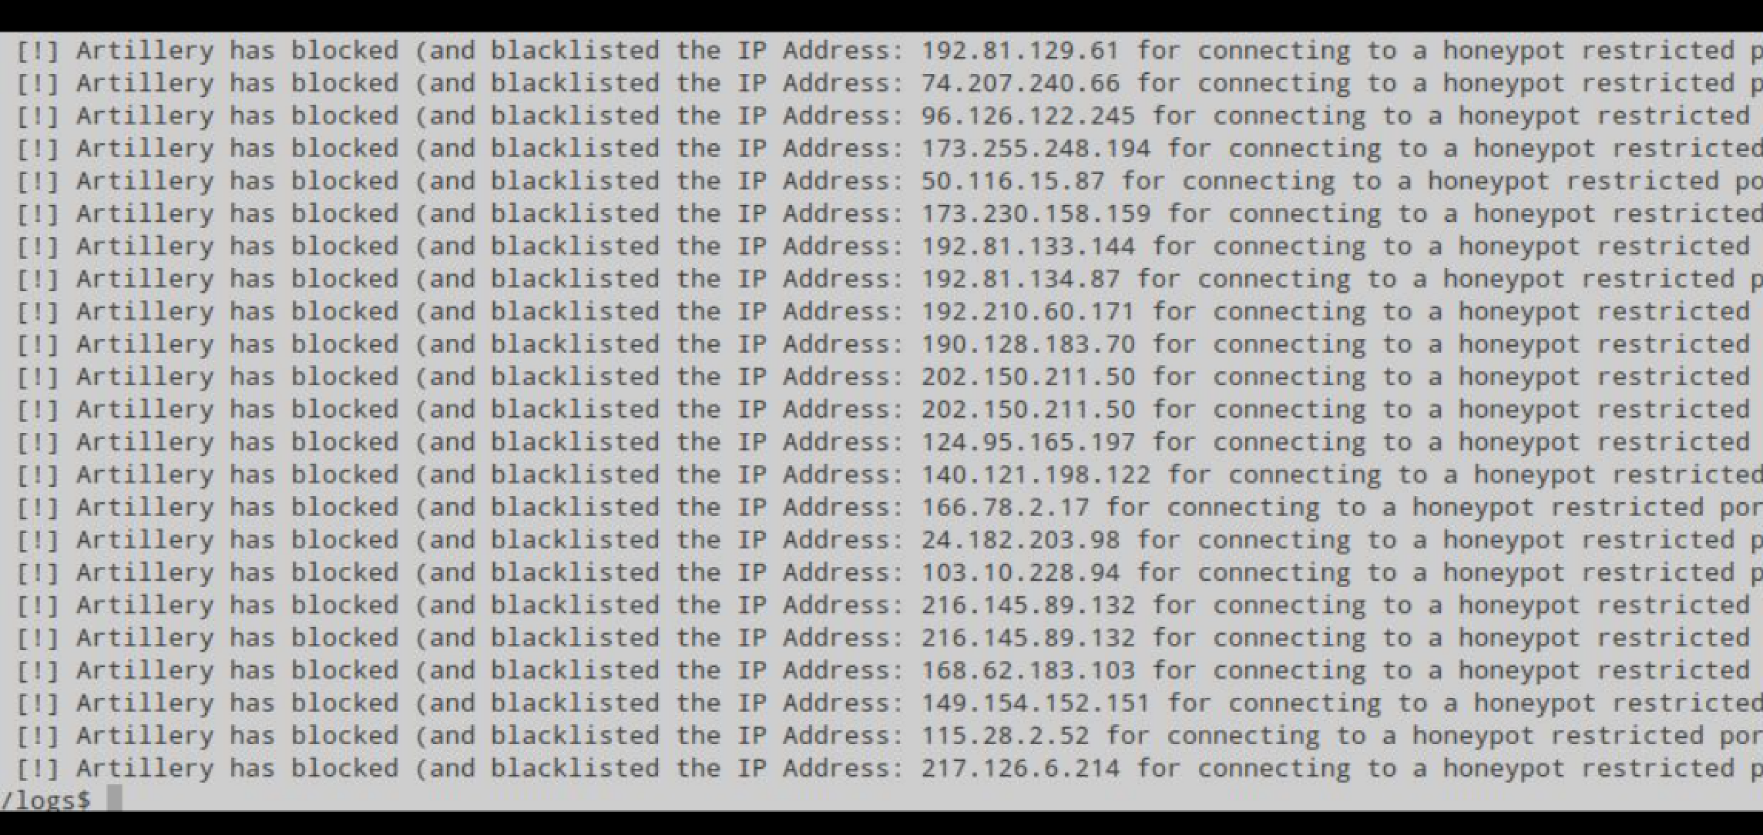

Slide 30
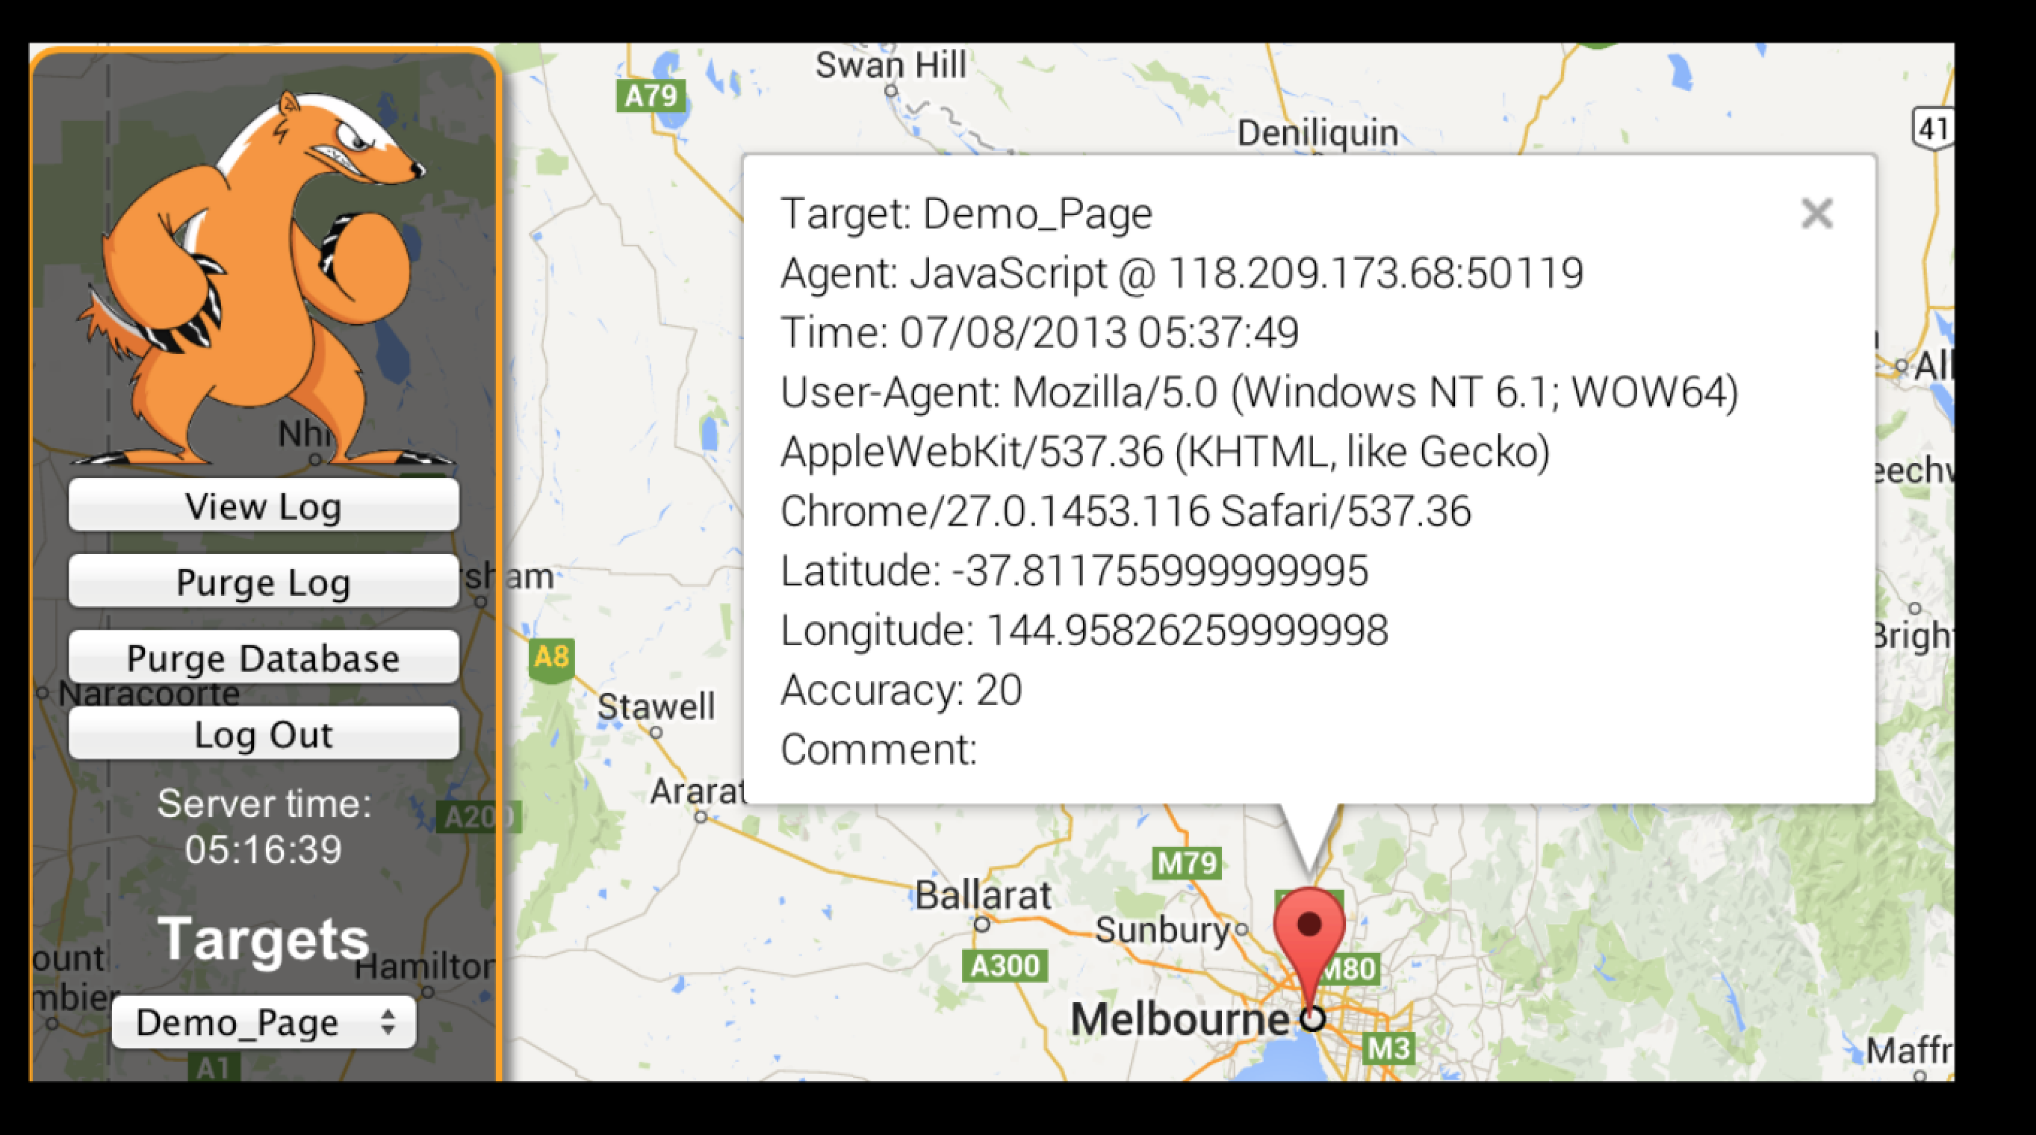

Slide 31
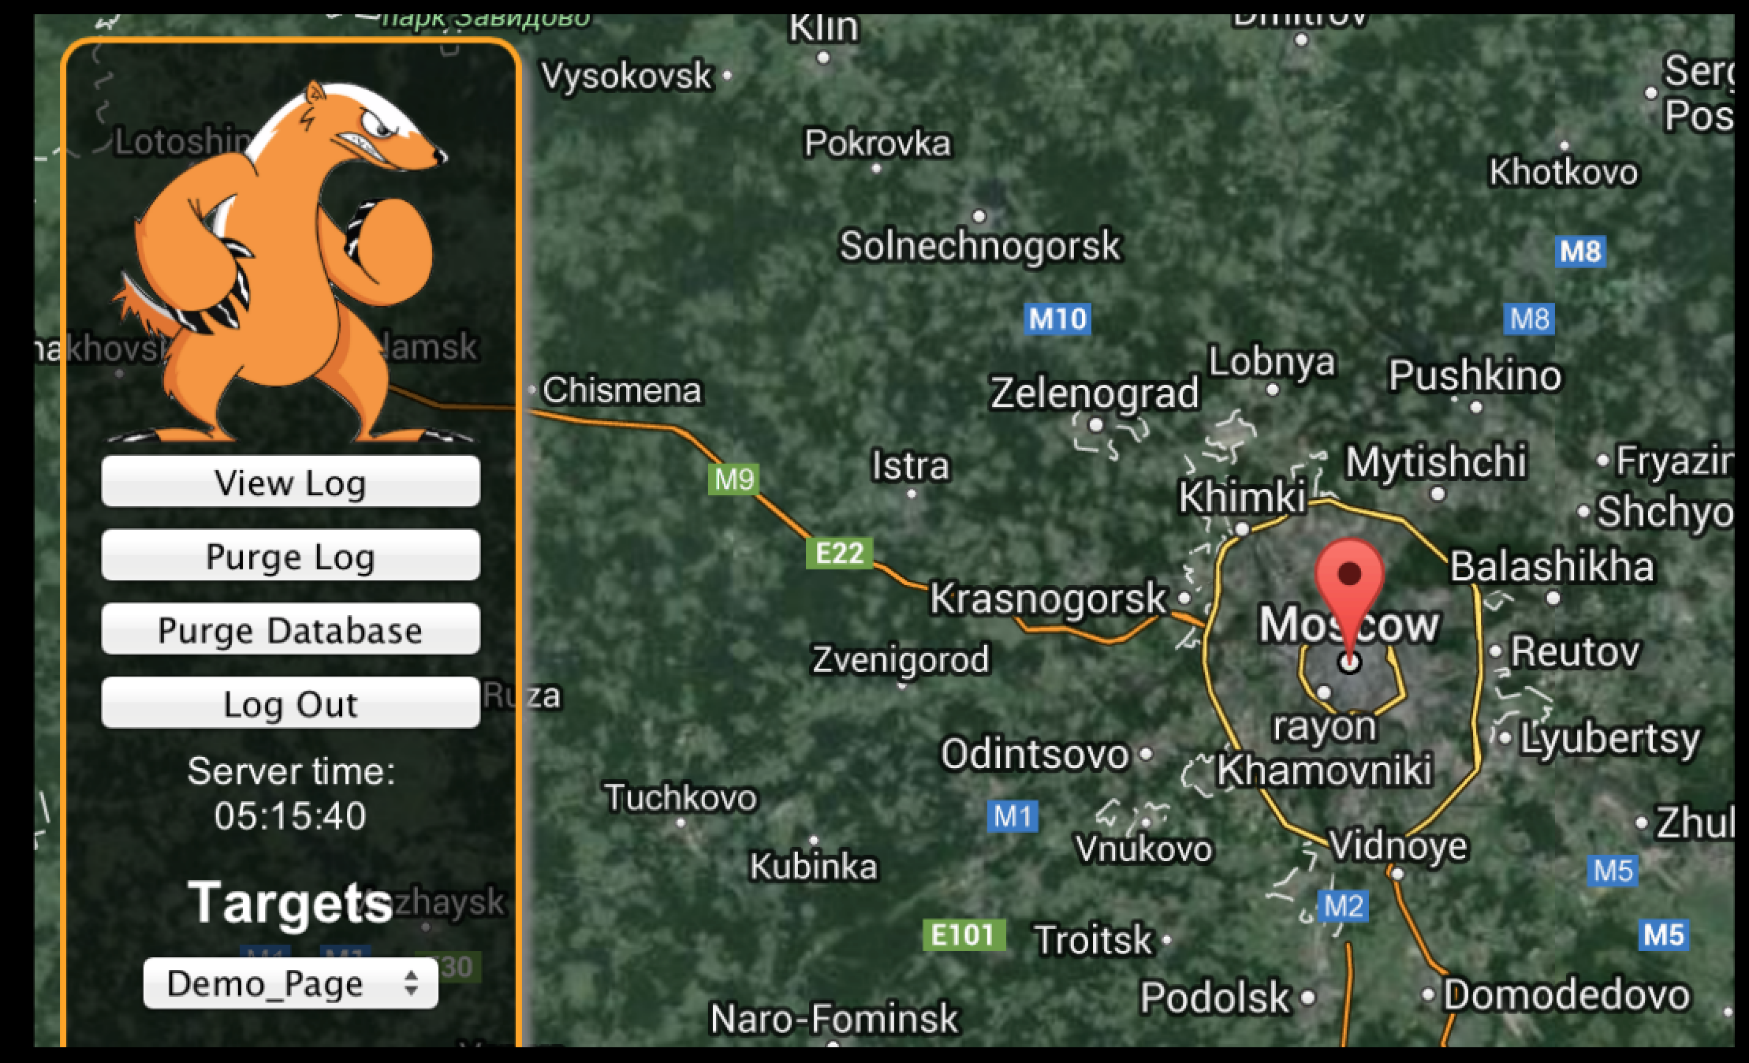

Slide 32
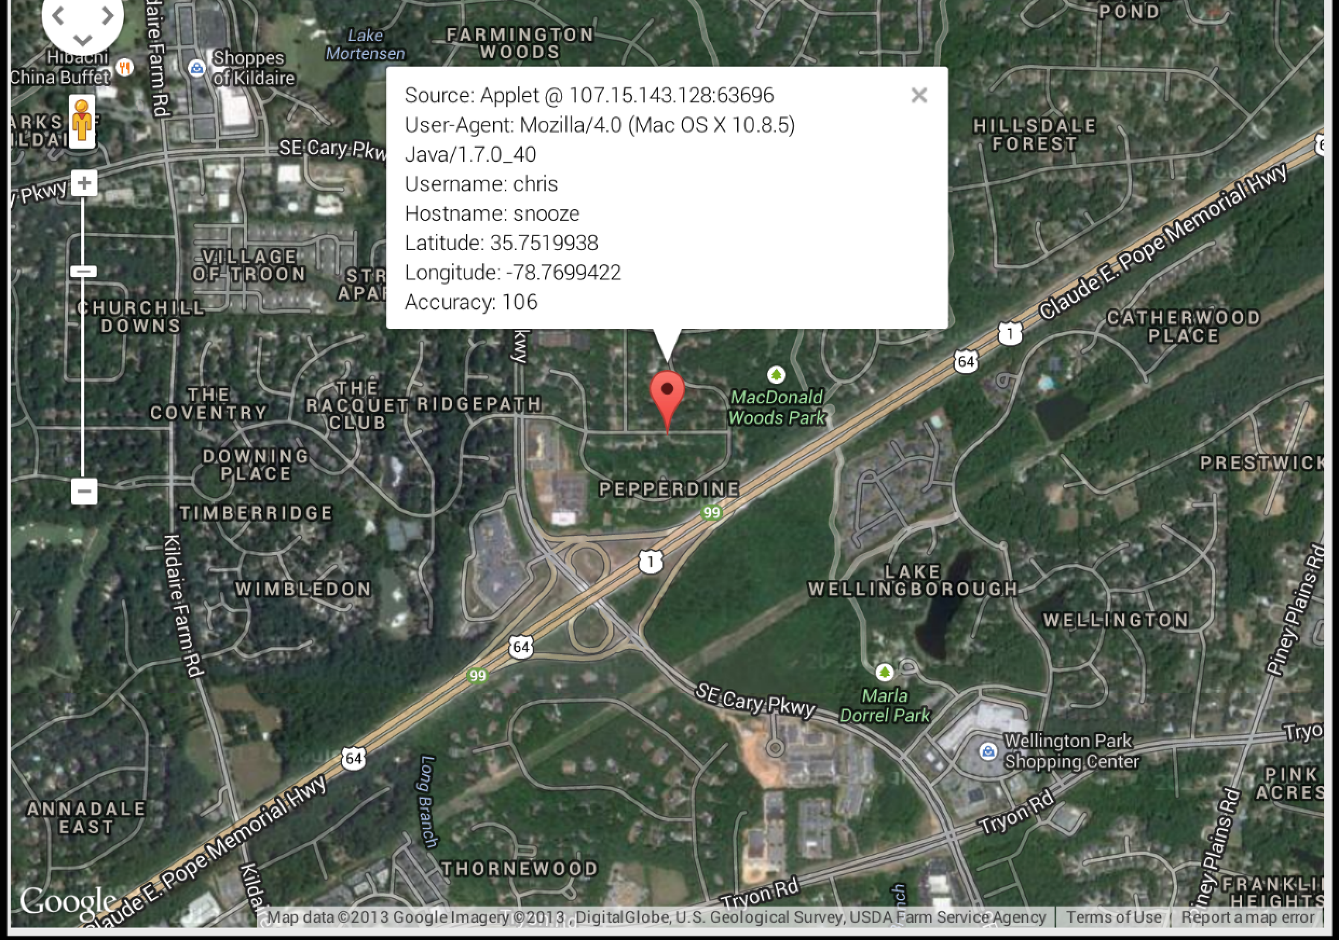

Slide 37
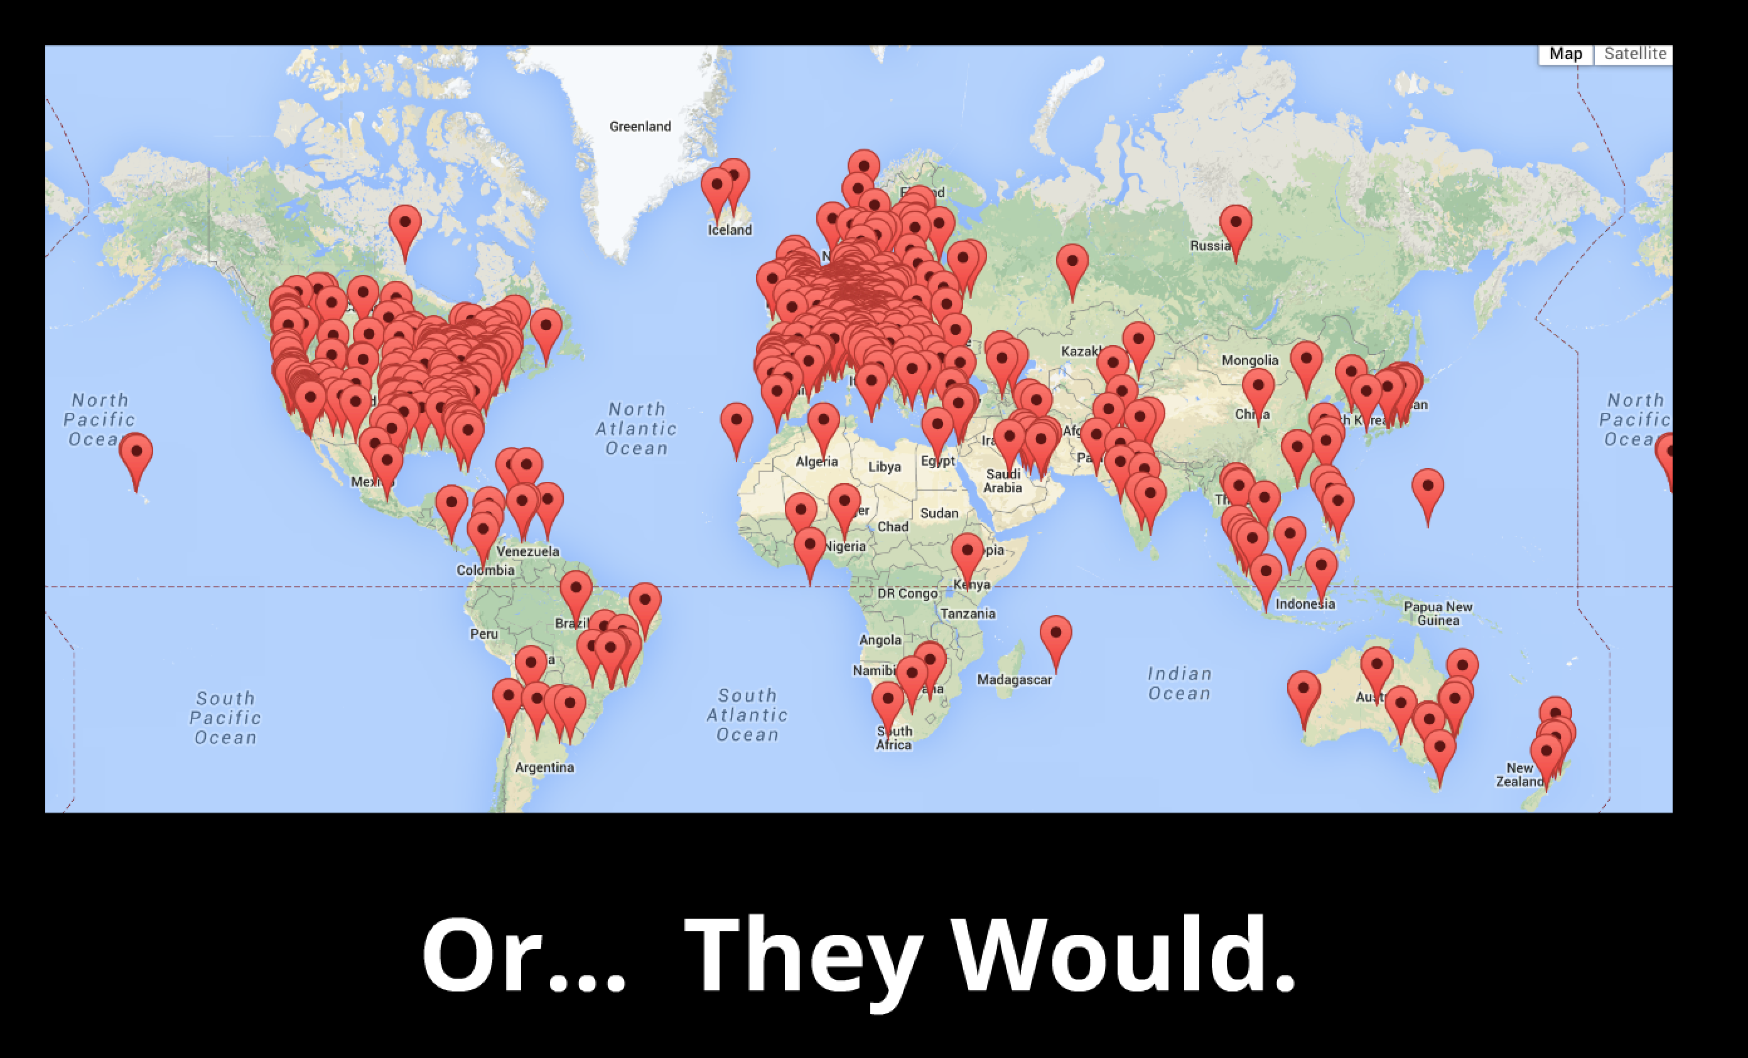

Slide 38
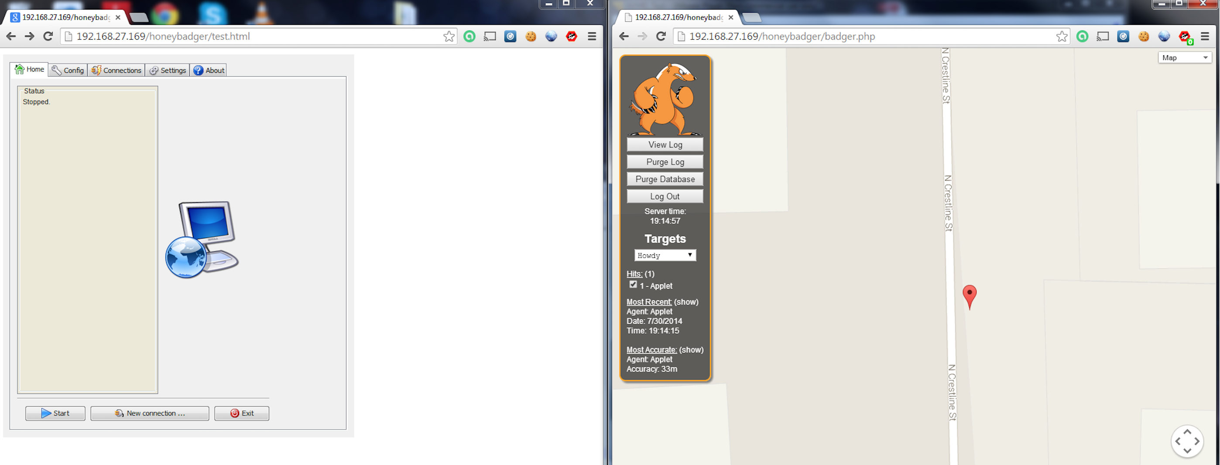
.Jar Combiner

Slide 40
Get A Warrant

Slide 42
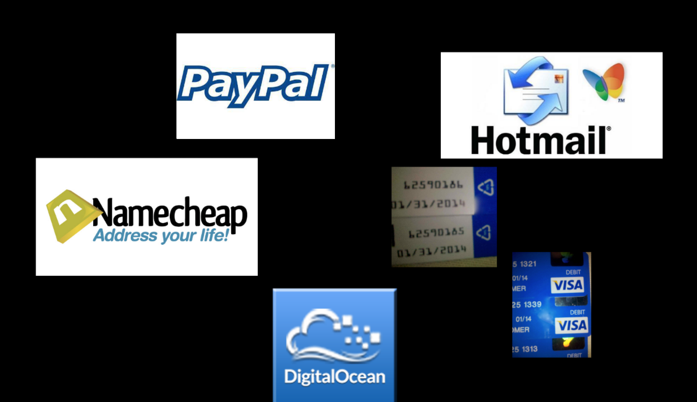

Slide 43
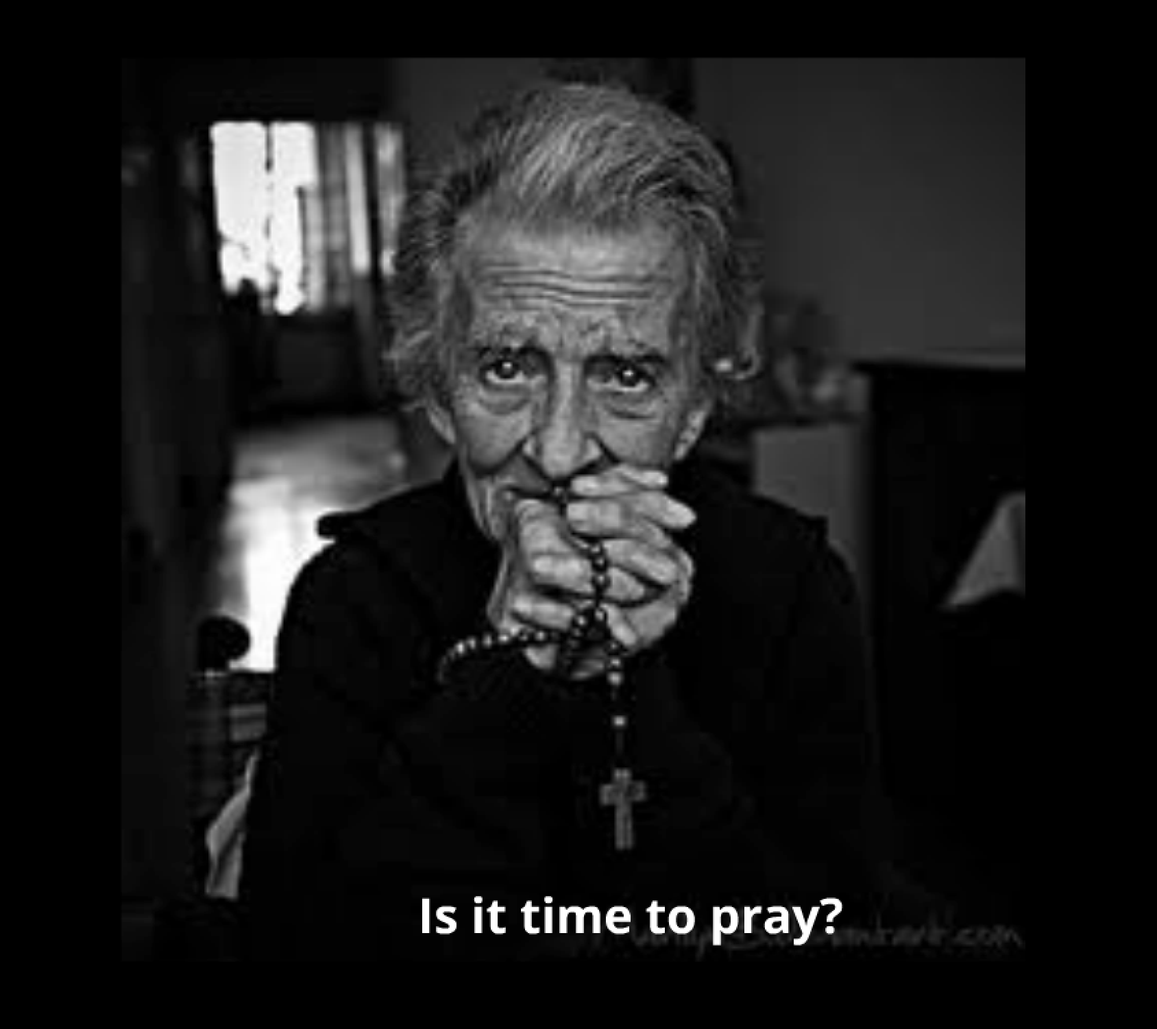

Slide 45
http://www.blackhillsinfosec.com/?page_id=4419

Slide 46
Thank you!!!
John Strand
www.blackhillsinfosec.com
www.offensivecountermeasures.com
@strandjs
+1 303-710-1171

Slide 47
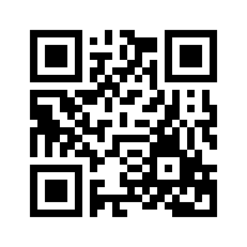
Oh… One more thing…
We will be releasing a OWA Two Factor Bypass attack next week…
Register here..
http://eepurl.com/ZhFfn
Because we trust QR Codes - >

