Slide 1
Scraping Leaky Browsers for Fun and Passwords
BruCON, October 27th, 2016

Slide 2
Introduction

Slide 3
I got my master’s degree in computer science specializing in secure software at KU Leuven. In collaboration with NVISO, I was able to produce a thesis on scraping the RAM of web browsers.
Currently, I am employed by Planet Talent.
planet-talent.com
Stefaan Truijen
+32 (0)487 22 87 97
stefaan_truijen@yahoo.com
www.linkedin.com/in/stefaan-truijen-572ba2a4

Slide 4
Bachelor in specialization of networks and computer systems at ESI (HEB)
Internship at NVISO, developing a volatility framework plugin able to parse credentials patterns from web browsers.
Working as .NET Developer consultant at OnePoint
(groupeonepoint.com)
Adrian Toma
+32 (0)485 27 23 79
adrian.toma@outlook.be
www.linkedin.com/in/alinadriantoma

Slide 5
Table of Contents
RAM scraping?
Test the waters
Going all out
$$$
Annihilating the threat
Vendor response
Volatility
Demo

Slide 6
About RAM scraping

Slide 7
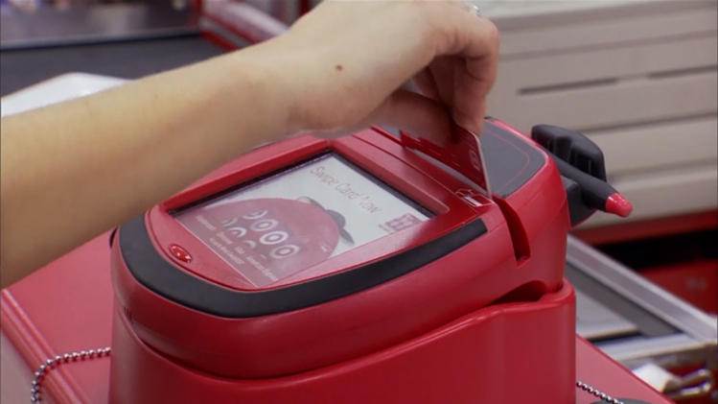
About RAM scraping
What is RAM scraping?

Slide 8
About RAM scraping
What is RAM scraping?

Slide 9
About RAM scraping
What is RAM scraping?

Slide 10
About RAM scraping
The numbers

Slide 11
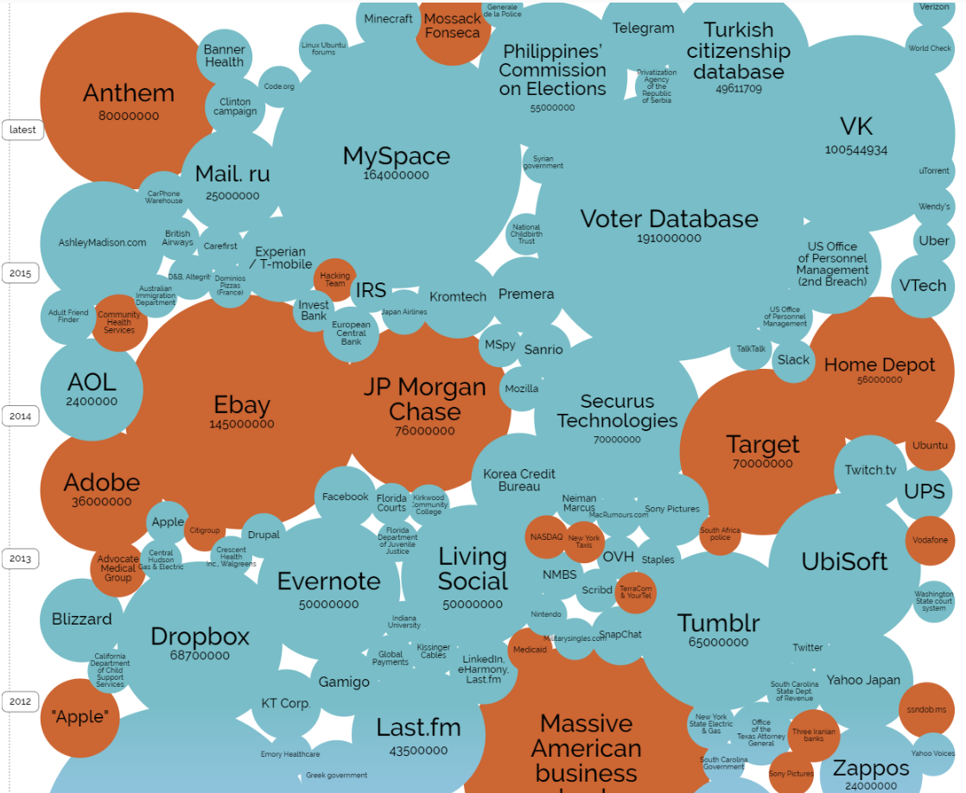
http://www.informationisbeautiful.net/visualizations/worlds-biggest-data-breaches-hacks/

Slide 12
Testing the waters

Slide 13
Testing the waters
Challenges
Username: Alice
Password: a[($%VvWbx+34

Slide 14
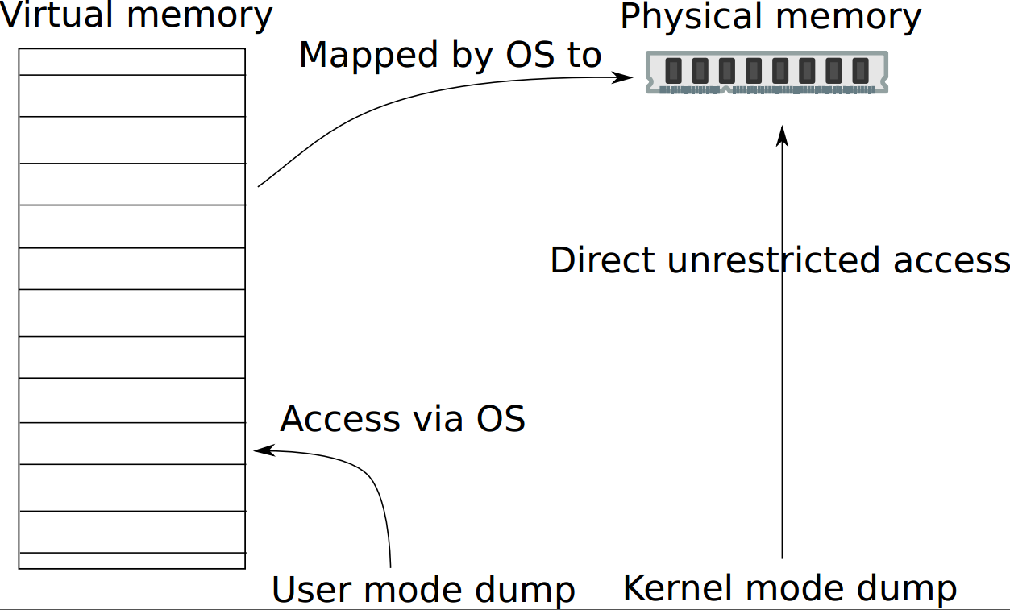
Testing the waters
Challenges

Slide 15
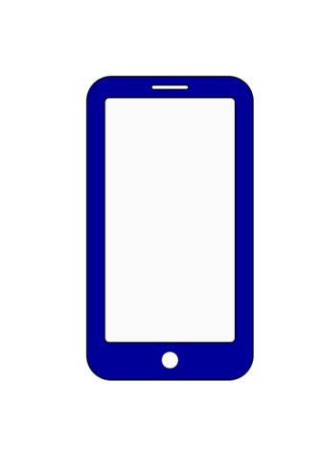
Testing the waters
Motivation
Username: Alice
Password: a[($%VvWbx+34
Alice

Slide 16
Testing the waters
Scope

Slide 17
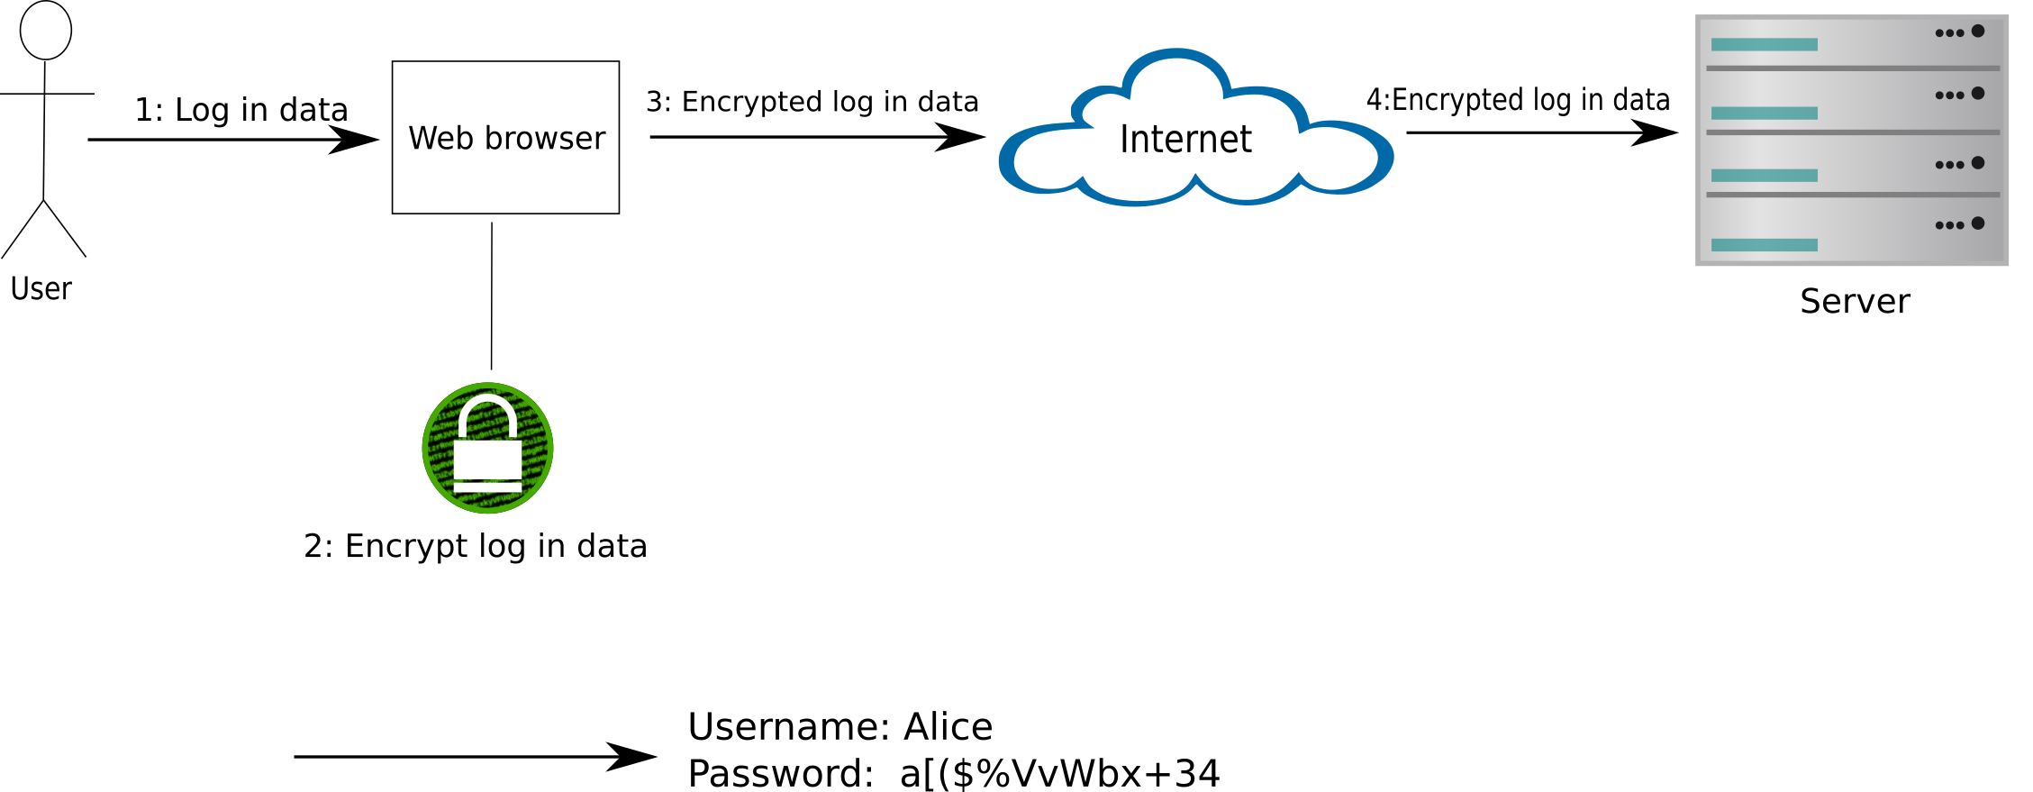
Testing the waters
Points of vulnerability in typical web browser use cases
Timing attack

Slide 18
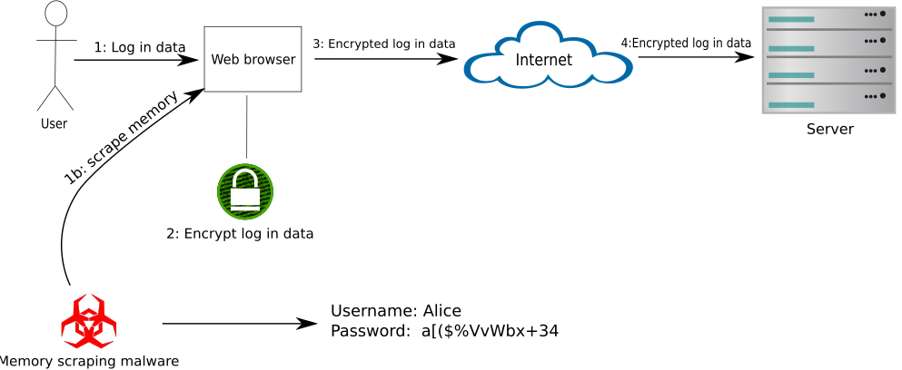
Testing the waters
Points of vulnerability in typical web browser use cases
Timing attack

Slide 19
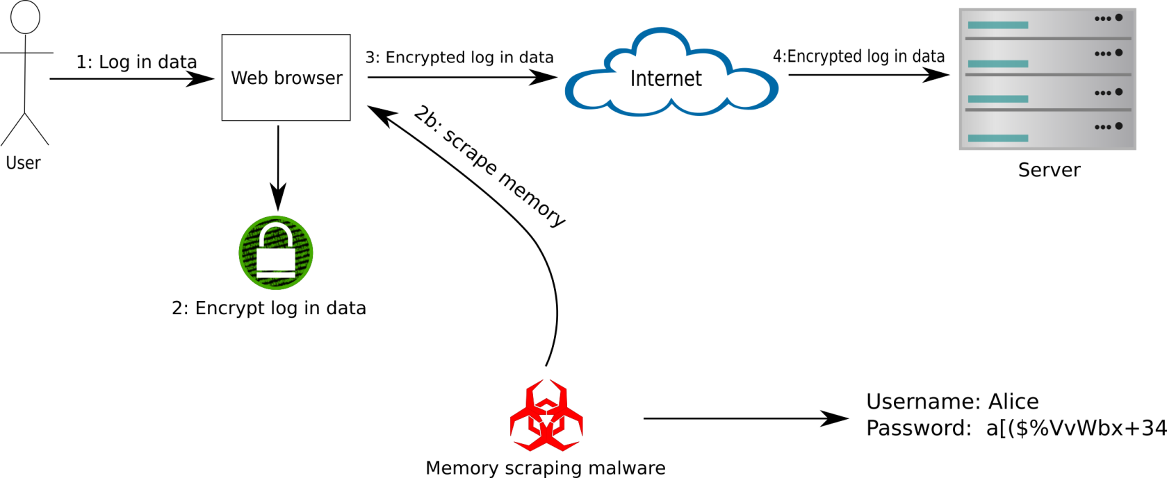
Testing the waters
Points of vulnerability in typical web browser use cases
Leaky browser

Slide 20
Testing the waters
Points of vulnerability in typical web browser use cases
Leaky browser

Slide 21
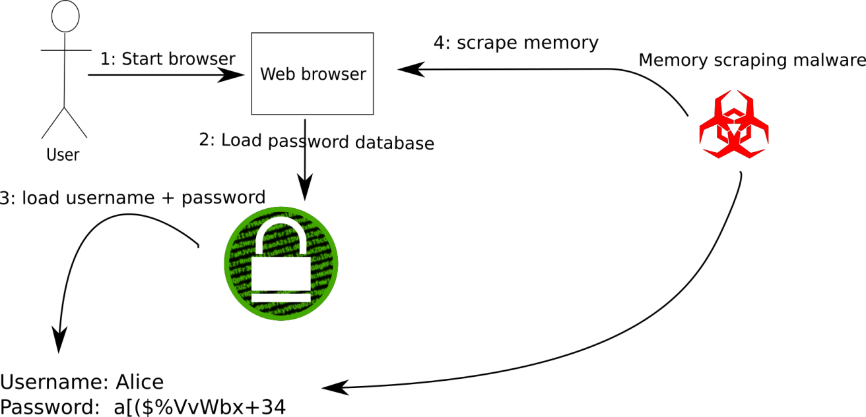
Testing the waters
Points of vulnerability in typical web browser use cases
Automatic completion of user credentials

Slide 22
Testing the waters
Points of vulnerability in typical web browser use cases
Automatic completion of user credentials

Slide 23
Testing the waters
Initial approach
On a clean VM:
Attach Immunity Debugger to browser
Interact with websites; perform login
Pause browser
Search memory

Slide 24
Going all out

Slide 25
Going all out
Automated attack requirements
Dump RAM fast
Parallel execution
Reproducible
Cover realistic situations

Slide 26
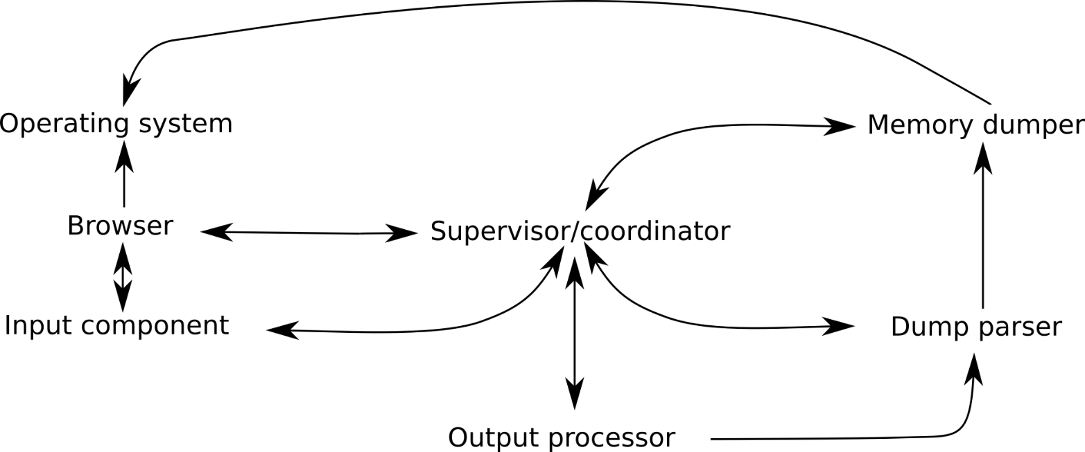
Going all out
Automated attack requirements

Slide 27
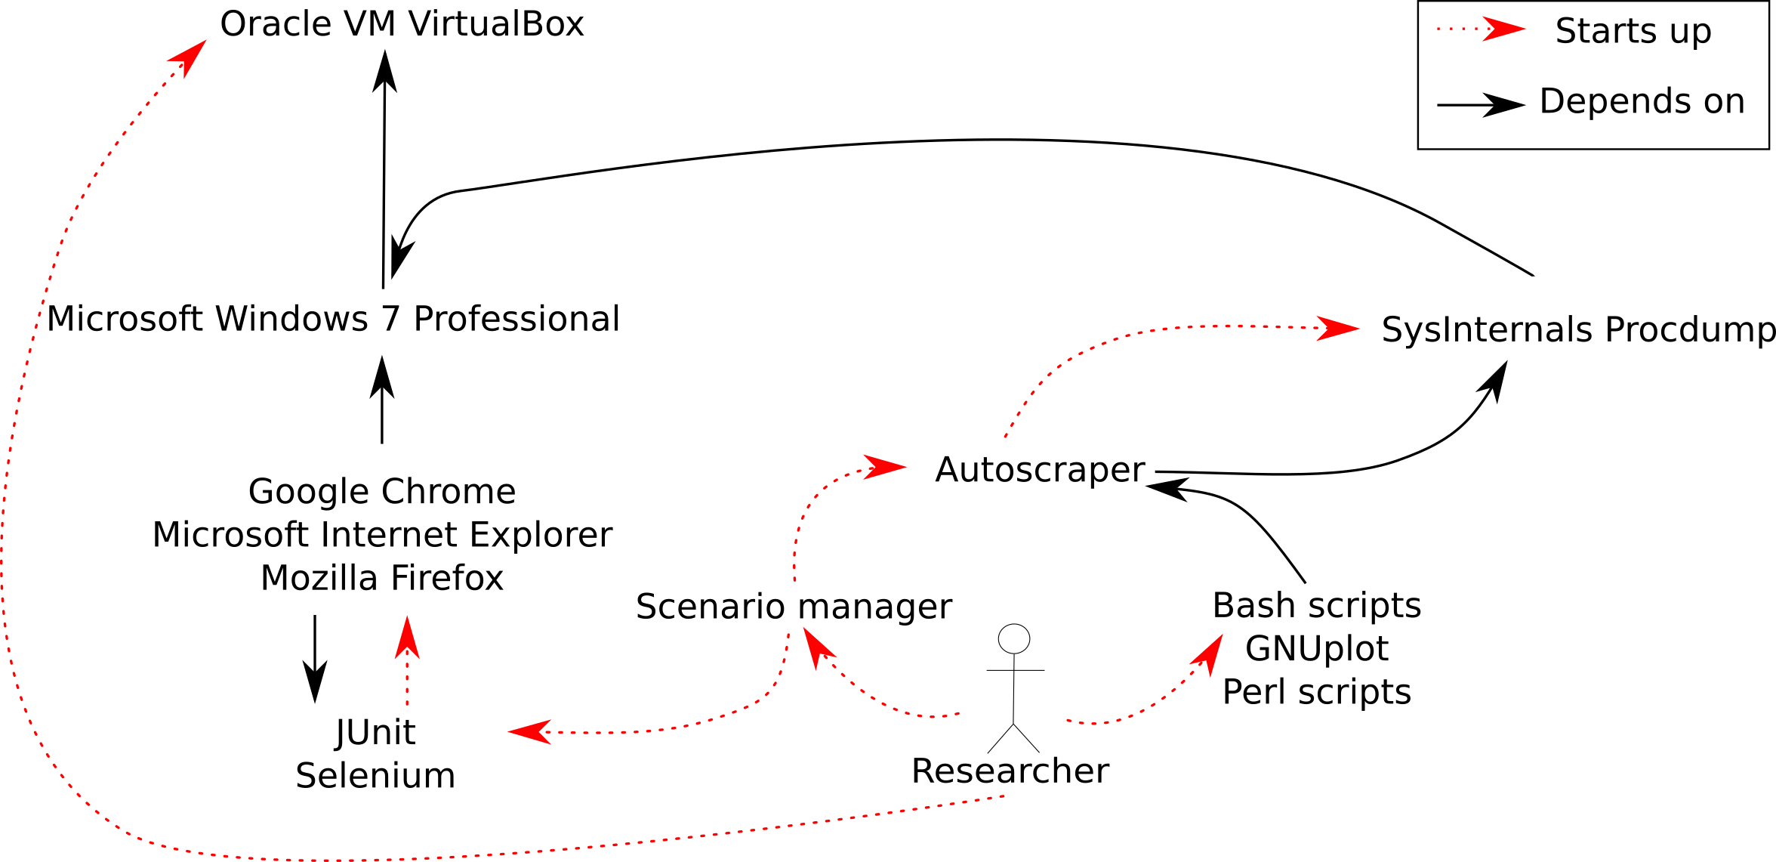
Going all out
Automating browser attacks

Slide 29
Jackpot
Measuring browser’s susceptibility to RAM scraping
Protection ratio
Examples:
Amount of tests | Amount of tests without credentials in memory | $$ρ$$
100 | 75 | = 75/100 = 0.75
50000 | 31337 | = 31337/50000 = 0.63

Slide 30
Jackpot
Resulting protection ratios

Slide 31
Jackpot
Impact of using Incognito/Private/InPrivate mode

Slide 32
Annihilating the threat

Slide 33
Annihilating the threat
Root cause analysis
Problem: UN/PW linger in memory longer than they should

Slide 34
Annihilating the threat
Root cause analysis
Problem: UN/PW linger in memory longer than they should
Causes and solutions:
Bad malloc/free implementation
Zero out before freeing
Bad browser code
Audit code (Verifast)
OS does not separate process address space
… tough break
Protected Module Architectures (PMA)

Slide 35
Annihilating the threat
Root cause analysis
Problem: UN/PW linger in memory longer than they should
Causes and solutions:
Intended behavior
Competitive browser market
Browser architecture
Multi process vs single process
Remember password prompt
Reenter UN/PW

Slide 36
Vendor response

Slide 37
Vendor response
Microsoft
This issue is being serviced and it looks like it will be fixed in either the October or November update.

Slide 38
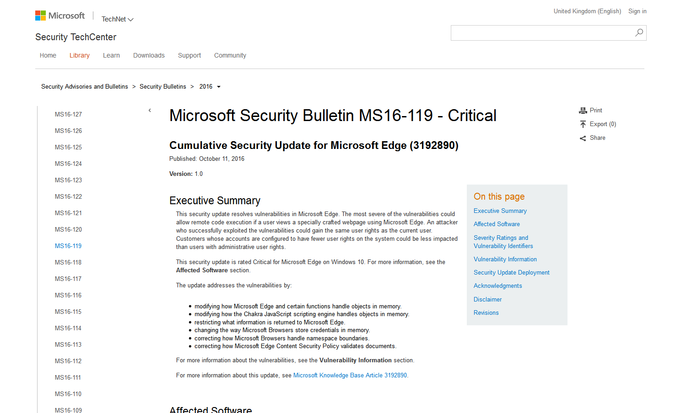
Vendor response
Microsoft
CVE-2016-3391
https://technet.microsoft.com/library/security/MS16-119

Slide 39
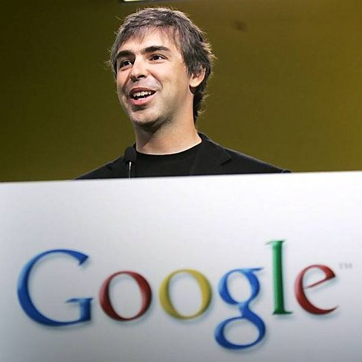
Vendor response
Google
Sorry, we don't consider this a vulnerability, see https://www.chromium.org/Home/chromium-security/security-faq#TOC-Why-aren-t-physically-local-attacks-in-Chrome-s-threat-model-
In particular, once you've added the malicious plugin, it can grab the data at the moment it is sent to the server, being able to do so after the fact doesn't change the equation.

Slide 40
Jackpot
Resulting protection ratios

Slide 41
Vendor response
Google
Sorry, we don't consider this a vulnerability, see https://www.chromium.org/Home/chromium-security/security-faq#TOC-Why-aren-t-physically-local-attacks-in-Chrome-s-threat-model-
In particular, once you've added the malicious plugin, it can grab the data at the moment it is sent to the server, being able to do so after the fact doesn't change the equation.

Slide 42
Vendor response
Mozilla
If someone has the rights to see your process memory, can't they probably also install a keylogger on the machine?
And if you encrypt the data, isn't the person also able to access the in-memory copy of the decryption key? If the OS doesn't enforce proper separation, we can't fix the problem at the application level. Anything we tried would be snake oil.

Slide 43
Leveraging the Volatility framework

Slide 44
Volatility Framework
Tools
Open Source Framework (2007)
GitHub community
Python 2.7
Multi-platform
Extraction of digital artifacts from RAM
Target
Windows 7, v 32bits

Slide 45
Volatility Framework
Scenarios of credentials leaks
Scenarios
Closing tabs
Login / Logout
Capture Live RAM (Belkasoft)
Scripting to collect memory dumps

Slide 46
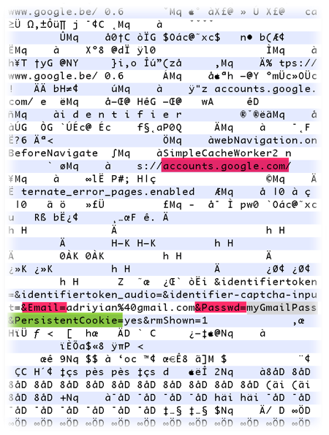
Volatility Framework
Approach to develop the plugin
Detecting patterns Partial post methods
Gmail
&email=
&Passwd=

Slide 47
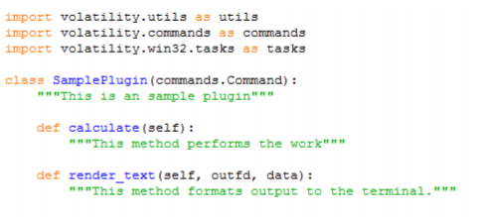
Volatility Framework
Approach to develop the plugin
Plugin structure Analyse based on existing plugins

Slide 48
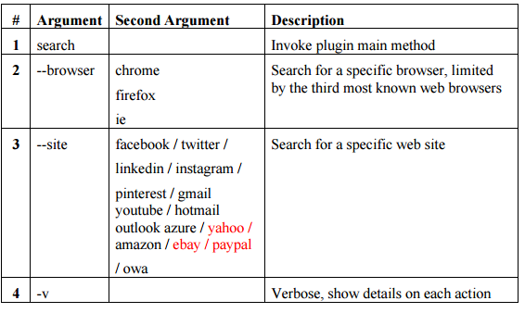
Volatility Framework
Approach to develop the plugin
Arguments

Slide 49
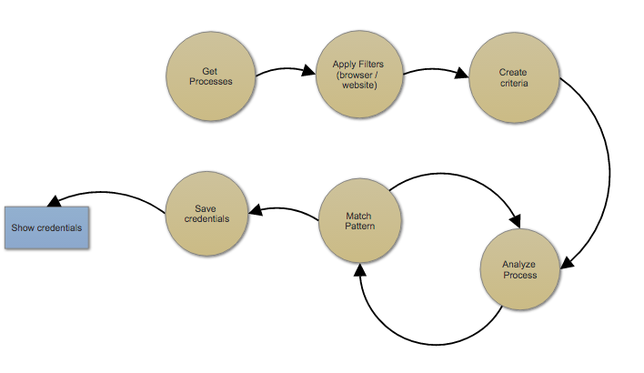
Volatility Framework
Approach to develop the plugin
Algorithm

Slide 50
DEMO

Slide 51
Discussion
LastPass

Slide 52
Q&A
Questions?

Slide 53
Volatility Plugin source code
https://github.com/adriyian/volatility_browser_memory_scraping
Pushing in 3… 2... 1...

