Slide 1
The Best Of 2023-2024: inside the biggest hacks and facts of the past year
Notes:
Who is here from Germany? Gluten tach Who is here from..
So the true story is that I wrote in feedback form of BruCON 2011 that I would be interested in a recap of all major things that happened the past year. Because with so much happening in the security world, who really has the time to stay on top of it all, day after day? We pretend to be on top of things, but actually we are not.
Let’s take a nostalgic trip down the past year with the most intriguing hacks and facts and the biggest drama’s.
-------------------------------------

Slide 2
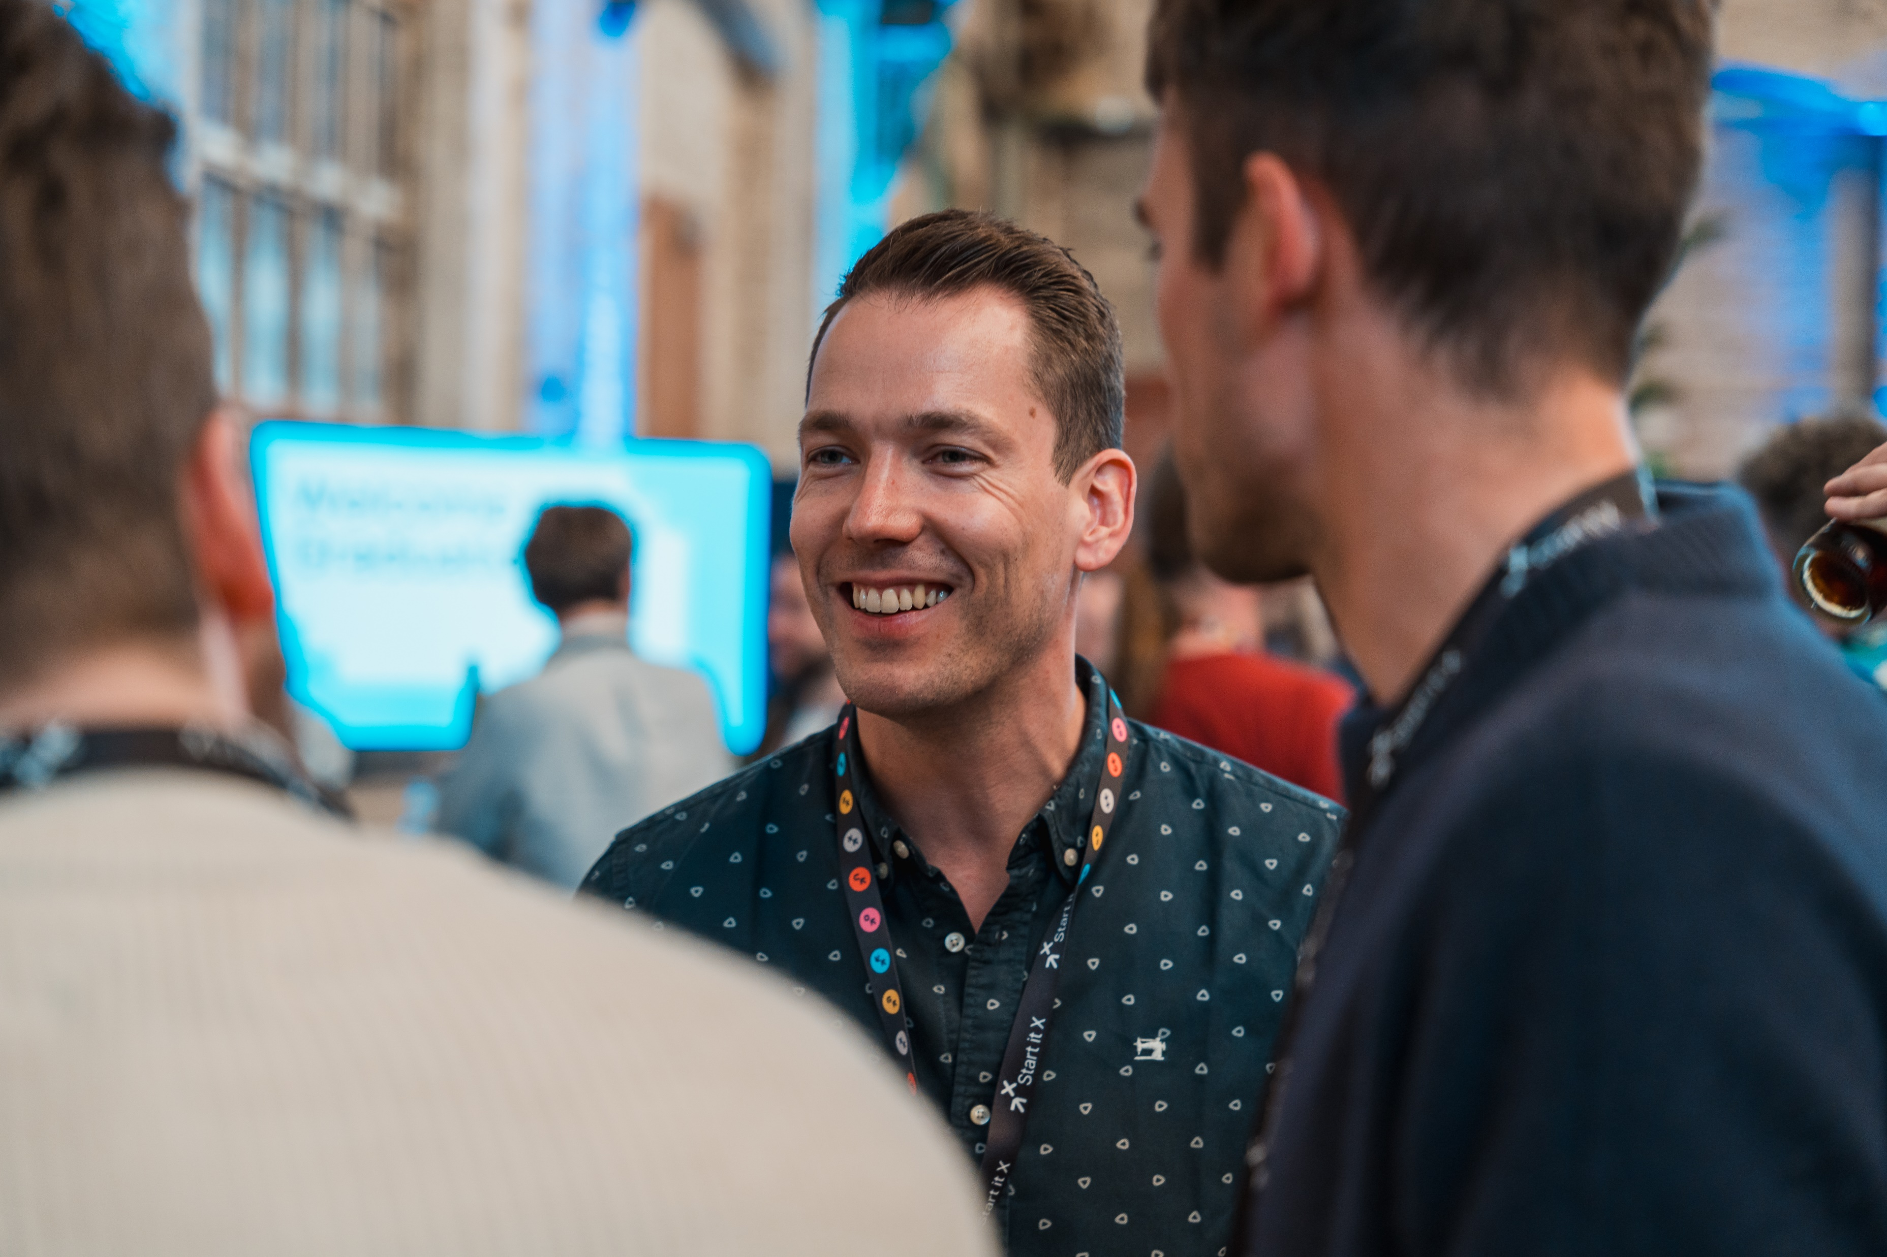
WHO AM I
Dieter Van Den Bosch
Addicted to learning geeky stuff
All things technical, Sci-Fi, Science, Astronomy, Birds, Insects, …
Since 2009 in security
Threat Intelligence analyst in group CERT
International lead Attack Surface Management
Notes:
Who am i? I’m Dieter Van Den Bosch, I love BruCON and just about everything geeky, including Dinosaurs. We dinosaur-geeks would freak when someone touches a 68 million year old dinosaur, right? But relax… this is just a replica hanging in the Best Western hotel in Denver.
I’m in security since 2009 in a financial services company that has 42 000 employees. And I’ve been Threat Intelligence Analyst & global lead in Attack Surface Management.
---------------
Yes, nature-geeks are geeks too. You should see us geek out “yeah, but the feathers are not covering more then 50% of the beak, so it’s not that bird.

Slide 3
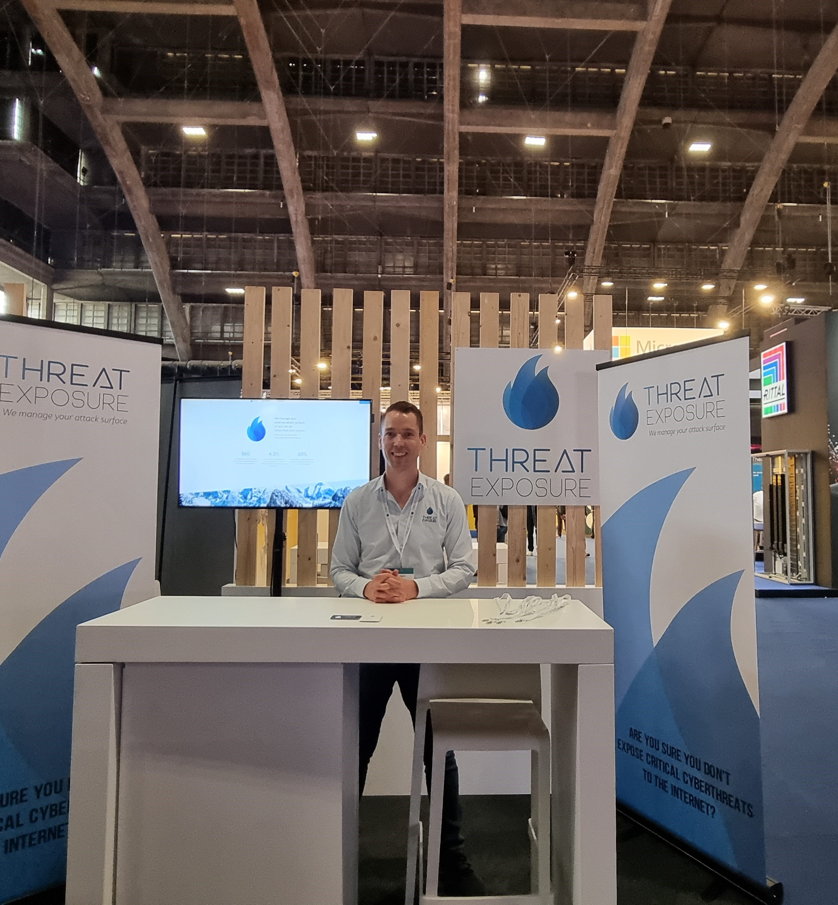
WHO AM I
Proud Dieter Van Den Bosch
threatexposure.eu dieter@threatexposure.eu www.linkedin.com/in/vdbdieter/
Notes:
But I left KBC and started ThreatExposure, an External Attack Surface Management company. We’re specialized in scanning for critical vulnerabilities (like emerging zero-days) that organizations have exposed to the internet. We follow-up what hackers are up to and then scan our customers for those vulnerabilities
For example we do that for the company that is the biggest employer of Belgium, that’s a customer of ours

Slide 4
BruCON 2023
START
Notes:
So let’s start our journey exactly a year ago

Slide 5
Ransomware MGM Sep 11: Scattered Spider gets in by calling MGM's helpdesk posing as an employee
Even key cards for rooms not functioning
Jan - June: 3 young adults from US & UK arrested
MGM doesn’t pay any ransom Cyberattack costed $100 million
OCT 11

Slide 6
Ransomware Ceasars Days before MGM’s cyberattack, Caesars paid a $15 million ransom
SEP 7
Ransomware MGM Sep 11: Scattered Spider gets in by calling MGM's helpdesk posing as an employee
Even key cards for rooms not functioning
Jan - June: 3 young adults from US & UK arrested
MGM doesn’t pay any ransom Cyberattack costed $100 million
OCT 11
Notes:
ironic

Slide 7
OCT 10
HTTP/2 ‘Rapid Reset’ DDoS attack
A primary design goal of HTTP/2 was efficiency, and unfortunately the features that make HTTP/2 more efficient for legitimate clients can also be used to make DDoS attacks more efficient.
New DDoS record: 400 million requests per second. Many times bigger than the last record.
Notes:
All web servers and other systems that support HTTP/2 and that is very common.
--------------------------
https://cloud.google.com/blog/products/identity-security/how-it-works-the-novel-http2-rapid-reset-ddos-attack
https://blog.cloudflare.com/technical-breakdown-http2-rapid-reset-ddos-attack/

Slide 8
23andMe hack finally clear
23andMe spent months downplaying it and blaming their customers
DNA related data of 6.9 million, about half of 23andMe’s customers, in the hands of hackers
The names, addresses belonging to 1 million 23andMe customers with Jewish heritage on BreachForums
No MFA
DEC 5
Notes:
Who can keep count on how many times I say a hack is caused by the lack of MFA?

Slide 9
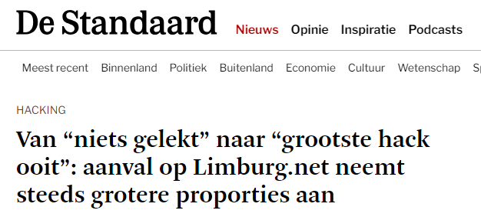
DEC 13
Ransomware attack Limburg.net By Medusa
One server hacked with data of 311.000 families. Also leaked: data of 61 people in debt mediation etc.
Hackers got in via an RDP server exposed to the internet without MFA. Source: Belang van Limburg

Slide 10
Ransom payments to ransomware gangs are
tax-deductible as business expenses
- Minister of Finances Vincent Van Peteghem -
Notes:
Maar door losgeld te betalen financier je cybercriminaliteit. Cybercriminelen zetten de opbrengsten van ransomwareaanvallen in om nieuwe aanvallen op andere bedrijven te lanceren.

Slide 11
By paying ransom, you are financing cybercrime. Cybercriminals use their profit from ransomware attacks to launch new attacks on other companies.
- Simen Van Der Perre (Orange Cyberdefense), de Tijd -
Notes:
Fines, gambling is not tax-deductable. It’s even illegal as a company to give money to politcians. Which I get. But giving millions to cybercriminals is not a problem. That’s even supported/encouraged by the government.

Slide 12
Ransom payments to ransomware gangs are tax-deductible as business expenses
- Minister of Finances Vincent Van Peteghem -
Notes:
---------------------------------------------------
Maar door losgeld te betalen financier je cybercriminaliteit. Cybercriminelen zetten de opbrengsten van ransomwareaanvallen in om nieuwe aanvallen op andere bedrijven te lanceren.

Slide 13
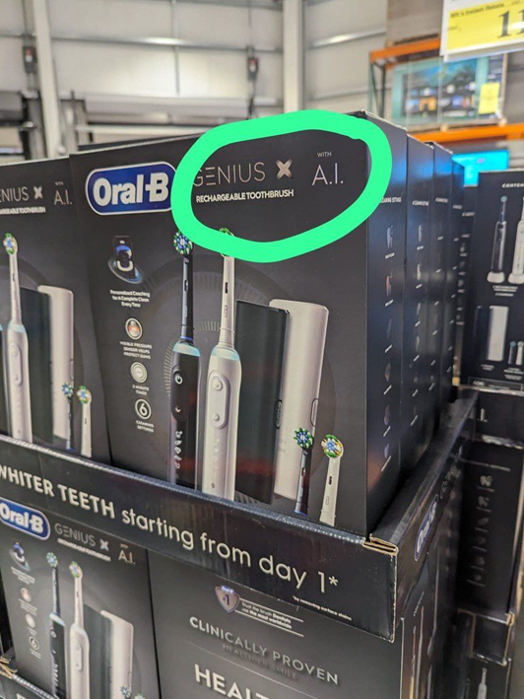
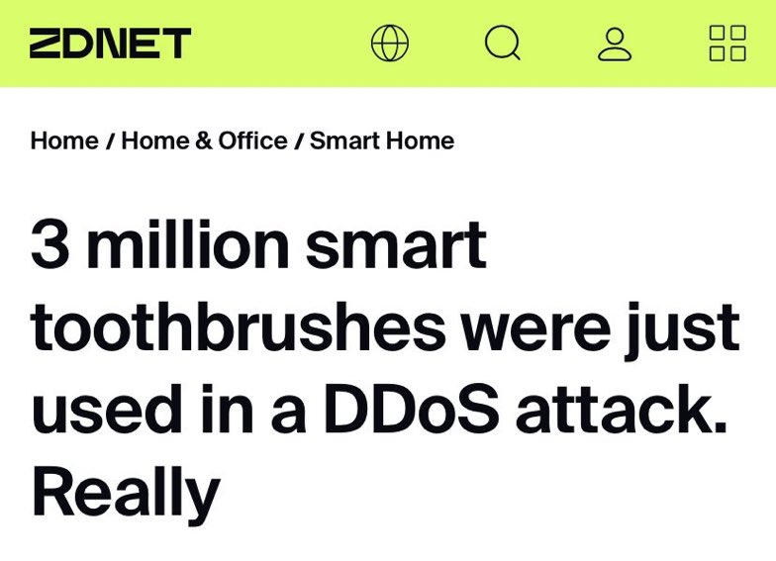
The toothbrushes DDoS attack
Reported by Swiss newspaper after an interview with Fortinet. The DDoS knocked out a Swiss company for several hours, costing millions of euros in damages. The news went viral around the world.
FEB 6
Except… it wasn’t true. Fortinet said it was just a hypothetical story. Did we all think it was indeed plausible?
Notes:
-------------------------------------------
https://www.microsoft.com/en-us/security/blog/2022/05/09/ransomware-as-a-service-understanding-the-cybercrime-gig-economy-and-how-to-protect-yourself/#DEV-0193
https://www.bleepingcomputer.com/news/security/how-the-fbi-nuked-qakbot-malware-from-infected-windows-pcs/

Slide 14
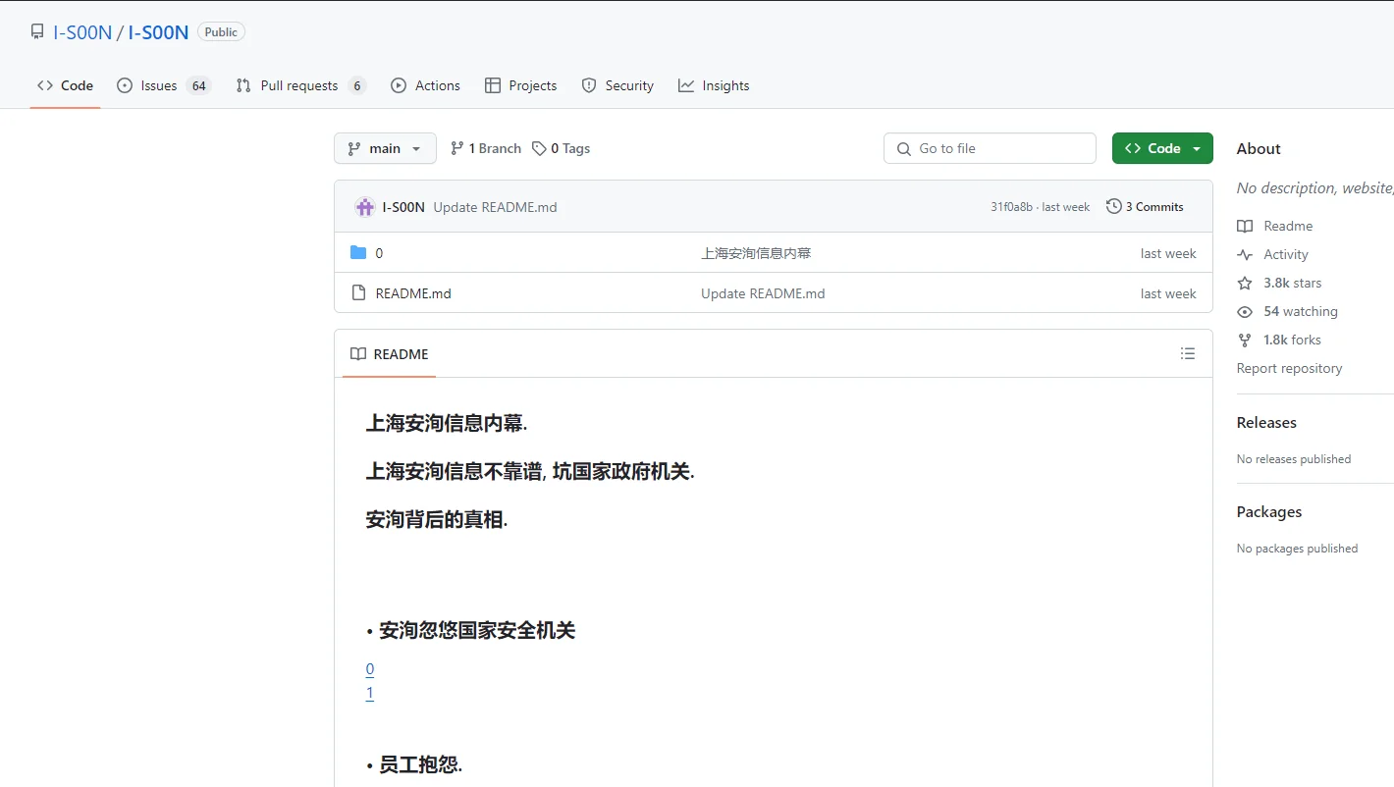
i-Soon leak APT-for-hire for multiple Chinese authorities
It got quickly deleted
80 targets: government of India, Thailand, Vietnam, South Korea, Pakistan, Afghanistan… Chat logs reveal :
A: we've got stuff from their chairman Jens Stoltenberg
B: they are not interested
A: what about making it cheaper? I'm running low on money
FEB 18
1800 forks
Notes:
Chinese firm operated as an APT-for-hire for multiple Chinese authorities
80 targets appear to have been hacked
-------------------------------------------
Chat log:
> A: also they're not interested
> B: we've got stuff from their chairman Jens Stoltenberg
> A: they are not interested
> B: what about making it cheaper? I'm running low on money
> A: it's not about how much it costs, but that it's not worth it
https://www.microsoft.com/en-us/security/blog/2022/05/09/ransomware-as-a-service-understanding-the-cybercrime-gig-economy-and-how-to-protect-yourself/#DEV-0193
https://www.bleepingcomputer.com/news/security/how-the-fbi-nuked-qakbot-malware-from-infected-windows-pcs/

Slide 15
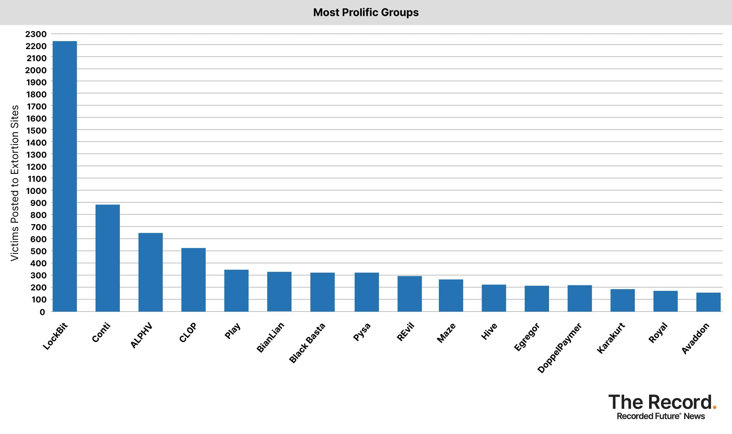
FEB 20
LockBit hackers hacked
Disruption campaign led by British National Crime Agency
Victims: Accenture, British Royal Mail, City of Geraardsbergen, Maldegem, province Namur, French Ministry of Justice, Canada’s largest pediatric hospital, …
2500 victims. More than $500 million in ransom. And caused billions in losses because of the impact.
194 affiliates (the ones that do the actual hacking). 80% off ransom goes to affiliate.
Notes:
US Department of justice: 2500 victims. More than $500 million in ransom. And caused billions in losses because of the impact.
Active since 2019

Slide 16
Number of victims is 50% -60% higher, because not all victims reach the leak site. Source: Orange Cyber Defense

Slide 17
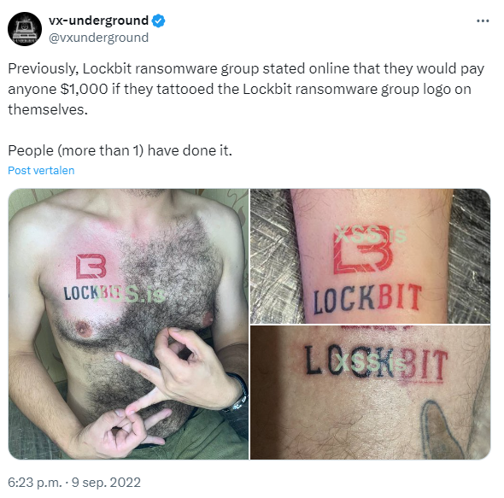
FEB 20
LockBit hackers hacked
Disruption campaign by led British National Crime Agency
Victims: Accenture, British Royal Mail, City of Geraardsbergen, Maldegem, province Namen, French Ministry of Justice, Canada’s largest pediatric hospital, …
2500 victims. More than $500 million in ransom. And caused billions in losses because of the impact.
194 affiliates (the ones that do the actual hacking). 80% off ransom goes to affiliate.
In 2021 LockBit said jokingly they would give money to anyone who would get a tattoo.
Notes:
US Department of justice: 2500 victims. More than $500 million in ransom. And caused billions in losses because of the impact.

Slide 18
And some were crazy enough to do it!

Slide 19
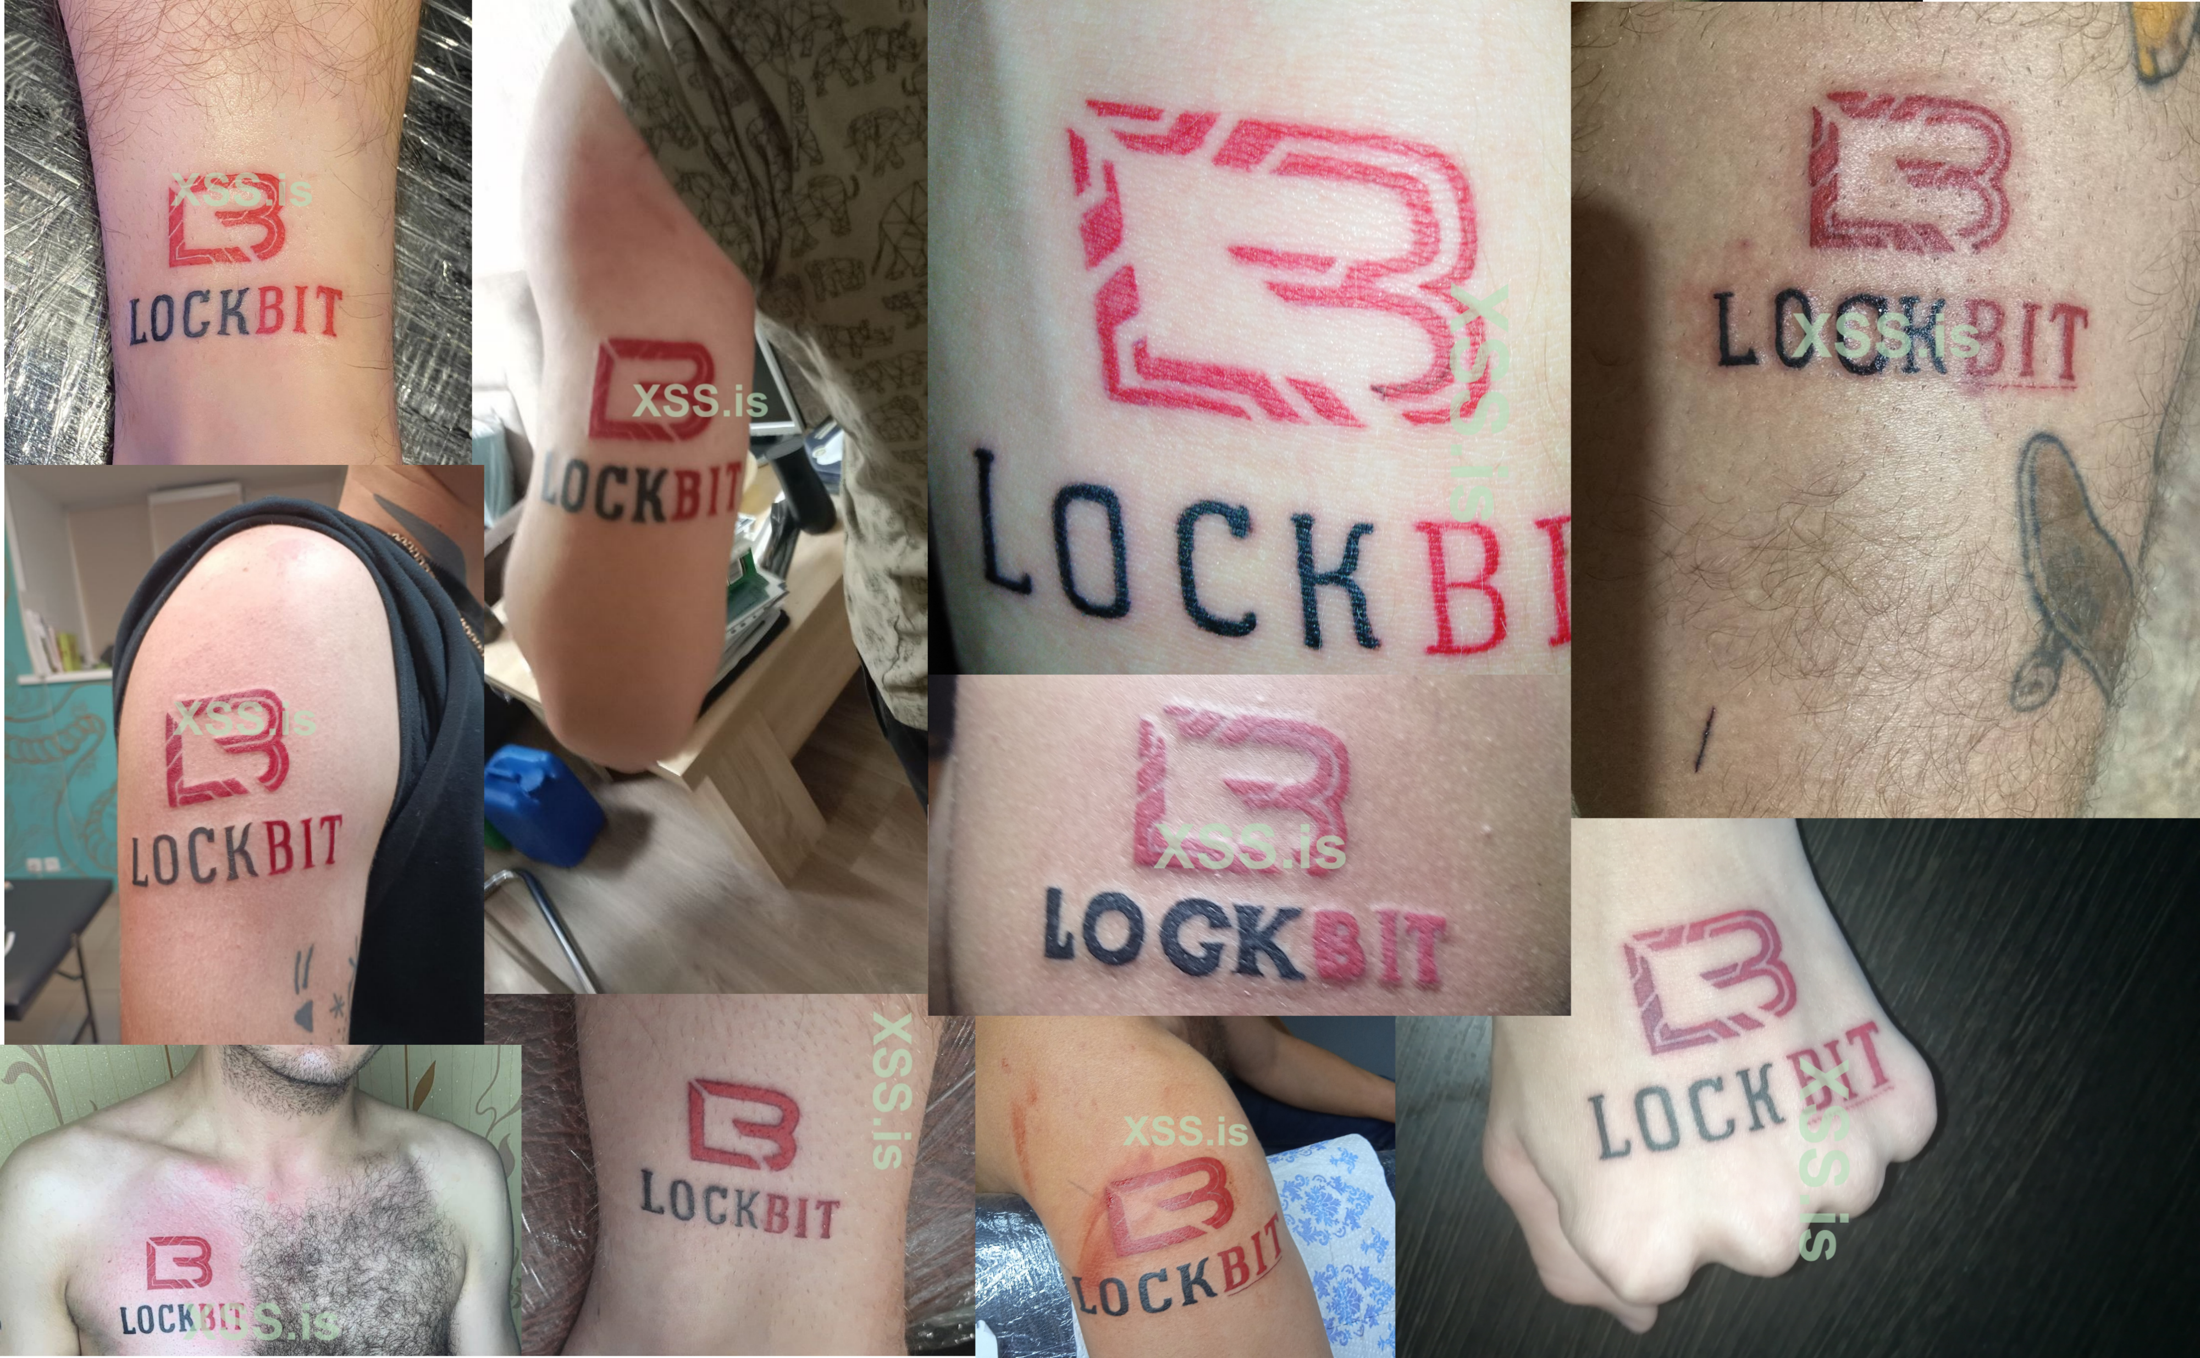

Slide 20
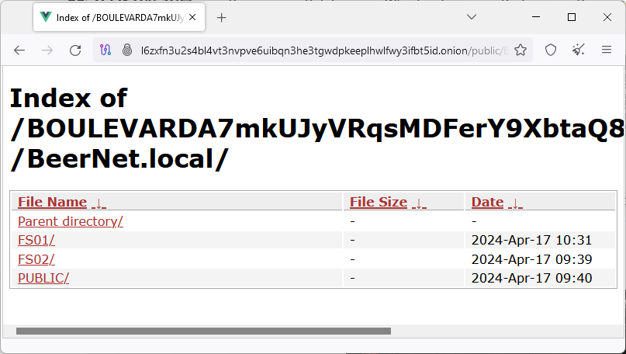
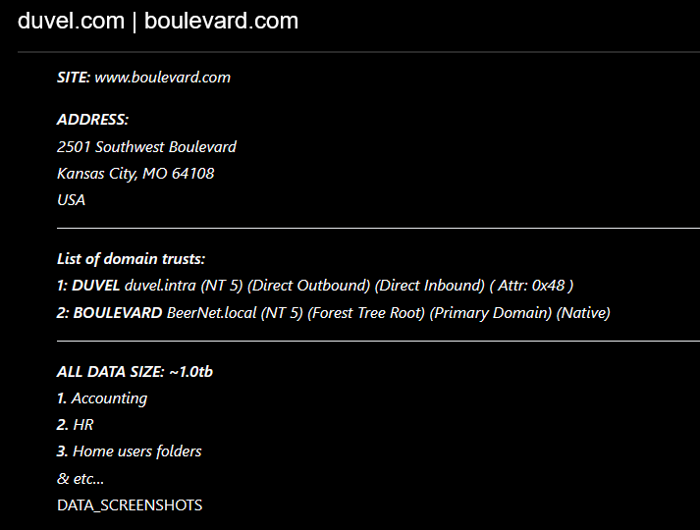
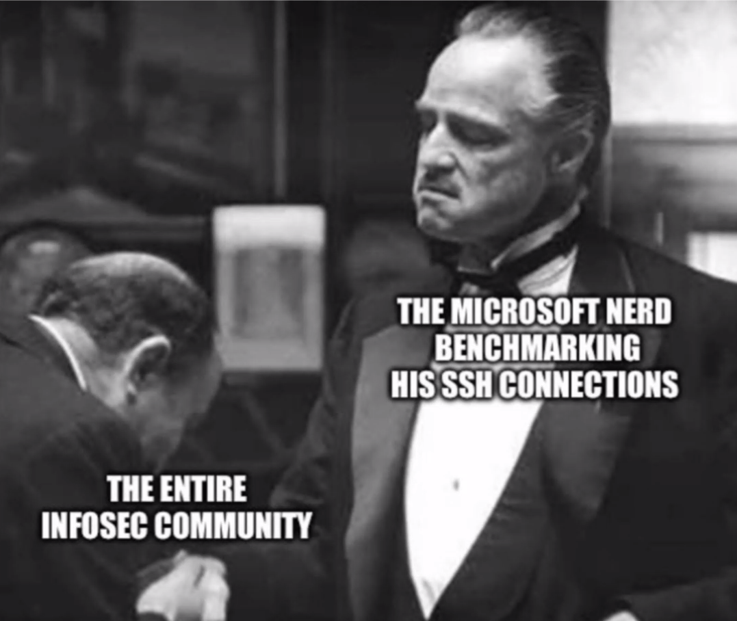
MAR 6
Ransomware attack Duvel Moortgat Ransomware Gang Stormous…
or Black Basta? Conti?
2 fileservers from American daughter & but also access to Belgian DC e.g. domain admins with passwords
1 day later main brewery of Duvel was back in action
MAR 29
XZ Utils backdoor XZ = a compression tool e.g. used in sshd Three years in the making Found by Andres Freund, Postgres developer, working at Microsoft
who thought his CPU levels were suspicious

Slide 22
MAR 20
Microsoft hacked
Chinese cyber-espionage group Storm-0558
compromised the Microsoft Exchange Online mailboxes of 22 organizations around the world.
From 10 State Department e-mail boxes alone, 60 000 emails were stolen
Notes:
“Cascade of security failures” is a very friendly way to say: cluster fuckup
--------------------------------------------------
https://therecord.media/microsoft-details-outlook-hack-on-government-officials-china?utm_campaign=Security%2BNewsletter&utm_medium=web&utm_source=Security_Newsletter_co_214
Microsoft revealed that a China-based hacker group, dubbed Storm-0558, had done exactly that. The group, which is focused on espionage against Western European governments, had accessed the cloud-based Outlook email systems of 25 organizations, including multiple government agencies.

Slide 23
May and June, 2023 Chinese cyber-espionage group Storm-0558 compromised the Microsoft Exchange Online mailboxes of 22 organizations around the world.
From 10 State Department e-mail boxes alone, 60 000 emails were stolen.
“Cascade of security failures at Microsoft” caused hack
Found a key from 2016. These ‘keys to their kingdom’ were still valid after 7 years.
In September: the hackers found the key in a crash dump. In March: we have not found a crash dump containing the impacted key material. It was just a ‘theory’.

Slide 24
May and June, 2023 Chinese cyber-espionage group Storm-0558 compromised the Microsoft Exchange Online mailboxes of 22 organizations around the world.
From 10 State Department e-mail boxes alone, 60 000 emails were stolen.
Jan 19, 2024
Hack #3 by Midnight Blizzard
1) Got access to a legacy test account on Azure by simply guessing passwords. No MFA.
2) Test account had access OAuth application, which had access to production environment
3) Which allowed to steal data from corporate mailboxes at Microsoft
2020 SolarWinds
Hack #1 by Midnight Blizzard at Microsoft
Stole source code for Azure, Intune, and Exchange components.
Mar 8, 2024
Hack #4 by Midnight Blizzard Accessed some of its internal systems and source code repositories using authentication secrets stolen during January cyberattack
Midnight Blizzard Attributed by US and UK as the Foreign Intelligence Service of Russia, also known as the SVR. Infamous for SolarWinds 2020 Supply-Chain Attack
APT29/ Cozy Bear/Nobelium
“Cascade of security failures at Microsoft” caused hack
Found a key from 2016. These ‘keys to their kingdom’ were still valid after 7 years.
In September: the hackers found the key in a crash dump. In March: we have not found a crash dump containing the impacted key material. It was just a ‘theory’.
July 25, 2021
Hack #2 by Midnight Blizzard at Microsoft.
Information stolen for a limited number of customers.
Notes:
SolarWinds 2020 Supply-Chain Attack, the boldest Supply-Chain Attack ever
-----------------
Midnight Blizzard is tracked by partner security vendors as APT29, UNC2452, and Cozy Bear.

Slide 25
We are making security our top priority at Microsoft, above all else, above all features
- Charlie Bell, Executive Vice President, Microsoft Security -
Notes:
boetes, gokken; money you give to politcians. It’s even illegal as a company to give money to politcians. Which I get. But giving millions to cybercriminals is not a problem. That’s even supported/encouraged by the government.
---------------------------------------------------
Maar door losgeld te betalen financier je cybercriminaliteit. Cybercriminelen zetten de opbrengsten van ransomwareaanvallen in om nieuwe aanvallen op andere bedrijven te lanceren.

Slide 26
MAY 20
Microsoft announces Recall Photographic memory of your PC life
Only admins can read the database
Users on the same device can not access the database
June 14: Recall got… recalled
Built-in keylogger/information stealer/password grabber
Nope!
Nope!
delayed to Ocober! Windows Insiders with Copilot+ PCs
Notes:
T“screenshots” of your PC constantly, and makes it into an instantly searchable database of everything you’ve ever seen

Slide 27
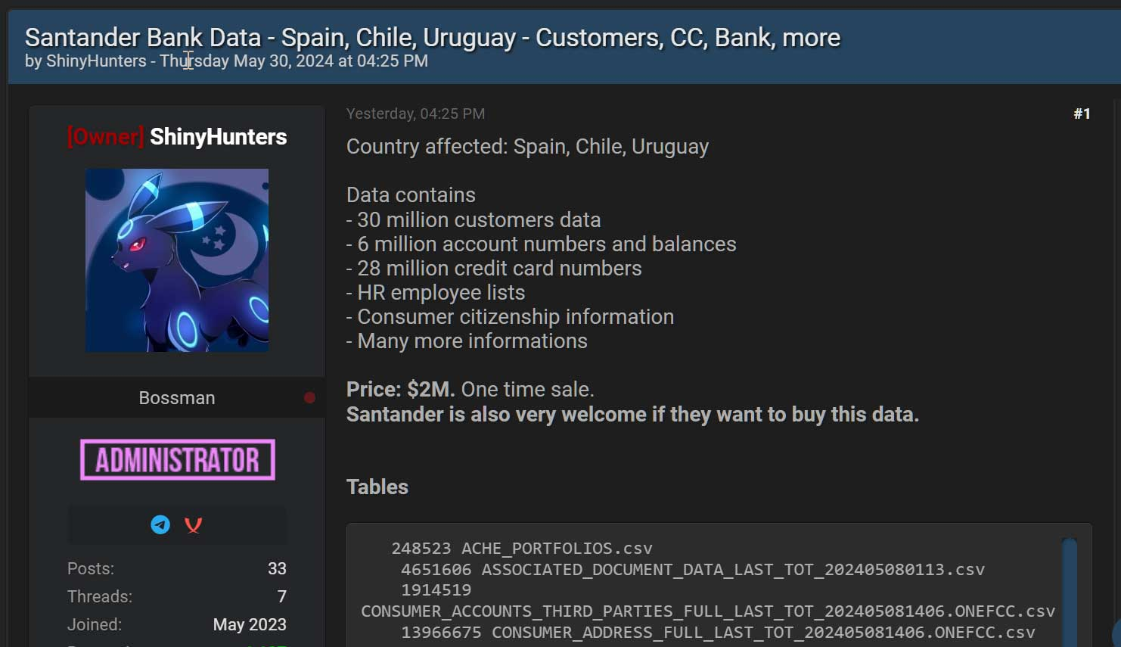
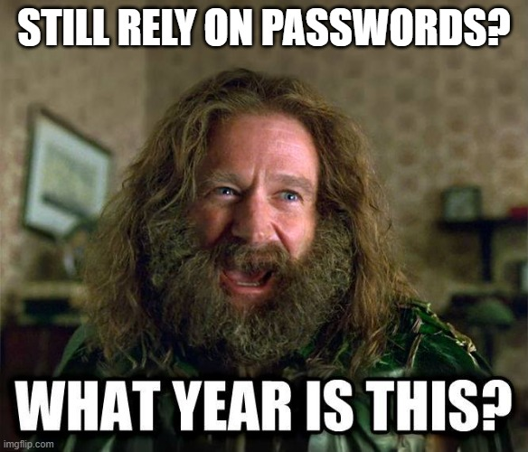
May 14
Data stolen of 30 million customers and employees ‘ShinyHunters’ claims it contains 28 million credit card numbers
May 30
Leading cloud-based data storage and analytics provider
Compromised customer credentials without MFA
Future prediction
This kind of attack will continue, as long as there are sites relying on passwords only
Infostealer malware
April 14
Data stolen of 109 million customers, or nearly all of its mobile customers Months worth of call and text records
Paid $370,000 to delete the data
‘ShinyHunters’ hacked them in 2021 as well
May 20
‘ShinyHunters’ claims data from 560 million customers
One of the largest data breach ever
June 10:
UNC5537
Sell stolen data and extorts victims
“A teen crimeware group”
165 potentially impacted organizations, mostly under the radar
Threat actor claims: Anheuser-Busch, Mitsubishi, …
Notes:
------------------------------------------------------
Sources:
https://www.bleepingcomputer.com/news/security/clop-gang-exploiting-solarwinds-serv-u-flaw-in-ransomware-attacks/
https://www.bleepingcomputer.com/news/security/global-accellion-data-breaches-linked-to-clop-ransomware-gang/

Slide 28
BruCON 2024
The End

Slide 29
Conclusion
Teenage hackers with new skills will keep popping up
No MFA and rely on passwords? You will get hacked at some time.
This will not stop. Next year will not be boring…
This will not stop. Next year will not be boring…
Notes:
Hopefully you learned a lot and/or had a trip of nostalgia
Teens: Snowflake & Scattered Spider
Automation
MFA
Future prediction
This will not stop. Mandiant:
“It is likely that we will continue to observe Chinese cyber espionage operations targeting edge infrastructure with zero-day vulnerabilities”.
------------------
APTs and ransomware gangs are getting bolder
Trend to buy zero-days, also by ransomware gangs
----------------
Moderne cloud hacking is ook een trend bijv. Scattered Spider

Slide 30
Presentation of today
threatexposure.eu/brucon2024.pdf dieter.vandenbosch@threatexposure.eu www.linkedin.com/in/vdbdieter/
Notes:
If you know other places for me to give this presentation, let me know
-------
@Threat_Exposure (Twitter/X) @Threat_Exposure@infosec.exchange (Mastadon)

