Slide 1
CurveBack
A Backdoor Analysis
Stian Jahr, Senior Reverse Engineer
Svein Roger Engen, Senior Reverse Engineer
Rafael Lukas Maers, Reverse Engineering Team Lead

Slide 2
Who are we?
Stian Jahr
Senior Reverse Engineer
Svein Engen
Senior Reverse Engineer
Rafael Lukas Maers
Reverse Engineering Team Lead

Slide 3
What do we do?
Support Managed Detection & Response
Incident Response
Research & Development

Slide 4
Agenda
Introduction
Malware Analysis
Command & Control

Slide 5
Background
Origin
Threat Actor
Malware
mnemonic Incident Response Team (mIRT) engaged to uncover an attack as part of an espionage campaign in 2023
Attack attributed to a China-nexus threat actor, more specifically APT41 by us and other intelligence partners
Employed previously¹ undocumented malware that bares resemblance to – but is different from – CrossWalk and SideWalk (a.k.a. ScrambleCross)
1 As of June 2024

Slide 6
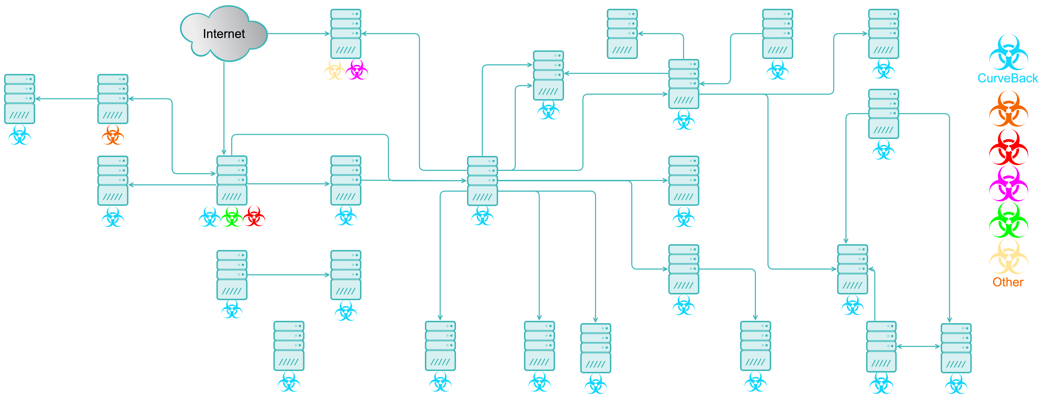
Incident

Slide 7
Overview
CurveLast
Persistence mechanism
DLL hijacking
CurveLoad
Loader
DLL sideloading
CFG bypass and DLL hollowing
CurveBack
Backdoor
ECDH Curve25519
Modular architecture
Components are generally independent, but related by configuration parameters
CurveLast
CurveLoad
mscoree.dll
mscorwks.dll
ntkd.exe
dbgeng.dll
CurveBack
Core
Process execution
File operations
Network
Cryptography
Other

Slide 8
[…] previously undocumented […]
June 14th
mnemonic presents at annual FIRST conference
July 10-11th
Zscaler publishes a two-series blog post on DodgeBox (a.k.a. CurveLoad) and MoonWalk (a.k.a. CurveBack) [1,2]
July 18th
Mandiant publishes a blog post on DUSTTRAP (a.k.a. CurveLoad) and its payload (a.k.a. CurveBack) [3]
August 9th
Trend Micro publishes a blog post on StealthReacher (a.k.a. CurveLoad) and SneakCross (a.k.a. CurveBack) [4]
”Additionally, we want to thank Mnemonic for reaching out to Mandiant to share their observations.”
[1] https://www.zscaler.com/blogs/security-research/dodgebox-deep-dive-updated-arsenal-apt41-part-1
[2] https://www.zscaler.com/blogs/security-research/moonwalk-deep-dive-updated-arsenal-apt41-part-2
[3] https://cloud.google.com/blog/topics/threat-intelligence/apt41-arisen-from-dust
[4] https://www.trendmicro.com/en_us/research/24/h/earth-baku-latest-campaign.html

Slide 9
Malware Analysis

Slide 10
CurveLast
Components
Legitimate, signed, modified dynamic-link library mscoree.dll (Microsoft Runtime Execution Engine)
Malicious, signed dynamic-link library mscorwks.dll (Microsoft Runtime CLR – WorkStation)
%SYSTEMROOT%\Microsoft.NET\Framework64\v4.0.30319\
Outdated code signing certificate allegedly belonging to Russian travel agency OOO ALEAN-TOUR
Recent versions also use other outdated code signing certificates¹
mscoree.dll
Core component of .NET
Loaded at .NET application startup
Location leads to DLL hijacking
Added import from mscorwks.dll
Effectively DLL sideloading
mscorwks.dll
Core component of older .NET versions
Observed two significantly different versions
Encrypted configuration
Command line
Arguments
.NET Application
mscoree.dll
mscorwks.dll
1 https://cloud.google.com/blog/topics/threat-intelligence/apt41-arisen-from-dust

Slide 11
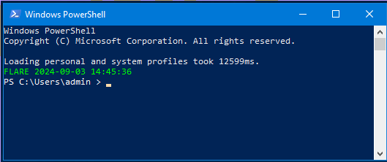
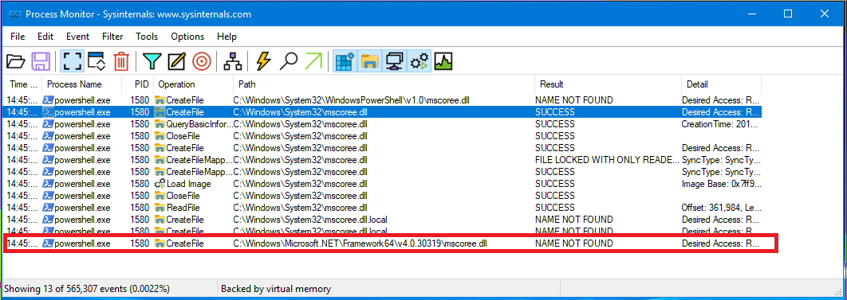
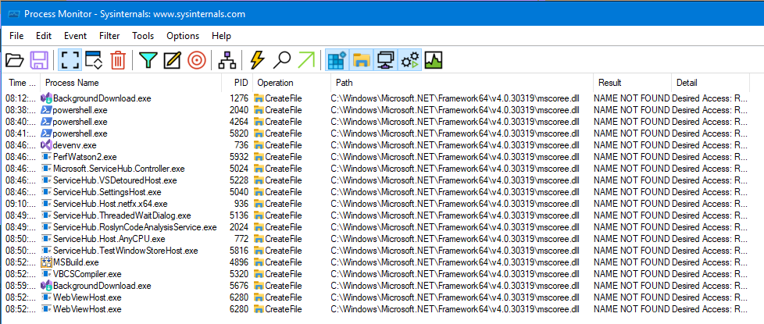
CurveLast – mscoree.dll – DLL sideloading
ng if it is possible, or someone has done, to create a

Slide 12
CurveLast – mscoree.dll – Modifications
 | Original file | Modified
File size | 0x63000 bytes | 0x650A0 bytes
Number of section: | 7 (.text, .rdata, .data, .pdata, .didat, .rsrc, .reloc) | 8 (.text, .rdata, .data, .pdata, .didat, .rsrc, .reloc, .hdata)
Size of Image | 0x67000 | 0x68000
Checksum | 0x6E58E | 0x6F1EC (invalid)
Import Directory | 0x59DE0 (.rdata) | 0x67000 (.hdata)
Security Directory | 0x0 | 0x64000 (raw: overlay)
Overlay | 0 bytes | 0x1100 bytes (Certificate)
Notes:
8352 bytes larger

Slide 13
CurveLast – mscoree.dll – Import Directory
Original Import Directory
Modified Import Directory
Offset (raw) | Name | OriginalFirstThunk | Name | FirstThunk | Imports
0x59de0 | kernel32.dll | 0x59e08 | 0x5a7e6 | 0x4ac80 | 126 imports
Offset (raw) | Name | OriginalFirstThunk | Name | FirstThunk | Imports
0x63000 | kernel32.dll | 0x59e08 | 0x5a7e6 | 0x4ac80 | 126 imports
0x63014 | mscorwks.dll | 0x6703c | 0x6704c | 0x6703c | 1 import: «szAnsi»

Slide 14
CurveLast – mscorwks.dll
Version A
Version B
Executes CurveLoad using Windows Management Instrumentation (WMI)
Mutual exclusion algorithm
Calculates and stores system boot time on disk
%PROGRAMDATA%\sshd_[0-9a-f]{8}\[0-9a-f]{8}
Runs only if calculated system boot time - stored boot time > ± 2 seconds
Executes CurveLoad using scheduled task
Creates scheduled task using registry
Task path in configuration
Triggers at system startup
No security descriptor, no visibility¹
Optionally using COMHandler action
COM class object (CLSID) in configuration
Duplicates token from TrustedInstaller service
.NET Application
mscoree.dll
mscorwks.dll
WMI
CurveLoad
System Startup
Scheduled Task
1 https://www.microsoft.com/en-us/security/blog/2022/04/12/tarrask-malware-uses-scheduled-tasks-for-defense-evasion/

Slide 15
CurveLast – mscorwks.dll – Scheduled task
HKLM\Software\Microsoft\Windows NT\CurrentVersion\Schedule\TaskCache\
Tree\<Task Path>
Tasks\<Task ID>
Boot\<Task ID>
Without CLSID
Tree\<Task Path>\Actions: <CmdLine>, <Args>
With CLSID
Tree\<Task Path>\Actions: <CLSID>, <Args>
HKCR\CLSID\<CLSID>\InprocServer32: <CmdLine>
03 00 0c 00 00 00 41 00 75 00 74 00 68 00 6f 00 |......A.u.t.h.o.|
72 00 66 66 00 00 00 00 6c 00 00 00 43 00 3a 00 |r.ff....l...C.:.|
5c 00 50 00 72 00 6f 00 67 00 72 00 61 00 6d 00 |\.P.r.o.g.r.a.m.|
20 00 46 00 69 00 6c 00 65 00 73 00 5c 00 57 00 | .F.i.l.e.s.\.W.|
69 00 6e 00 64 00 6f 00 77 00 73 00 20 00 4d 00 |i.n.d.o.w.s. .M.|
65 00 64 00 69 00 61 00 20 00 50 00 6c 00 61 00 |e.d.i.a. .P.l.a.|
79 00 65 00 72 00 5c 00 77 00 6d 00 70 00 6e 00 |y.e.r.\.w.m.p.n.|
65 00 74 00 77 00 6b 00 68 00 6f 00 73 00 74 00 |e.t.w.k.h.o.s.t.|
2e 00 65 00 78 00 65 00 0e 00 00 00 2f 00 64 00 |..e.x.e...../.d.|
20 00 61 00 75 00 74 00 6f 00 4a 00 00 00 43 00 | .a.u.t.o.J...C.|
3a 00 5c 00 50 00 72 00 6f 00 67 00 72 00 61 00 |:.\.P.r.o.g.r.a.|
6d 00 20 00 46 00 69 00 6c 00 65 00 73 00 5c 00 |m. .F.i.l.e.s.\.|
57 00 69 00 6e 00 64 00 6f 00 77 00 73 00 20 00 |W.i.n.d.o.w.s. .|
4d 00 65 00 64 00 69 00 61 00 20 00 50 00 6c 00 |M.e.d.i.a. .P.l.|
61 00 79 00 65 00 72 00 00 00 |a.y.e.r... |
03 00 0c 00 00 00 41 00 75 00 74 00 68 00 6f 00 |......A.u.t.h.o.|
72 00 77 77 00 00 00 00 e0 7f 86 86 49 a1 ab 49 |r.ww....à...I¡«I|
b5 d9 fb 23 3d 8d bd 32 0e 00 00 00 2f 00 64 00 |µÙû#=.½2..../.d.|
20 00 61 00 75 00 74 00 6f 00 | .a.u.t.o. |

Slide 16
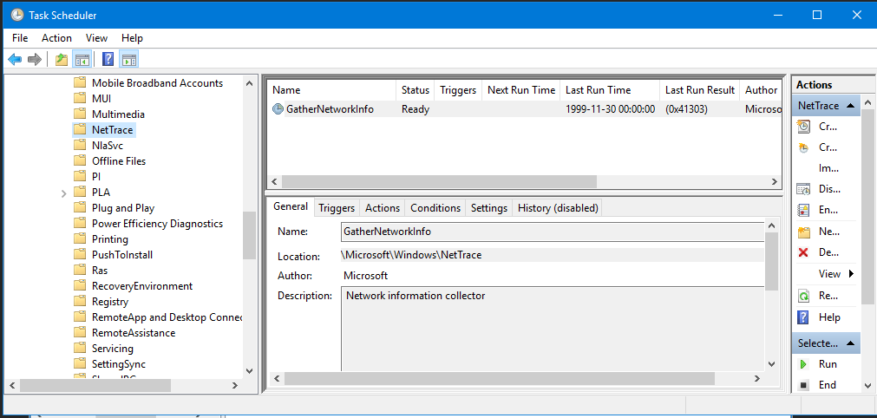
CurveLast – mscorwks.dll – Security Descriptor

Slide 17
CurveLoad
Components
Legitimate executable from Microsoft, with original name ntkd.exe (NT Kernel Debugger)
Malicious, signed dynamic-link library dbgeng.dll (Debugger Engine)
Encrypted CurveBack payload in separate file on disk
Encrypted configuration
Obfuscated command line arguments
Payload location, offset, size, integrity and encryption parameters
Miscellaneous Boolean behavioural parameters, e.g. PEB unlinking and self-deletion
CFG bypass and DLL hollowing
Similarities to StealthVector¹ loader for ScrambleCross (a.k.a. SideWalk)
Recent versions re-encrypt the payload using md5(machine_guid) as IV^{2,3}
ntkd.exe
DLL sideloading
dbgeng.dll
DLL hollowing
CurveBack
1 https://documents.trendmicro.com/assets/white_papers/wp-earth-baku-an-apt-group-targeting-indo-pacific-countries.pdf
2 https://www.zscaler.com/blogs/security-research/dodgebox-deep-dive-updated-arsenal-apt41-part-1
3 https://cloud.google.com/blog/topics/threat-intelligence/apt41-arisen-from-dust

Slide 18
CurveBack
Core is a standalone EXE, embedding:
Configuration
Network module
Cryptography module
Framework for command dispatching and module coordination
All backdoor functionality implemented in modules, also loaded using DLL hollowing
Encrypted configuration contains parameters for core as well as embedded modules
Once embedded configuration and modules are loaded, it’s retrieves commands from C2
Employs several offensive techniques
API hashing
Indirect syscalls
EDR hook bypass
Recent versions Windows Fibers API to evade detection^{1,2,3}, but not present in our sample.
CurveBack
Core
Process execution
File operations
Network
Cryptography
Other
1 https://cloud.google.com/blog/topics/threat-intelligence/apt41-arisen-from-dust
2 https://www.trendmicro.com/en_us/research/24/h/earth-baku-latest-campaign.html
3 https://www.zscaler.com/blogs/security-research/moonwalk-deep-dive-updated-arsenal-apt41-part-2

Slide 19
DLL Hollowing
Find candidate/sacrificial DLL
Search for DLLs in the system directory
Excluding 58 hardcoded filenames (same list in StealthVector, CurveLoad and CurveBack)
Check various properties, e.g. characteristics, alignment and section size to contain payload
Determine hollow DLL path
Check privileges by writing to %SYSTEMROOT%\Microsoft.NET\Framework\[0-9]{10}.log
%SYSTEMROOT%\Microsoft.NET\assembly\GAC_MSIL\System.Core\v4.0_4.0.0.0_[0-9a-f]{16}
%PROGRAMDATA%\Microsoft.NET.Core\System.Core\v4.0_4.0.0.0_[0-9a-f]{16}
Note: Legitimate subdirectory is v4.0_4.0.0.0__[0-9a-f]{16} with double underscores
Hollow DLL and load module into process memory
Prepare: Write payload to hollow DLL file on disk
Load: Use NtCreateSection and NtMapViewOfSection
Cleanup: Copy candidate/sacrificial DLL to hollow DLL file
Inspired by phantom DLL hollowing¹, but detected by hollows_hunter² and pe-sieve³
1 https://www.forrest-orr.net/post/malicious-memory-artifacts-part-i-dll-hollowing
2 https://github.com/hasherezade/hollows_hunter
3 https://github.com/hasherezade/pe-sieve

Slide 20
Modules
Module ID | Description
6 | HTTP
7 | Google Drive
Three enumerated module types: 1, 2, 3
Type 3: Cryptography
Implements cryptographic algorithms, e.g. symmetric, asymmetric, hashing
Necessary for C2 communication, and thus embedded in CurveBack
Only observed one, implementing Curve25519 for key negotiation
Type 2: Network
Implements C2 protocol, and thus embedded in CurveBack
Observed Google Drive (incident) and HTTP (public samples)
Type 1: General
Implements backdoor functionality, e.g. process execution, file operation, etc.
Transferred from C2 when necessary, and only present in memory
Extracted 16 modules, some with different compilation times
Compilation times coincides with incident timeline
Updated functionality implies active development
Module ID | Description
1 | Process execution
2 | Filesystem operation
3 | Shellcode injection
5 | Connectivity check
6 | Network information
8 | Screenshot
9 | Host information
10 | File operation
12 | Relay
13 | Keylogger
14 | User information
17 | File read
18 | RDP sessions
19 | DNS query
23 | DNS cache
24 | Registry

Slide 21
Module extraction
Modules transferred from C2 are stored as entries in a circular doubly linked list in memory
Each entry contains among other AES-CFB128 encrypted module and encryption parameters
Entries are not automatically removed, which enables module extraction from process dumps
Find entry with known id, type and enc_mod_size
Decrypt enc_buf with key = md5(key) and iv
Store metadata and decrypted module on disk
Iterate circular doubly linked list until first entry
struct module_entry {
_DWORD id;
_DWORD type;
_DWORD enc_mod_size;
…
enc_mod *enc_mod; // 0x10
…
LIST_ENTRY list; // 0x58
};
struct enc_mod {
…
_BYTE key[16]; // 0x18
_BYTE iv[16];
_DWORD enc_size;
_BYTE enc_buf[];
}

Slide 22
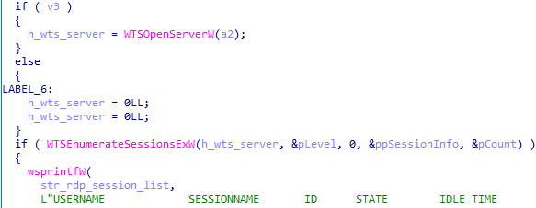
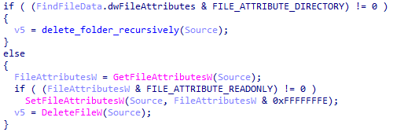
Module comparison
No changes, except for updated compile timestamps
No functional changes, but more robust implementation
Functional changes, extending backdoor module functionality
2023-06-21
2023-08-17

Slide 23
Keylogger
Poor implementation is an easy win
Keylogger data stored in file on disk
C:\Users\Public\Document\[0-9]{1,10}\[0-9a-f]{32}
%APPDATA%\[0-9]{1,10}\[0-9a-f]{32}
Encrypted with AES-CBC and custom obfuscation
Encryption key is derivable from folder name [0-9]{1,10}, e.g. 1234567890
First entry is at offset 0x8, and each entry is encrypted with the same key and IV zero
struct keylogger_entry {
_DWORD entry_size;
_QWORD timestamp;
_DWORD username_size;
wchar_t username[]; // username_size
_DWORD title_size;
wchar_t title[]; // title_size
_DWORD exe_size;
wchar_t exe[]; // exe_size
_DWORD keys_size;
wchar_t keys[]; // keys_size
}
fname = ‘1234567890’
tmp = fname.encode(’utf-16le’)
tmp = md5(tmp).hexdigest().upper()
tmp = tmp.encode(‘utf-16le’)
key = CryptDeriveKeyMD5(tmp)
for d in data:
out.append(((d + 0x7c) ^ 0xee) & 0xff)

Slide 24
OpCodes
Req. | Res. | Description
0x01 | 0x02 | Request beacon
0x0A | N/A | Time sync. (noop)
0x0B | N/A | Reset network connections
0x0C | 0x0D | Get/set network module timeouts
0x11 | 0x12 | Get/set core module timeouts
0x0F | 0x16 | Load relay configuration
0x14 | 0x15 | Get module information
0x17 | N/A | Load and activate module
0x18 | 0x19 | Deactivate module
0x1A | 0x1B | Unload module
0x32 | 0x33 | Get configuration
0x34 | 0x35 | Set configuration
0x3C | 0x41 | Set general module thread token
0x3D | 0x41 | Steal process token, and 0x3C
0x3E | 0x41 | Create user token, and 0x3C
Req. | Res. | Description
0x01 | 0x02 | Request beacon
0x0A | N/A | Time sync. (noop)
0x0B | N/A | Reset network connections
0x0C | 0x0D | Get/set network module timeouts
0x11 | 0x12 | Get/set core module timeouts
0x0F | 0x16 | Load relay configuration
0x14 | 0x15 | Get module information
0x17 | N/A | Load and activate module
0x18 | 0x19 | Deactivate module
0x1A | 0x1B | Unload module
0x32 | 0x33 | Get configuration
0x34 | 0x35 | Set configuration
0x3C | 0x41 | Set general module thread token
0x3D | 0x41 | Steal process token, and 0x3C
0x3E | 0x41 | Create user token, and 0x3C
Generally
All requests have a response
Response = Request + 1
“Rules are meant to be broken”
Note: General (type 1) modules are based on module ID when interpreted in hexadecimal
Core
Req. | Res. | Description
901 | 902 | Enumerate WTS sessions
903 | 904 | Get installed security products
905 | 906 | Get host information
907 | 908 | Get user, groups and privileges
909 | 910 | Get system boot time
911 | 912, 913 | Enumerate open windows
Host information (ID 9)
Req. | Res. | Description
901 | 902 | Enumerate WTS sessions
903 | 904 | Get installed security products
905 | 906 | Get host information
907 | 908 | Get user, groups and privileges
909 | 910 | Get system boot time
911 | 912, 913 | Enumerate open windows

Slide 25
Command & Control

Slide 26
Emotional Roller Coaster
Advanced Encryption Standard!
Key embedded in malware or transferred in clear text?!
Crash & Process dumps!
They should contain key material!
Dumps contain packets!
They should contain matching data and keys!
They used AES-CFB!
Elliptic Curve Cryptography
Does anyone have a quantum computer?
Wrong keys!
Keys are negiotiated for each session
Wrong IVs!
Renewed for each message and unpredictable

Slide 27
Cryptography
By Gwenda (PNG version), WhiteTimberwolf (SVG version) - PNG version, Public Domain, https://commons.wikimedia.org/w/index.php?curid=26434097

Slide 28
Command & Control
Supports several C2 communication protocols
Determined by embedded modules
Tracking operator activity requires decode several layers of obfuscation
Compression: LZ4
Symmetric: AES-CFB128
Asymmetric: Curve25519
Application: HTTP, Google Drive
Encapsulation: TLS
Additionally requires knowledge of hardcoded client/server pinning key
Located in CurveBack configuration
Key negotiaton is performed per session
IV renewal is performed per message

Slide 29
High Level Description
Communicates directly over HTTP
Templates in CurveBack configuration
Message structure
Metadata: session id, etc.
Payload: encrypted message
Client messages
Cookie header, GET /Api/v2/Proxy/Get/<md5>
HTTP body template, POST /Api/v2/Proxy/Post/<md5>
Server messages
HTTP body template, HTTP 200
Google Drive as intermediary for C2
Credentials in CurveBack configuration
Client uploads public key to /data/temp/<session id>
Server uploads public key to /data/<session id>/s1/1
Session established
Client folder: /data/<session id>/c1
Server folder: /data/<session id>/s1
Compromised Client
Command & Control

Slide 30
Key Exchange
Session identification
HTTP: http_metadata
Google Drive: folder name
XOR key in http_metadata
Key exchange
HTTP: key_exchange
Google Drive: gdrive_c2s_kx, gdrive_s2c_kx
XOR key in CurveBack configuration
AES Key = ECC Shared Secret ^ XOR Key (from CurveBack configuration)
struct key_exchange {
_BYTE public_key_xored[32];
_BYTE host_iv_xored[16];
_DWORD key_iv_xorkey_md5;
_DWORD host_hash;
_BYTE conn_type;
_BYTE padding[];
};
struct gdrive_c2s_kx {
_BYTE sequence_number;
key_exchange kx;
};
struct http_metadata {
_QWORD session_id_xored;
_DWORD payload_size_shifted_xored;
_WORD payload_fnv1a_xored;
_WORD xorkey;
};
struct gdrive_s2c_kx {
_BYTE zeros[7];
_BYTE sequence_number;
_BYTE junklen;
_BYTE junk[junklen];
key_exchange kx;
};

Slide 31
Messages
struct message {
_WORD compressed_size; // xored with host_iv
_DWORD integrity;
_BYTE is_compressed;
_BYTE data[compressed_size]; // message_data
};
Can be split into at least three logical layers
Header: validation
Data: dispatching
Payload: command
Encrypted (except for compressed_size) using AES-CFB128 with negotiated AES key and host_iv
Use of host_hash or host_hashes depends on the direction
The payload structure depends on op_code and module_id
struct message_data {
_BYTE to_client;
_BYTE message_queue;
_DWORD decompressed_size;
union {
_DWORD host_hash; // client to server
struct host_hashes { // server to client
_DWORD count;
_DWORD host_hash[count];
};
};
_WORD op_code;
_DWORD module_id;
_DWORD transaction_id;
_DWORD payload_size;
_BYTE payload[payload_size];
};
struct gdrive_msg {
_BYTE zeros[7];
_BYTE sequence_number;
_BYTE junklen;
_BYTE junk[junklen];
message msg;
};

Slide 32
Payload
Depends highly on op_code and module_id in the message data
A simple example for completeness
Request
OpCode: 909 (get system boot time)
Module: 9 (host Information)
Payload: empty
Response
OpCode: 910 (system boot time)
Module: 9 (host information)
Payload: payload_910
struct payload_910 {
_DWORD success;
_DWORD size;
wchar_t string[size];
};
00000000 01 00 00 00 25 00 00 00 |....%...|
00000008 53 00 79 00 73 00 74 00 |S.y.s.t.|
00000010 65 00 6d 00 20 00 62 00 |e.m. .b.|
00000018 6f 00 6f 00 74 00 20 00 |o.o.t. .|
00000020 74 00 69 00 6d 00 65 00 |t.i.m.e.|
00000028 3a 00 20 00 32 00 30 00 |:. .2.0.|
00000030 32 00 34 00 2d 00 30 00 |2.4.-.0.|
00000038 39 00 2d 00 31 00 31 00 |9.-.1.1.|
00000040 20 00 30 00 37 00 3a 00 | .0.7.:.|
00000048 31 00 35 00 3a 00 31 00 |1.5.:.1.|
00000050 32 00 |2.|

Slide 33
Applications
Operator Activity Tracking
C2 Hijacking
C2 Sinkholing
Possible, but difficult due to technical requirements
Data: TLS decryption
AES key: Process dumps
XOR key from CurveBack configuration
Encrypted payload, OR
Process dumps
AES IV
TLS decrypted data, AND
XOR key from CurveBack configuration
Possibly more feasible than operator activity tracking
XOR key from CurveBack configuration
C2 server implementation
HTTP: Reroute traffic to own C2 server
Google Drive:
Register a watcher that notifies upon file uploads
Hijack key exchange before TA C2 server
Might observe infected clients from other environments
Might leave traces observable by TA
Similar to C2 hijacking, but more requirements
C2 server implementation
HTTP: domain sinkholing
Google Drive: same as C2 hijacking
Note: XOR keys from CurveBack configurations outside own environment

Slide 34
Resources
Watch out for upcoming technical report in the near future!
Can’t wait for the technical report and want to have a look yourself?
CurveLoad & CurveBack

Slide 35
Thank you!
Stian Jahr
Senior Reverse Engineer
Svein Engen
Senior Reverse Engineer
Please visit mnemonic.io
or follow us at
Rafael Lukas Maers
Reverse Engineering Team Lead

