Slide 1
I don’t need privacy,
I got confidentiality!
And other privacy misconceptions
Kim Wuyts
Manager Cyber & Privacy

Slide 3
Do you really need all of it?
Only take what you really need or it can get messy
3

Slide 5
What is going on?
1
5

Slide 6
What can go wrong?
2
Scoop will fall off
Too much to finish
Starts eating the cone
Doesn’t like the flavor
It starts melting and make a mess
6

Slide 7
What to do about it?
3
Limit to 2 scoops
Favorite flavor
In a cup
7

Slide 8
Wait a minute?!
4
Limit to 2 scoops
Different
Appetite?
Favorite flavor
Different shop,
Different preference?
In a cup
+ Napkins
(lots of napkins!!)
8

Slide 9
Threat modeling
1
What is going on?
2
What can go wrong?
3
What to do about it?
4
Wait a minute?!
9

Slide 10
Kim Wuyts
Privacy engineer | Threat modeling expert | AppSec enthusiast | privacy-by-design advocate
LINDDUN Privacy Threat Modeling Pioneer
Threat Modeling Manifesto Co-Author
International Workshop of Privacy Engineering (IWPE) Program Co-Chair
ENISA ad-hoc Working Group on Data Protection by Design Member
Institute of Privacy Design (IOPD) Advisor
PhD in privacy engineering
Cyber & Privacy Manager at PwC Belgium
Kim.Wuyts@pwc.com
@wuytski
@kimw@mastodon.social
https://www.linkedin.com/in/kwuyts/
10

Slide 11
Privacy

Slide 12
Why privacy matters?
12

Slide 13
Why privacy matters?
I HAVE DONE NOTHING WRONG,
SO I HAVE NOTHING TO HIDE
MISCONCEPTION
13

Slide 14
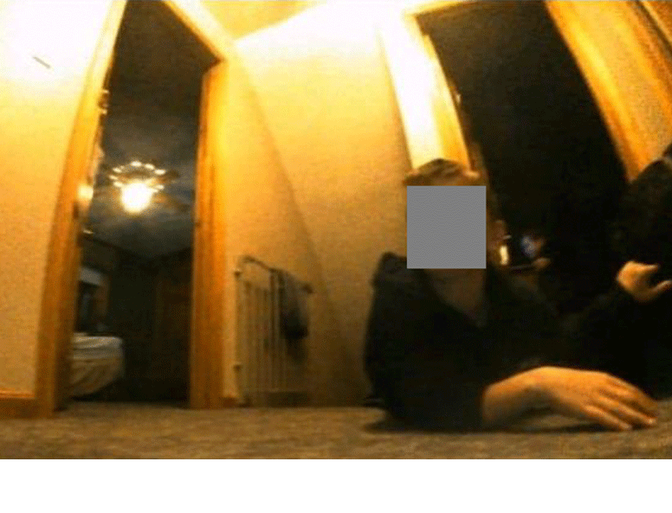
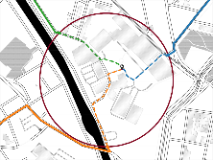
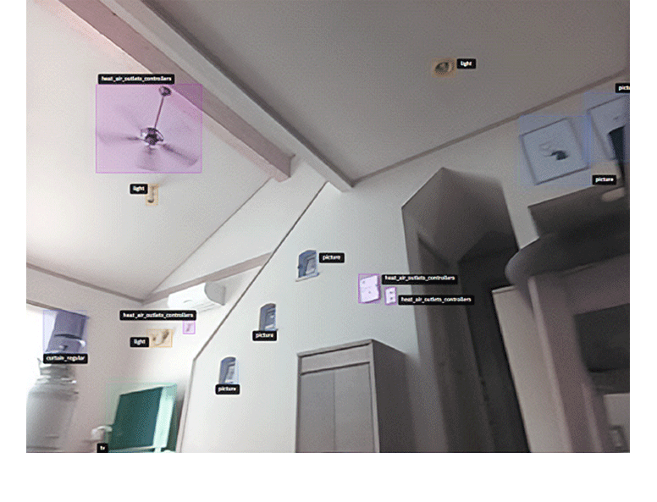
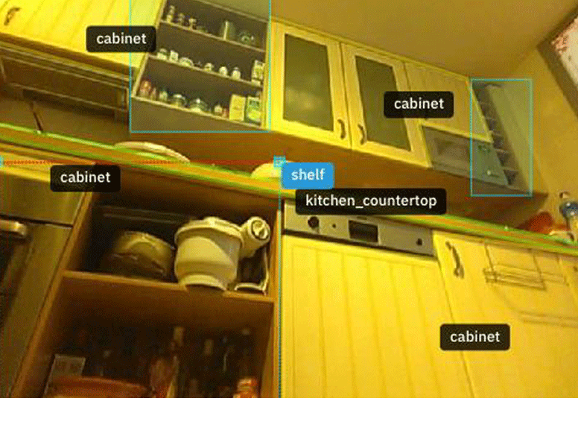
Why privacy matters?
Roomba testers feel misled after intimate images ended up on Facebook
A run a day won’t keep the hacker away: privacy in sports apps often subpar
KU Leuven News
Nov 2022
Tesla workers shared images from car cameras, including “scenes of intimacy”
MIT technology review
Jan 2023
I HAVE DONE NOTHING WRONG,
SO I HAVE NOTHING TO HIDE
Ars Technica, April 2023
MISCONCEPTION
From cheating to pregnancy reveals, wearables know what you're doing intimately
Inverse, March 2020
14

Slide 15
PRIVACY IS THE LAWYERS’ PROBLEM
COMPLIANCE
MISCONCEPTION

Slide 16
Compliance is Overrated
We need
Privacy Engineering
16

Slide 17
NO WORRIES! WE HAVE CONFIDENTIALITY!
SECURITY vs. PRIVACY
MISCONCEPTION

Slide 18
PRIVACY
ENGINEERING
INTERVENABILITY
MANAGEABILITY
UNLINKABILITY
TRANSPARENCY
DISASSOCIABILITY
PREDICTABILITY
M. Hansen, M. Jensen and M. Rost, "Protection Goals for Privacy Engineering," 2015 IEEE Security and Privacy Workshops, 2015
NISTIR 8062 An Introduction to Privacy Engineering and Risk Management in Federal Systems, 2017
18
Notes:
Privacy engineering protection goals (Hansen, Jensen & Rost)
Privacy engineering objectives (NIST)

Slide 19
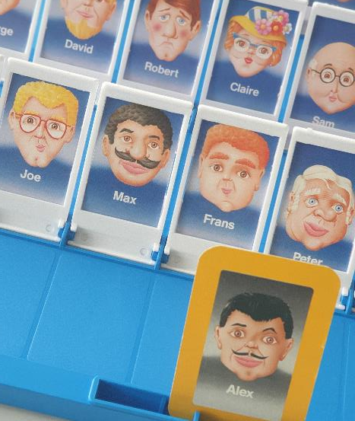
UNLINKABILITY
CONNECTING THE DOTS
19
Notes:
Own picture

Slide 20
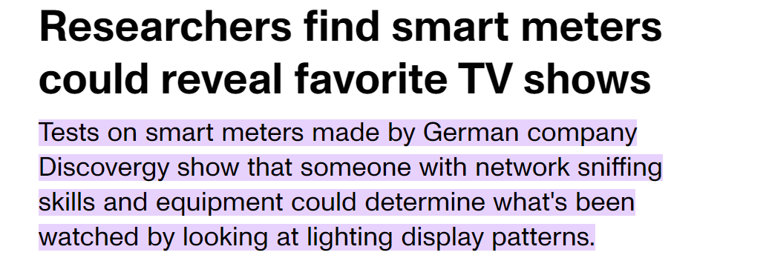
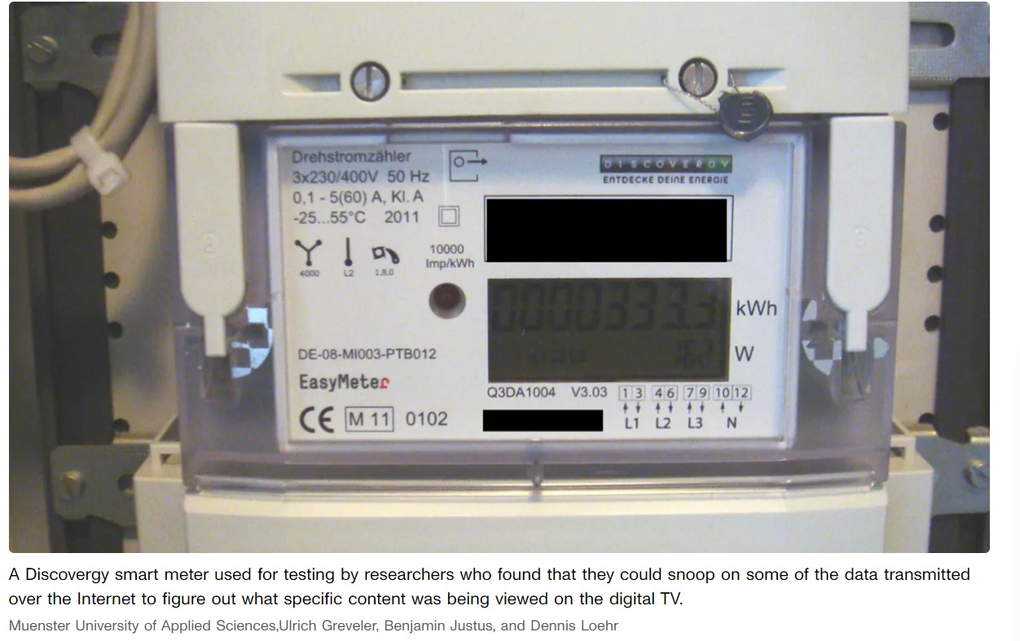
UNLINKABILITY
https://www.cnet.com/news/privacy/researchers-find-smart-meters-could-reveal-favorite-tv-shows/
20

Slide 21
UNLINKABILITY
PERIOD TRACKING APPS
Roe v. Wade
The US Supreme Court overruled Roe in 2022
ending the constitutional right to abortion.
21
Notes:
Roe v. Wade, 410 U.S. 113 (1973),^{[1]} was a landmark decision of the U.S. Supreme Court in which the Court ruled that the Constitution of the United States conferred the right to have an abortion.
In June 2022, the Supreme Court overruled Roe in Dobbs v. Jackson Women's Health Organization on the grounds that the substantive right to abortion was not "deeply rooted in this Nation's history or tradition", nor considered a right when the Due Process Clause was ratified in 1868, and was unknown in U.S. law until Roe. This view was disputed by some legal historians and criticized by the dissenting opinion,^{[21][22]} which argued that many other rights—contraception, interracial marriage, and same-sex marriage—did not exist when the Due Process Clause was ratified in 1868, and thus, by the Dobbs majority's logic, were not constitutionally protected.^{[23]} The decision was supported and opposed by the anti-abortion and abortion-rights movements in the United States, respectively, and was generally condemned by international observers and foreign leaders.
https://www.nature.com/articles/d41586-022-02139-3

Slide 22
TRANSPARENCY
INFORM
CONTROL
INTERVENABILITY
22
Notes:
Own picture

Slide 23
TRANSPARENCY & INTERVENABILITY
WANT TO KNOW MORE?
We hope you will not read this part because when you click on this link you will sell us your soul.
YES! SHOW ME THE COOL STUFF
No. I am a boring person
Notes:
Mediahuis – 45days (sept 3) to fix the use of deceptive user patterns, or 25K fine per day.

Slide 24
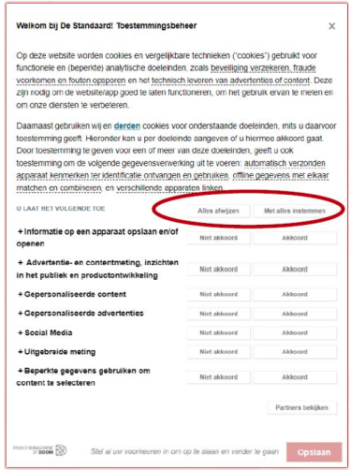
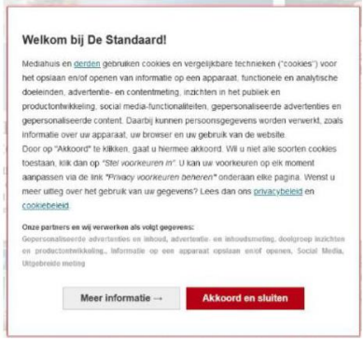
TRANSPARENCY & INTERVENABILITY
Reject all option only at a second layer
September 3, 2024
https://www.dataguidance.com/news/belgium-dpa-imposes-daily-fine-25000-mediahuis-due-dark
Deceptive colors for buttons.
Screenshots from https://www.gegevensbeschermingsautoriteit.be/publications/beslissing-ten-gronde-nr.-113-2024-van-6-september-2024.pdf
24
Notes:
Also revocation wasn’t easy + legitimate basis was used as backup option

Slide 25
TRANSPARENCY
INFORM
CONTROL
INTERVENABILITY
MINIMALITY
UNLINKABILITY
25
Notes:
Own picture

Slide 26
What your car (company) can collect about you
Name
Address
Phone number
Email
Date of birth
Your credit card number social security number
Driving habit and style
Use of accelerator
Location history
Marital status
Race
Education
Medical information
Health insurance information
Genetic information
Facial templates
Keystroke
Physical or mental disability
Voiceprints
Audio recordings of vehicle occupants
Pictures
Iris or retina scans
Gait
Sleep data
Sexual activity
Religion or creed
Philosophical beliefs
…
Mozilla’s Privacy Not Included study,Sept 2023
https://foundation.mozilla.org/en/privacynotincluded/articles/what-data-does-my-car-collect-about-me-and-where-does-it-go/

Slide 27
September 9, 2024
“
https://therecord.media/ford-patent-application-in-vehicle-listening-advertising
“In one example, the controller may monitor user dialogue to detect when individuals are in a conversation,” the patent application says. “The conversations can be parsed for keywords or phrases that may indicate where the occupants are traveling to.”
The tech — labeled as “in-vehicle advertisement presentation” — will determine where a car is located, how fast it is traveling, what type of road it is driving on and whether it is in traffic. It also will predict routes, speeds and destinations to customize ads to drivers, the application said.
”
27

Slide 28
PRIVACY MITIGATIONS & CONTROLS Going beyond compliance and security
Unlinkability Minimality
Transparency
Inform
Intervenability
Control / Empower
Minimize personal data being collected, processed, stored, and shared
De-identification techniques
Data deletion (retention period)
Limit processing to intended purposes
Privacy notices
(e.g. transparency enhancing technologies (TETs) to align with implementation)
UI/UX avoiding deceptive patterns
Consent management
Support for data subject requests
(e.g. data subject access request (DSAR), deletion, updating)
Notes:
Minimize = broad term: separate, hide, abstract, minimize
DSAR: ‘without undue delay’, within one month

Slide 29
NO WORRIES! WE HAVE CONFIDENTIALITY!
SECURITY vs. PRIVACY
MISCONCEPTION
WE VALUE SECURITY SO WE CAN’T SUPPORT PRIVACY!
MISCONCEPTION

Slide 30
I KNOW WHAT YOU DID LAST SUMMER
NON-REPUDIATION
PROOF OF A CLAIM
ABOUT AN INDIVIDUAL
Evidence of action
Evidence of the claim / action
Attribution to the individual
Attributed to the individual
30
Notes:
Own picture

Slide 31
PLAUSIBLE DENIABILITY
vs. NON-REPUDIATION
Conflicting requirements?
Even on the same action, both are reconcilable
31

Slide 32
DIFFERENT MINDSET
SECURITY
PRIVACY
Protecting data
Company assets
(External) attacker
Protecting personal data
Data subject assets
Attacker + (internal) ‘misbehavior’
32
Notes:
Own picture

Slide 33
VARIED VIEWPOINTS
Diverse team for cross-functional collaboration
Security strengthens privacy
Privacy strengthens security
Technical details & attacks
Asset-focused
Confidentiality is essential for privacy
Logical business flow
Data-centric & user-focused
Minimization to reduce breach impact
From Security Heroes vs. the Power of Privacy, by Avi D & Kim Wuyts, at Troopers 2023
Notes:
One of the Manifesto patterns – having different perspectives.
security focuses deeply on how the underlying tech actually works, and how the system will be attacked.
Which in turn also protects the privacy of the individuals in the system.
Privacy’s alternate view and abstraction – data centric gives better perspective more focused on business flows
User-focused = Customer-focused = Revenue-focused, Business context
For example, Minimizing data can help reduce impact of breaches vs. only confidentiality

Slide 34
But… we already do security
Yay!
Privacy and security by design share the same foundation.
Align and integrate privacy in secure development lifecyle!
Notes:
Don’t re-invent the wheel.
Security alone is not enough. But the good things is that security and privacy share the foundation. So rather than considering both in silo’s, privacy can and should be aligned and integrated in secure development practices

Slide 35
Threat modeling
Analyzing representations of a system to highlight concerns about security and privacy characteristics.
Threat Modeling Manifesto
1
What are we working on?
2
What can go wrong?
3
What are we going to do about it?
4
Did we do a good enough job?
© Adam Shostack /
Threat Modeling Manifesto
35

Slide 36
Threat modeling
Reusable knowledge
1
What are we working on?
STRIDE
LINDDUN
SPOOFING
TAMPERING
REPUDIATION
INFORMATION DISCLOSURE
DENIAL OF SERVICE
ELEVATION OF PRIVILEGE
LINKING
IDENTIFYING
NON-REPUDIATION
DETECTING
DATA DISCLOSURE
UNAWARENESS
NON-COMPLIANCE
2
What can go wrong?
3
What are we going to do about it?
MITRE ATT&CK
4
Did we do a good enough job?
MITRE PANOPTIC
…
xCOMPASS
© Adam Shostack /
Threat Modeling Manifesto
36

Slide 37
Threat Modeling as Swiss Army Knife
Approach to structured (D)PIA
Driver for all S&PDLC steps
Means to bring privacy back into engineering
Bring security & privacy closer together
Notes:
Reqs for devs
Red teaming input
Hanger for all those activities

Slide 38
We can’t do it!
MISCONCEPTION

Slide 39
Privacy analysis is not straightforward
environment
business
feature
(eco)system
Privacy is complex
Multiple layers that need to be analyzed
Unraveling Privacy Threat Modeling Complexity: Conceptual Privacy Analysis Layers, Kim Wuyts & Avi Douglen (August 2024, https://www.arxiv.org/abs/2408.03578)
Notes:
Finding threats. We have all this threat knowledge from all these privacy threat modeling frameworks. How hard can it be?
Well… it’s definitely not straightforward.
Contexts
Feature
Broader impact of entire system and ecosystem (3rd party services, libraries, …)
Business perspective. Why? What purpose? How will it bring value?
Wider environment. External influence/context. Country/culure where deployed. Target audience. Expectations. Legislations.
We still have some work left to do to make this more applicable and actionable.

Slide 40
Choose
reasonable privacy over perfect privacy
Notes:
140 years

Slide 41
We can’t do it…
…we’re no privacy pro’s.
MISCONCEPTION

Slide 42
Leverage your security expertise and approaches
CALL TO ACTION
42

Slide 43
Threat model every story
DEV
Verify privacy protections
PENTESTING
Hunt for privacy violations
BUG BOUNTY
43
Notes:
Own picture

Slide 44
Leverage your security expertise and approaches
CALL TO ACTION
Be a privacy champion
44

Slide 45
I don’t need privacy,
I got confidentiality!
And other privacy misconceptions
Kim Wuyts
Manager Cyber & Privacy

