Slide 1
Bypassing Firewalls with API-to-API Hacking
TLP:GREEN
Delivering payloads to 2nd order API’s
Notes:
It’s a really long title.
Hopefully by the end of the presentation, the audience will know what I mean with it.

Slide 2
# whoami
Johan Caluwé
Cyber Security Expert @ Centre for Cybersecurity Belgium
Lead Pentester / Researcher / CVDP @ CERT.be
Professor Advanced Web App Pentesting @ Howest University of Applied Sciences
Ethical hacker / Bugbounty Hunter

Slide 3
Bypassing Firewalls with API-to-API hacking:
Delivering payloads to 2nd order API’s
Exposing a bonus API attack surface
Utilize it to bypass the firewall
Detonate payloads deep in the application.
Notes:
In this presentation I’ll talk about how todays common API infrastructure is enabling attackers to utilize the properties of this infrastucture and use it against itself.
Modern API driven applications are fairly secure. WAF’s & frameworks make life harder for the pentester.
We’ll see how to maximize the attack surface & apply novel techniques to reach deep into the application and detonate payloads in hard to find places.

Slide 4
Introduction

Slide 5
API Hacking
API adoption is on the rise
Multi client
Multi domain
Complex applications with legacy codebase
Huge infrastructures
Interoperability
Notes:
API’s are everywhere, visible and invisible.
For good reason: scalabity, interoperability, multi client, multi domain support etc.
From modern web applications to old & complex infrastructures, all those services are glued together with API’s.
Especially in large organisations like banks, governments, ports & airports, transportation & automotive industries, API’s are widely used.
As a consequence API security is also on the rise.
Books, blogs, tools and services are coming out at a fast pace. OWASP has come out with a dedicated API Top 10.
Everybody is jumping on de bandwagon.
API security is a bit different than traditional web app pentesting.
Classical web app pentesting techniques are still valuable, but API’s open up a whole new range of potential bugs & vulnerabilities.
This talk will give you insight in how to navigate these complex API fueled, WAF protected infrastructures as a pentester.

Slide 6

Roadmap
API Hacking
API-to-API Hacking
1+1=3 : The bonus attack surface
Web Application Firewalls
Transformations: Bonus attack surface as a tool
Bypassing Firewalls with API-to-API hacking: Using tranformations to deliver payloads to 2nd order API's
Notes:
The roadmap of this presentation is as follows:
We’ll start with simple, singular API hacking, move up to more complex infrastructures, throw some Web Application Firewalls in the mix.
Then we’ll explore how you can use all these different elements to your advantage.
By using real-world vulnerabilities, all found in hardened targets such as yearly tested applications and bug bounty programs, I hope I can show you some alternative ways of looking at API hacking.
Although some if not most of these techniques look dead simple, keep in mind these vulnerabilities were found where numerous pentesters had looked already.

Slide 7
API Hacking
Practical example of payload-less approach
Notes:
Let’s start of with the most simple example: a single API
This talk is about WAF bypasses, but in this stage it’s more about WAF avoidance.
Even in applications protected by a very strict WAF and framework, there are still opportunities for the pentester.
We’ll call this the payload-less approach.

Slide 8

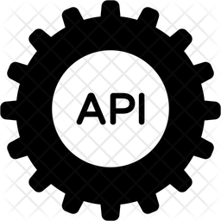
API Attacks: Payloadless approach
Notes:
This is the most vanilla, simple example possible.
A pentester and a singular API.
I imagine this is how most pentesters experience API hacking.
A simple request / response pair in Burp suite.
A request can be a structured data object, or GET parameters or a classic form POST.
The response will contain a structured data object.
Most of the time the structured data format is JSON, but it can be other data formats as well such as XML, or a JSON structured GraphQL query.

Slide 9
API Attacks: Payloadless approach
POST /api/v1/documents HTTP/2
Host: example.be
Authorization: Bearer eyJhbGciOiJIUzI1NiIsInR5cCI6IkpXVCJ9.ey4gICJpc3MiOiAdQ0VSVC5iZSIsCiAgICAiZXhwIjogMTY0ODAzNzE2NCwKICAgICJuYW1lIjogIkpvaGFuIENhbHV36SIsCiAgICAic3ViIjogImpvaGFuIiwKICAgICJyb2xlIjogImF0dGFja2VyIiwKICAgICJpYXQiOiAxNjY0MjYzMDk1fQo.Y3E_TiaHt6jOOm56ujWahorKFage609fSoh2gUQB33U
{“startdate”:”2023-01-01”, “enddate”:”2023-02-01”, {“userid”:12345, “env”: “production” } }
Values must match
Notes:
This first vulnerability I want to show you was a document API.
The JSON request body was fairly simple, 2 dates and a userid. The API allowed you to retrieve all documents created between start and end date for this userid.
Any userid?
Of course not, that would be a huge vulnerability right?
You could only retrieve documents belonging to your own userid. But how did the system know which userid was yours?
Usually, applications look at the authentication mechanism to see which userids the user has access to.
In this case, the authentication mechanism used is a Authorization: Bearer token in the form of a JWT (JSON Web Token)
A JWT consists of three parts separated by a dot: a header, a payload and a signature.
The header contains information about the signature algorithm used, the payload is a B64 encoded string that contains the data to be signed, and the signature makes sure the payload cannot be changed in transit.
The payload is not encrypted, you can decode it and read it. In this case, it also contained a userid:12345 parameter.
The backend code compared the userid from the JWT with the userid from the request, and if they were not the same, you don't get access to the documents.
This application was very secure, and tested multiple times already. Every possible injection technique was tried, along with NULL, FALSE, minus infintiy -0 and every other weird number you can think of. Nothing worked.

Slide 10
API Attacks: Payloadless approach
POST /api/v1/documents HTTP/2
Host: example.be
Authorization: Bearer eyJhbGciOiJIUzI1NiIsInR5cCI6IkpXVCJ9.ey4gICJpc3MiOiAdQ0VSVC5iZSIsCiAgICAiZXhwIjogMTY0ODAzNzE2NCwKICAgICJuYW1lIjogIkpvaGFuIENhbHV36SIsCiAgICAic3ViIjogImpvaGFuIiwKICAgICJyb2xlIjogImF0dGFja2VyIiwKICAgICJpYXQiOiAxNjY0MjYzMDk1fQo.Y3E_TiaHt6jOOm56ujWahorKFage609fSoh2gUQB33U
{“startdate”:”2023-01-01”, “enddate”:”2023-02-01”, { “env”: “production” } }
Result: Access to ALL documents of ALL users instead of NONE
NULL Comparison
Notes:
Until I tried something weird: just leave out the whole key-value pair!
Now the backend code would take the userid from the JWT payload, but the JSON object from the request had no userid key value pair.
So there was nothing to compare it with.
A very different situation than if you would use userid: false or userid: null
In those cases the userid key would exist, it just would hold no value.
In this case, the key did not exist.
This resulted in the application having a fail-open bug:
Instead of returning no documents, it returned all documents from all users.
Now don't be fooled by how simple this payload-less attack is: it was missed by many eyes.

Slide 11
API Attacks: Payloadless approach
Critical bug
No payload used
Adding or substracting specific key:value pairs gives unexpected results.
Not bothered by the WAF
Notes:
So to conclude our most basic example of a single API attack with a payload-less approach.
This was a critical bug in a sensitive application. In fact, this bug was fixed in the same day!
But we used no payloads.
There was nothing in the request that could possibly trigger a WAF.
And the same is valid for adding parameters. Sometimes referred to as response-to-request injection.
Back in the day it was called mass-assignement, however that classification doesn't fit well anymore, since it's not
So if you are testing API's, don't just try manipulating values, but also keys.

Slide 12
API-to-API Hacking
Notes:
Next we'll add some complexity with API-to-API hacking!

Slide 13
API-to-API Hacking
Notes:
In today's architectures, API's are used all over the place.
It's the glue that binds services together.
It allows an organisation to scale to global sized infrastructures.
It is very common, but little known that API's use API's.
So in this setup, we have our attacker speaking to an API.
But the backend code of the API makes it's own API calls to various other API's.
This can be 3th party API's, or internal API's, or undocumented parts of the public API etc...
As a API pentester, it's always a good idea to assume that the structured data object you are seeing in the response, is the result of multiple API calls to behind-the-scenes API's.
These calls are consolidated into one response object, and presented to you, the pentester.
And for the pentester, it would look like there is only communication with one API, one endpoint that does all the CRUD. But that is not the case.

Slide 14
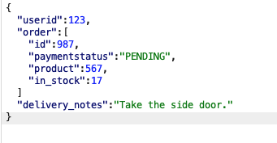
API-to-API Hacking
Response objects are the result of multiple API calls
From Payment API
From stock mgmt API
Pushed to 3th party API
Notes:
Take a look at this response object.
It contains data from different facets of the business logic.
Account management
Order processing (Fullfilment)
Payment status (Accounting)
Stock management
Delivery
In a sufficiently large organisation, this JSON object could represent multiple API calls to various micro- or macro services throughout the organisation.
The response object however holds no information that that is the case.
We, as attackers, just have to assume that it's often the case.

Slide 15
API-to-API Hacking
Very often, parameters are parsed, but not processed
Instead, the parameter value is forwarded to another API
Notes:
Very often, parameters are parsed but not processed.
Instead the parameter value is forwarded to another API.
What do I mean with that?
Let's say you have an JSON request with a number of parameters, integers strings and so on.
When backend code parses the JSON and the parameter is needed to construct an external API call to another service, often the sanitation checks of said parameter will happen there where the value is needed and used.
In this case, it's the 2nd API.
So if a JSON request contains an integer value, and you make a string, the first API often doesn't care.
It will just parse the string value, and use the string value in the call to the external API.
Only there the application will check the type and error out (or not).

Slide 16
API-to-API Hacking
https://www.example.fr/api/dealer/validate?extraCountries=AD|MC
Resulted in 3 backend API POST requests to Elastic database
POST /secured/fr/_search
Host: a2d-api.example-europe.com
POST /secured/AD/_search
Host: a2d-api.example-europe.com
POST /secured/MC/_search
Host: a2d-api.example-europe.com
Notes:
A practical example of this is shown here.
This was an API that let the user lookup data from a read-only database.
In this case an Elastic database.
The Gateway API would take a GET parameter called "extraCountries", and split the value of that parameter with the "|” (pipe) delimiter.
For every element in the resulting array, it would make a call to Elastic, using the value of that element as the index of Elastic.
For those who are not familiar with Elastic, it's kind of a special database, more a document store.
Instead of databases, it uses indices. Every index would hold a number of documents that could be looked up.
The backend code in this case would prefix the element value (the index) with the path to Elastic ie "/secured/"
The backend would then suffix the path with "_search". This is all happening in the background, so invisible to the user.

Slide 17
API-to-API Hacking
https://www.example.fr/api/dealer/validate?extraCountries=AD|MC
fr/<doc_id>/_create%3Frefresh%3Dtrue%23
POST /secured/MC/_search
Host: a2d-api.example-europe.com
POST /secured/fr/<doc_id>/_create%3Frefresh%3Dtrue%23/_search
Host: a2d-api.example-europe.com
Notes:
To hack it, I replaced one value of an index "MC" with a new index "FR".
Created a doc_id, and suffix'ed the string with _create.
A pound sign (%23) was then used to hide the "_search" suffix made by the code in the url fragment.
replacing the _search with _create turned the read-only database into a writeable database.
The _create command in the url doesn't mean anything to the WAF, but it means a lot to Elastic.

Slide 18
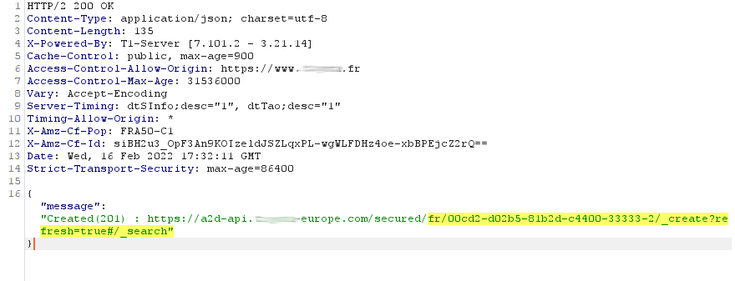
API-to-API Hacking
Notes:
The system responded in a very typical way for these kind of vulnerabilities:
With 2 different HTTP status codes in one response.
The first API, the one we as pentesters are communicating with, responds with 200-OK because the request triggered no errors.
The 2nd API responds with 201 - Created status code, which means that a resource that didn't exist before, is now created.

Slide 19
API-to-API Hacking
Critical bug
No payload used
Not bothered by the WAF
HINTS: Domain names, multiple status codes
Notes:
So again, as with the singular API hacking, we have a critical bug in a hardened target.
We didn't use any easy recognizable payload for the WAF to trigger a block.
And we saw some symptoms of the ecosystem where this kind of vulnerability is found:
Multiple HTTP status codes in one request.
Different domains being mentioned in response body.

Slide 20
1+1=3
The Bonus attack surface
Notes:
Let's dig deeper into this architecture.
First we saw singular API hacking with a payload-less approach.
Next we saw API-to-API hacking with minimal payloads.
Now we need to maximize our attack surface.
When we consider API-to-API hacking, it's very obvious we are dealing with 2 different attack surfaces.
There might be vulnerabilities in the first API, and there might be a completely different set of vulnerabilities in the second API.
We can however, squeeze the last drop of attack surface out of this architecture.

Slide 21
1+1=3 : The Bonus attack surface
Notes:
As it turns out, there are actually 3 attack surfaces here.
We have the first API, that deconstructs the original request and uses user input to create a second call to another API.
We have the second API, that can contain a very different set of vulnerabilities or technologies.
And we have the communication channel between the two, in this case an HTTP call.
This Third attack surface might lead to yet another set of vulnerabilities.

Slide 22
1+1=3 : The Bonus attack surface
POST /api/search
{“filter”:”a_brand_name”,”pagesize”:100, “page”:1}
Notes:
Consider this next real-life vulnerability: A search api like we’ve seen a thousand times.
This was also a well tested application.
Tested all kind of naughty strings & numbers, injection based vulnerabilities, type switching etc.
Nothing works, this was a very secure application.
So when I tried to find the maximum pagesize for this endpoint, I've tried 100, 1000, 10.000 as the pagesizes and when I tried a pagesize of 10K, the application very nicely informed me that a pagesize of 10k might be a bit too much. An error message was displayed and the request did not succeed.
That looked like sane defaults and proper sanitation.
So I tried to figure out the exact maximum pagesize, and I used Burp Intruder to try every integer between 1000 and 10.000.
And a very subtle symptom was exposed: error messages between 3001 and 5000 were of a different response size than pagesizes over 5000.

Slide 23
1+1=3 : The Bonus attack surface
Max pagesize: 5000
Max pagesize: 3000
POST /api/search
{“filter”:”a_brand_name”,”pagesize”:3001, “page”:1}
Notes:
What happened here was that:
Even though API1 and API2 were both having sane defaults and limits on pagesize, they did not agree on what the maximum pagesize should be.
API1 thought that a pagesize of 5000 is more than enough
And API2 thought that a pagesize of 3000 was more than enough.
So requests with a pagesize over 5000 (like my first attempted request) would be greeted with an error from the first API.
But requests with a pagesize between 3000 and 5000, would be ok for the first API.
Those requests would be greeted with an error of the 2nd API.
This was an edge case the first API did not account for.

Slide 24
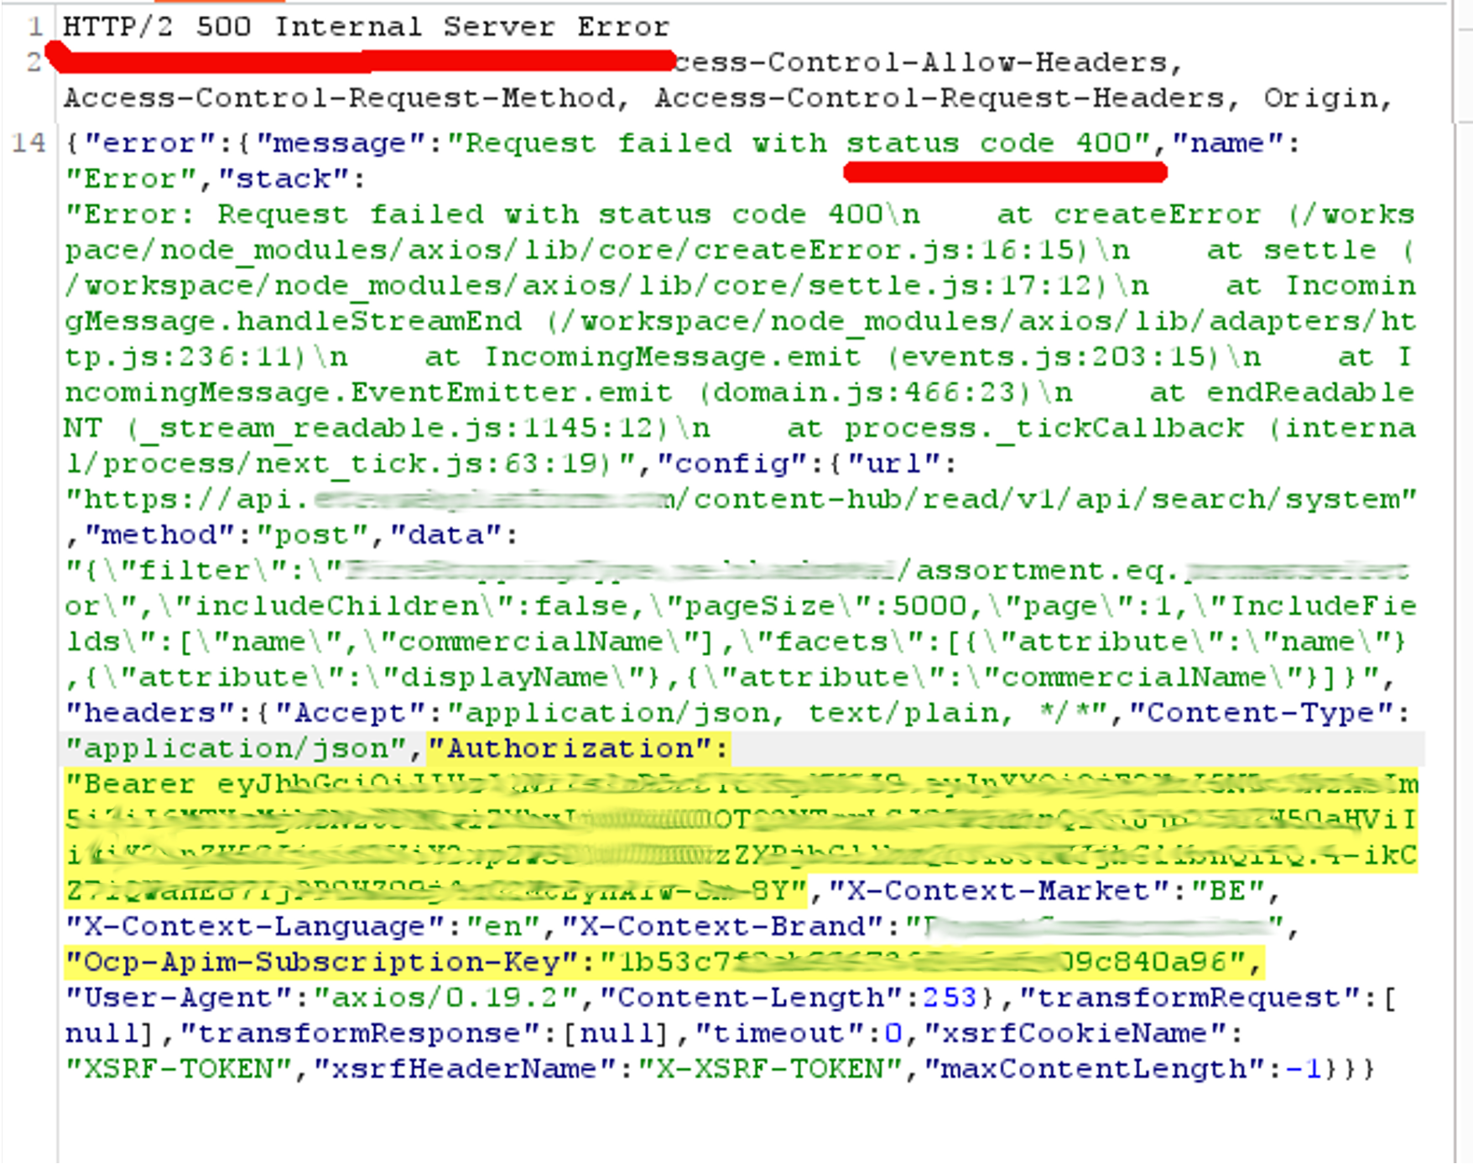
1+1=3 : The Bonus attack surface
Again: No payloads
2 status codes => API-to-API
No injection vulns in API 1 or API 2
API 1: Accepts pagesize < 5000
API 2: Accepts pagesize < 3000
Any number between 3001 & 4999
will get you
Keys to the Kingdom
Notes:
So the first API would generate a 500 server error, with an error message stating "Request failed with status code 400".
So that's weird: 500 are server errors, and 4xx are client errors.
2 status codes in one response.
From the point of view of the attacker, API 1 is acting as a server (500 Server error).
From the point of view of API 2, API1 is acting as the client.
API1, in it's capacity as the client, made an error to submit a pagesize that was too large.
So API2 responds with a client-side error code (400).
API 1, in it's capacity as the server for the pentester, relays this error message to the user with a server error code (500).
API 1 is very helpfully displaying all the information it used to construct the faulty call to API 2.
Amongst which, the authorization headers and the API key it used to authenticate to API 2.
So now the attacker has the authorization to API 2, which contained all kinds of backoffice functionality.
Any number between 3000 & 5000 gives you keys to the kingdom!
Works not only on pagesizes ofcourse, wanna bet?

Slide 25
API-to-API Hacking
Critical bug
No payload used, just a number between 3001-4999
Not bothered by the WAF
HINTS: Domain names, multiple status codes
No real vulnerabilities in API1 or API2, but rather a mismatch in configuration
Notes:
At this point we have 3 critical bugs in hardened targets, and haven’t even used payloads to speak of.
To hack an API, you don’t always need complicated looking payloads that can trigger a WAF.
But it’s not as easy as it looks: finding the right time and place can be challenge.
But what if you want or need to use payloads that could trigger a WAF?

Slide 26
Web Application Firewalls
Notes:
Let’s have a look at Web Application Firewalls.

Slide 27

WAF Placement &
Trust relationship between API’s
Pattern recognition:
../
SLEEP
UNION
oastify.com (!)
Not publicly reachable
Whitelisted IP
Bearer Tokens
API keys
Notes:
This is a schematic of a very common architecture.
We have a gateway API, that uses several other API’s.
The WAF is placed in front of the gateway API, to check all the incoming traffic for suspicious patterns.
As soon as the pentester uses a scanner, such as SQLmap or Burp Active scan, he/she is blocked from further communication with the gateway API.
As a result, there is some kind of trust relationship growing between the gateway API and the secondary API’s.
The secondary API’s are not publicly reachable, have authentication, and all their traffic is checked by the WAF, right?

Slide 28

WAF in action
{“ID”:”123”}
{“ID”:”123/../”}
POST /api/v1/user/123/
Well-known patterns blocked!
Notes:
A Web Application Firewall in action.
The attacker tries to use a well-known payload in the request.
It gets blocked by the WAF, and the payload never reaches the gateway API, and as such the secondary call, constructed with values from the attacker’s request, never happens.

Slide 29
Transformations
Notes:
Let’s talk about transformations, or ways in which your data can change, or be represented in a different way, while keeping it’s original meaning.

Slide 30
Transformations: A tool at our disposal
HTTP
XML
JSON
Form-urlencoded
HTTP
JSON.Parse()
{“id”:123}
User input travels through different protocols & standards
Notes:
Before I explain what transformations are, let’s take a look at how user data travels trough various standards & protocols.

Slide 31
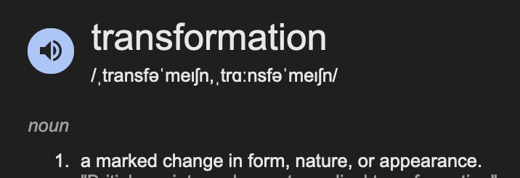
Tranformations
Every hop, every protocol, every parser you encounter
=> A transformation happens
Encodings are applied (non-ascii or dangerous characters)
Encodings are reversed (ascii)
Characters replaced (\t \n, entities)
Characters added ( escapes \” )
Interpretations (../)
Notes:
Let’s have a look at transformations.
Transformations are a thing that happens, automagically. Every standard, every protocol have some sort of transformations happening.
Most standards & protocols have ways to represent data that would otherwise break syntax, or cannot be represented any other way.
For example, JSON understands unicode, so we can have emoji’s & stuff.
HTTP has URL encoding, so we can transport characters that would otherwise break the syntax of a URL or POST body.
XML has entities, allowing the user to represent characters that would otherwise break the markup.

Slide 32
Tranformations: Reversable encodings
Some encodings can be reversed when used out-of-context
X-www-form-urlencoded
Multipart/form-data
URL Path
GET parameters
JSON
XML
% encoding
UNICODE
ENTITIES
Notes:
Now here’s the thing:
What happens if you use these transformations, or encoding mechanisms to represent characters that don’t break the syntax?
In other words, what does the RFC say what to do with ASCII characters or benign characters when they are represented with an encoding mechanism.
The protocol or standard is required to “downgrade” the encoding. The protocol or standard is required to use the most “human readable” way of representing the character.
So if I use unicode to represent the benign letter “a” in a json, the json parser will transform or downgrade the unicode to ASCII letter “a”
If I use URL encoding to represent the letter “a” where HTTP recognises it, but where it’s not needed, the URL encoding gets “decoded”.
If I use an entity in XML, and that element value is used later in a JSON or a URL, it will get cast as it’s true value.

Slide 33
Transformations:
A tool at our disposal
Unicode to ASCII
{“ID”:”123”}
=
{“ID”:”\u0031\u0032\u0033”}
JSON => Unicode!
POST /api/v1/user/123/
Notes:
Now remember our 3th attack surface.
If we have a situation where an API is using another API, we have a third attack surface, because something is happening between the two API’s.
The communication between the API’s has it’s own properties.
Most of the time it’s an HTTP call, and therefor transformations will happen.
Path traversals will be interpreted.
URL encodings will be ”downgraded” where possible.
Unicode will be transformed wherever possible.
There is nothing anybody can do about that, it’s inherited from the standard.
And for the attacker, this is not only an attack surface! It’s also a tool at our disposal. It’s a tool that the attacker can predict and anticipate.
A tool that the attacker can use for his/her advantage.
An attacker can use the properties of this multi-API environment against itself!

Slide 34
Bypassing Firewalls with API-to-API hacking:
Delivering payloads to 2nd order API’s
Chaining transformations
Notes:
So Finally, we can put this all together.
We’ll see how we can use this tool to bypass the Web Application Firewall, in order sneak past the gateway API, and deliver our payloads to the 2nd order API.

Slide 35
Double URL encoding: The mother of all chained transformations
/api/v1/user/123/../567
/api/v1/user/123%2F%2E%2E%2F567
/api/v1/user/123%252F%252E%252E%252F567 => double % encoding
Identical
Notes:
A really old example of this is the “mother of all chained transformations”
Double URL encoding.
This technique exploits the fact that 2 HTTP parsers are used consecutively.
2 HTTP calls after each other, will mean that URL decoding happens twice.
After decoding it twice, the payload manifests in it’s true malicious form.
Lot’s of tools are capable of doing this, it’s a very old technique.

Slide 36
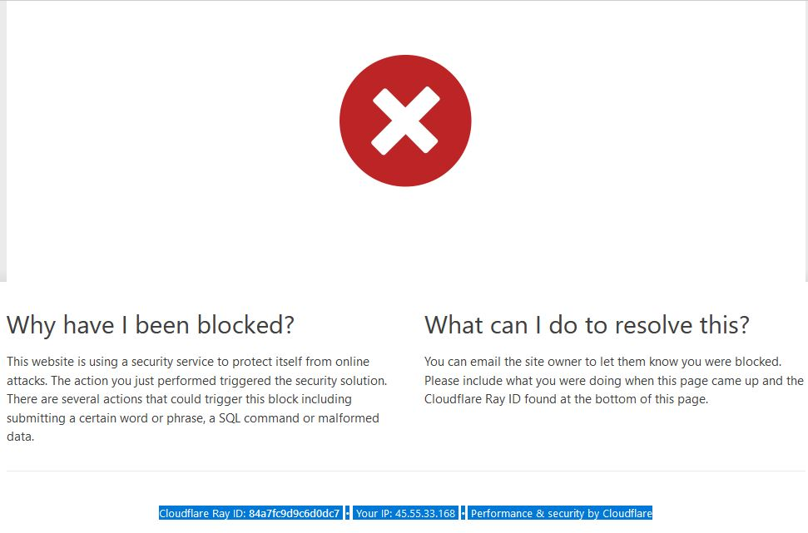
Chained Transformations : Staying within the same Content-Type
Blocked !!
Why?
Same Content-Type
WAF’s can be aware of the Content-Type
Notes:
But because it’s very old, WAF’s are also very capable in detecting it.
If a WAF is placed in front of the gateway API, using double URL encoding will get you blocked most of the time.
That’s because for a WAF, it’s fairly inexpensive in terms of CPU cycles to detect the presence of URL encoding after the first decoding cycle.
If there is still URL encoding present, the WAF will just keep decoding until none are left.
Your payload will be detected, and the request will be blocked.
Because we are staying within the same Content-Type.

Slide 37
Chained Transformations : Switching Content-Types
WAF’s are not aware of future forwarded requests with changed Content-Types
The request holds no information of future Content-Types!
Notes:
But as we have seen, in a multi API environment, lot’s of different Content-Types are being used.
User input from a JSON request can later be used in the URL path of another API.
User input from a form-url-encoded POST can be used in an XML later on.
Parts of the URL from the original request can later be used to construct a JSON element.
And so on and so on….
But all these original requests hold no information about the future content types in which the data will be used.
The WAF really has no idea that the data it sees, will later be used in another context, in another “transformational hop”

Slide 38
WAF in action
POST /api/v1/user/123/
{“ID”:”123”}
{“ID”:”123/../”}
Well-known patterns blocked!
Notes:
Let’s take a closer look at this blocked situation.
A JSON request where a value from the JSON later gets used in the URL path of another API.

Slide 39
Chained Transformations : Switching Content-Types
{“userid” : “123”} => Original
{“userid” : “123/../567”} => Path traversal
{“userid” : “123\u002F\u002E \u002E\u002F567”} => Path traversal unicode
{“userid” : “123\u00252F\u00252E \u00252E\u00252F567”}
=> Path traversal in Unicode representation of percent encoded path.
Notes:
How does this chaining of transformations work?
Take a look at this example.
We’ll be using 3 transformations here. Unicode - URL encoding - Path traversal
The initial value of 123 gets augmented with a payload: path traversal (this would be blocked)
It’s a JSON request, so we can use unicode to represent the path traversal.
We also know that the parameter is used later on in an HTTP context, so we can use URL encoding.
So we use Unicode to represent the % sign. And we suffix that with the hex codes of the path traversal characters.

Slide 40
Chained Transformations : Switching Content-Types
=> Payload
{“userid” : “123\u00252F\u00252E \u00252E\u00252F567”}
=> JSON.Parse()
“123%2F%2E%2E%2F567”
=> Value “123%2F%2E%2E%2F567” used to construct URL path
HTTP Url parsing manifests the true payload
=> 123/../567
Notes:
This payload doesn’t look like any pattern the WAF has in it’s pattern list.
There are too much different decoding cycles needed for the WAF to determine the true meaning of the payload.
The WAF would take an enormous performance hit would it attempt to combine all the different decoding mechanisms.
When our payload gets parsed by the first API, the unicode is “downgraded” to regular ascii.
This manifests the payload in it’s URL encoded form.
This form is used to construct an URL path.
The HTTP stack takes care of the 2 remaining transformations: First it will URL-decode the percent encoding, and then it will resolve the path traversal.

Slide 41

Bypassing Firewalls using transformations
WAF needs :
multiple decoding cycles
unrelated to Content-Type
In the correct order
Result: Undetected
{“ID”:” 123\u00252F\u00252E\u00252E\u00252F567”}
Notes:
The attacker supplies a payload in Unicode representation of a URL encoded path traversal.
The WAF has no means to detect maliciousness.

Slide 42
Bypassing Firewalls using transformations
JSON.Parse()
Unicode in JSON transforms
POST /api/v1/user/123%2F%2E%2E%2F567
Notes:
The JSON parser parses the payload with Unicode.
The JSON parser sees the Unicode encoded percent sign, and transforms it to an ASCII encoded percent sign.
Because that’s just how it works,

Slide 43
Bypassing Firewalls using transformations
HTTP Transforms % Encoding
HTTP interprets ../
POST /api/v1/user/123%2F%2E%2E%2F567
Notes:
The attacker supplies a payload in Unicode representation of a URL encoded path traversal.
The WAF has no means to detect maliciousness.
Every hop in the multi-API environment will perform a transformation.
As end result, the endpoint /user/123 will never receive traffic.
But the endpoint /user/567 will.

Slide 44
Bypassing Firewalls using transformations
HTTP Transforms % Encoding
HTTP interprets ../
POST /api/v1/user/123/../567
Notes:
The attacker supplies a payload in Unicode representation of a URL encoded path traversal.
The WAF has no means to detect maliciousness.
Every hop in the multi-API environment will perform a transformation.
As end result, the endpoint /user/123 will never receive traffic.
But the endpoint /user/567 will.

Slide 45
Bypassing Firewalls using transformations
POST
/api/v1/user/567
Notes:
The attacker supplies a payload in Unicode representation of a URL encoded path traversal.
The WAF has no means to detect maliciousness.
Every hop in the multi-API environment will perform a transformation.
As end result, the endpoint /user/123 will never receive traffic.
But the endpoint /user/567 will.

Slide 46
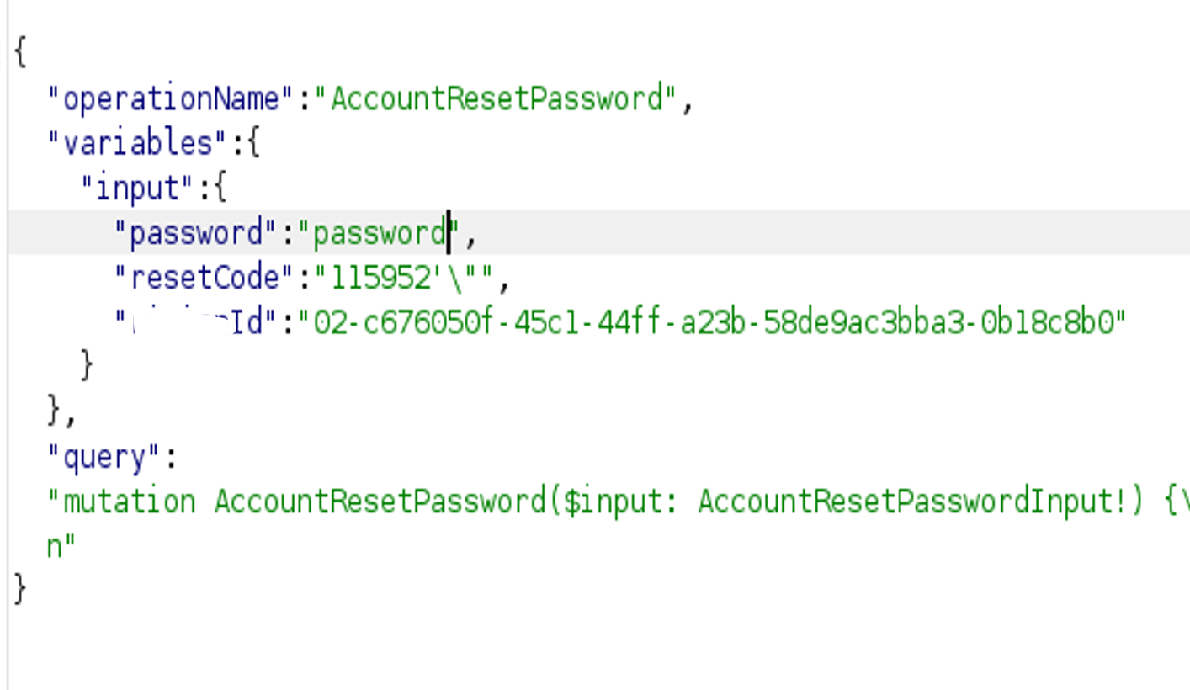
Bypassing Firewalls using transformations
Notes:
Let’s take a look at a real-world bug found in a bugbounty target.
This GraphQL endpoint was used in a password reset flow.
The user would have received a one-time token in the mail, and this token was used together with the new password to reset it.
First thing a pentester would do is to fuzz all the variables.

Slide 47
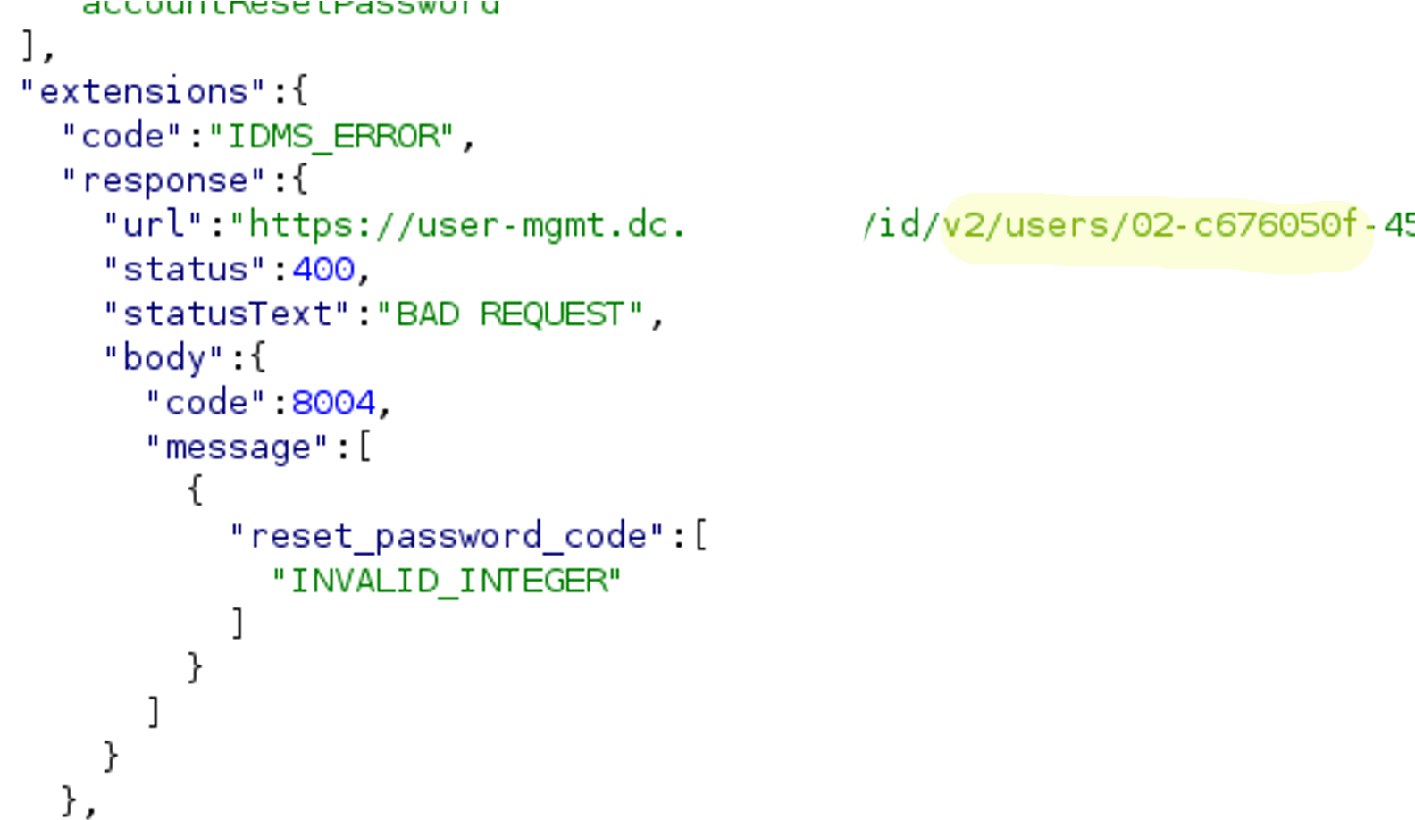
Bypassing Firewalls using transformations
https://user-mgmt.dc.example.com/id/v2/users/UUID/lifecycle/reset-password
Notes:
This would get our typical multi-Api response:
A 500 server error with a 400 client error embedded (bonus internal domain leaked).
The error here being the gateway API not using an integer as the resetcode in the POST body to the 2nd order API.
The 2nd order API answers with a 400 client error, the client being the gateway API.
The gateway API relays this to the initial client, the attacker, in the form of a 500 server error, since it’s not the attacker that made an error.
The thing to notice here is not the fuzzed resetcode parameter hidden in the POST body, but the UUID-like parameter being re-used in the path to the 2nd API.

Slide 48
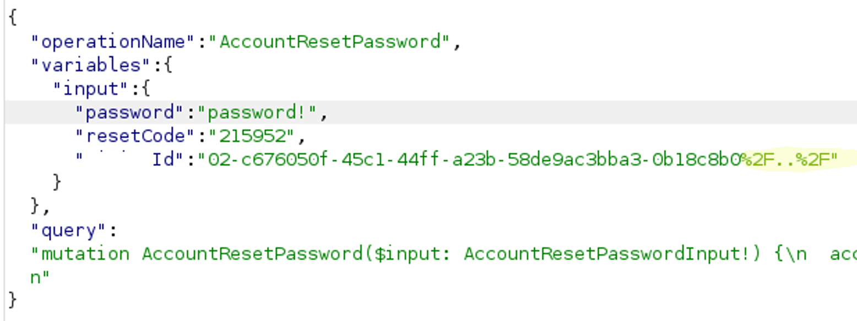
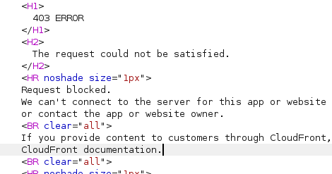
Bypassing Firewalls using transformations
Notes:
First thing to try is ofcourse a vanilla path traversal payload.
Which gets blocked by the WAF, because it’s very easily recognizable.

Slide 49
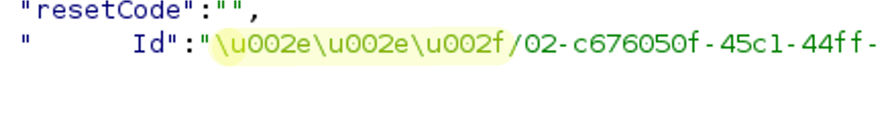
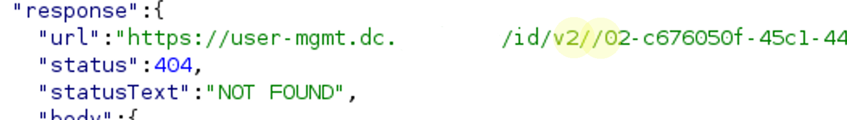
Bypassing Firewalls using transformations
Notes:
So we utilize Unicode to pre-transform our path traversal payload.
And the response immediately gives us feedback:
Where the reported URL before was /id/v2/user/<UUID>/, it now has become /id/v2//<UUID>
We have successfully traversed one level up.

Slide 50
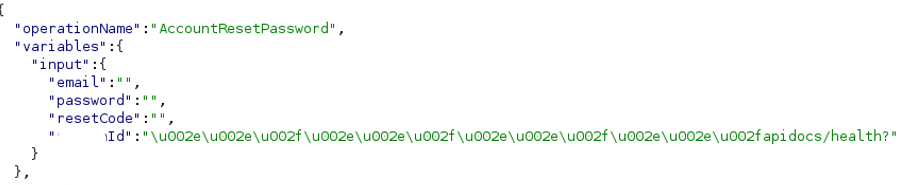
Bypassing Firewalls using transformations
Notes:
Now we can utilize this trick to traverse all the way up to the web root.
And start brute-forcing the API layout.
In this particular case, the well-known endpoint /apidocs/ was found.

Slide 51
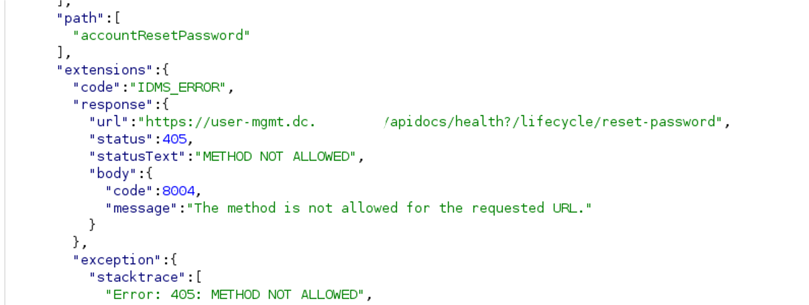
Bypassing Firewalls using transformations
Notes:
And the server answers with a helpful error message.
Even though it’s an error, a 405 response code embedded in a 500 Server error is actually good news!
It means we are succesful in hitting existing endpoints on the 2nd API.
Now comes the real hacking:
What other endpoints can be found.
Are you stuck with POST or are there tricks to turn it into a GET.
We’re left with a partially controlled POST body. Can you manage to construct a valid POST to another endpoint.
All this stuff is left as an exercise for you, the attendee. This talk is about payload delivery, avoiding and bypassing firewalls.

Slide 52
Bypassing firewalls with API-to-API Hacking
Delivering payloads to 2nd order API’s
API’s are the glue between services. API’s using API’s are common.
2nd order API’s often have a trust relationship with 1st order API’s
The properties of this architecture are a tool for bypassing WAF’s
Notes:
To conclude:
We’ ve seen how you can hack hardened API’s without complicated payloads.
We’ve seen that API’s using API’s are common in today’s highly scaled and diversified architectural landscape.
We have seen that API’s have a trust relationship between each other. This can be misplaced trust.
We have seen that multi-API environments have properties that we can use as an attack surface and as a tool to obfuscate our payloads
If you use these techniques instead of blindly starting SQLMap or Burp Active scan, I can all but guarantee that you will find critical bugs.

Slide 53
Bypassing firewalls with API-to-API Hacking
Delivering payloads to 2nd order API’s
API’s are the glue between services. API’s using API’s are common.
2nd order API’s often have a trust relationship with 1st order API’s
The properties of this architecture are a tool for bypassing WAF’s
Notes:
To conclude:
We’ ve seen how you can hack hardened API’s without complicated payloads.
We’ve seen that API’s using API’s are common in today’s highly scaled and diversified architectural landscape.
We have seen that API’s have a trust relationship between each other. This can be misplaced trust.
We have seen that multi-API environments have properties that we can use as an attack surface and as a tool to obfuscate our payloads
If you use these techniques instead of blindly starting SQLMap or Burp Active scan, I can all but guarantee that you will find critical bugs.

Slide 54
Bypassing firewalls with API-to-API Hacking
Delivering payloads to 2nd order API’s
API’s are the glue between services. API’s using API’s are common.
2nd order API’s often have a trust relationship with 1st order API’s
The properties of this architecture are a tool for bypassing WAF’s
Notes:
To conclude:
We’ ve seen how you can hack hardened API’s without complicated payloads.
We’ve seen that API’s using API’s are common in today’s highly scaled and diversified architectural landscape.
We have seen that API’s have a trust relationship between each other. This can be misplaced trust.
We have seen that multi-API environments have properties that we can use as an attack surface and as a tool to obfuscate our payloads
If you use these techniques instead of blindly starting SQLMap or Burp Active scan, I can all but guarantee that you will find critical bugs.

Slide 55


Hack The Government 1124!
A CVDP oriented live hacking event
In collaboration with Intigriti Bug Bounty Platform
Celebrating Belgium’s safe harbour laws for security researchers
Government issued awards !
Lots of prizes
Governmental targets
Students & experienced researchers collaborate
Find us at the CCB booth @ BruCon
Applicable for Belgian citizens only!
Notes:
Belgium is for now the only country in the world with legal protections in place for Coordinated Vulnerability disclosure.
The Centre for Cybersecurity Belgium would like to celebrate this milestone by organizing a CVDP oriented event.

